Slide 1
Environmental Impact Assessment (EIA)

Slide 2
EIA
EIA is a systematic process to identify, predict and evaluate the environmental effects of proposed actions and projects.
A broad definition of environment is adopted. Whenever appropriate social, cultural and health effects are also considered as an integral part of EIA.
Finally, particular attention is given in EIA for preventing, mitigating and offsetting the significant adverse effects of proposed undertakings

Slide 3
Definition
It is a planning and management tool for sustainable development that seeks to identify the type, magnitude and probability of environmental and social changes likely to occur as direct or indirect result of a project or policy and to design the possible mitigation procedure (Vanclay and Bronstein, 1995; Harvey, 1998; Momtaz et al., 1998; Thomas, 1998).

Slide 4
EIA is a tool that is applied…
before major decisions are taken and when all alternatives are still open;
to inform all stages of decision making, including final approval and the establishment of conditions for project implementation;
with public participation and consultation; and
to integrate environmental considerations and safeguards into all phases of project design, construction and operation

Slide 5
History
The National Environmental Policy Act 1969 of USA is the legislative basis for EIA. The policy was the result of wide spread recognition in the 1960s that some major environmental problems were created by the government’s projects (power stations, dams and reservoirs, industrial complexes).
The legislation made mandatory to assess the environmental consequences of all projects by federal agencies.
In 1990s, many developed and some developing countries designed their EIA legislation. e.g. New Zealand (1991), Canada (1995), Australia (1999), Vietnam (1993), Uganda (1994), Ecuador (1997).
Today, EIA is firmly established in planning process in many of these countries.

Slide 6
International Obligations
KEY Instruments/events | Requirements/Outcome
EIA requirements and procedures applied by international financial and aid agencies | Providing loans and implementing projects in developing countries.
Amendment of EC Directive on EIA (1997) | Required all member states to be in compliance by 1999; also assisted in drafting the EIA laws of transitional economies who are in the process of accession to the European Union.
UNECE - Convention on EIA in a Trans-boundary Context (1991) | Entered into force in 1997 as the first EIA-specific international treaty.

Slide 7
Purposes/Aims and Objectives
The immediate aim of EIA is to inform the process of decision-making by identifying the potentially significant environmental effects and risks of development proposals.
Objectives related to this aim are to:
improve the environmental design of the proposal;
ensure that resources are used appropriately and efficiently;
identify appropriate measures for mitigating the potential impacts of the proposal; and
facilitate informed decision making, including setting the environmental terms and conditions for implementing the proposal.

Slide 8
Purposes/Aims and Objectives (cont.)
The ultimate (long term) aim of EIA is to promote sustainable development by ensuring that development proposals do not undermine critical resource and ecological functions or the well being, lifestyle and livelihood of the communities and peoples who depend on them.
Objectives related to this aim are to:
protect human health and safety;
avoid irreversible changes and serious damage to the environment;
safeguard valued resources, natural areas and ecosystem components; and
enhance the social aspects of the proposal.

Slide 9
Steps in EIA

Slide 10
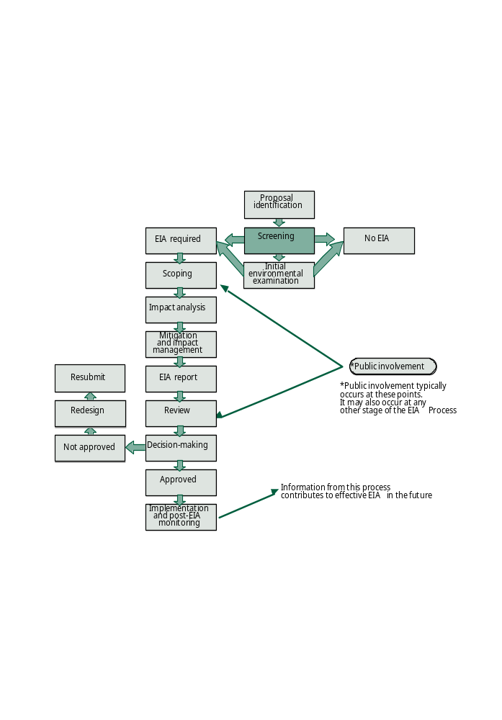

Slide 11
Step 1: Screening
This step determines:
  whether or not EIA is required for a particular project
  what level of EIA is required
Screening Outcomes:
  Full or comprehensive EIA required
  Limited EIA required
  No EIA required

Slide 12
Tools for Screening
Project lists:
  Inclusive — listed projects must undergo EIA
  Exclusive — listed projects exempted from EIA
Case-by-case examinations:
  determine whether projects may have significant environmental effects
  if so, project should undergo EIA
Combination of above

Slide 13
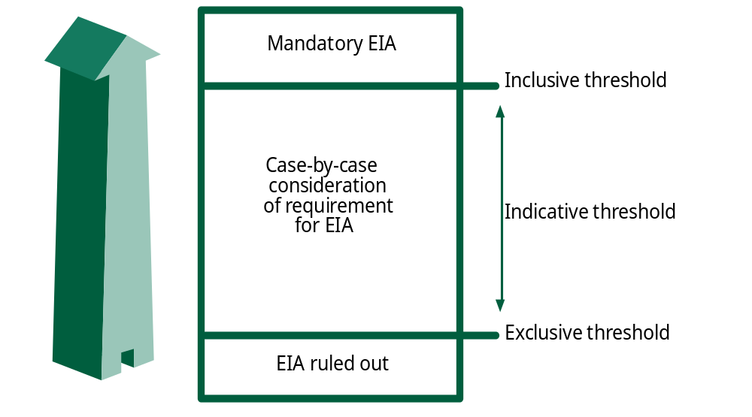
Screening Process

Slide 14
Step 2: Scoping
begins once screening is completed
the most important step in EIA
establishes the content and scope of an EIA report
Outcome:
identifies key issues and impacts to be considered
lays the foundation of an effective process, saves time and money, and reduces conflict

Slide 15
Types of Scoping
Closed scoping:
  wherein the content and scope of an EIA Report is pre-determined by law and modified through closed consultations between a developer and the competent authority
Open or Public scoping:
  a transparent process based on public consultations
Actors
proponent, EIA consultant, supervisory authority for EIA, other responsible agencies, affected public and interested public

Slide 16
The scoping process
prepare a scope outline
develop the outline through informal consultation with environmental and health authorities
make the outline available
compile an extensive list of concerns
evaluate relevant concerns to establish key issues
organise key issues into impact categories (study list)
amend the outline accordingly
develop ‘Terms of reference’ (ToR) for impact analysis
monitor progress against the ToR, revising as necessary

Slide 17
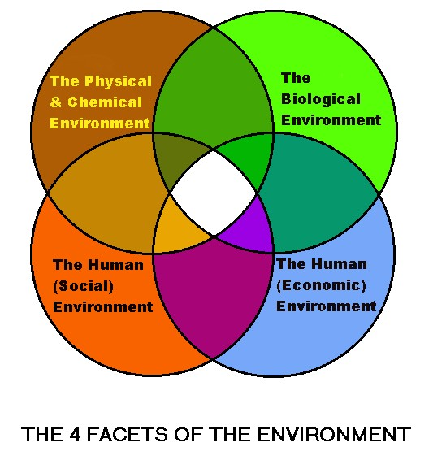
SCOPING

Slide 18
EXAMPLE : SCOPING
IMPACT OF A PROPOSED PAPER INDUSTRY
A PAPER INDUSTRY IS PROPOSED TO BE ESTABLISHED IN A LOCALITY AND THE EFFLUENT IS PROPOPED TO DISCHARGE IN ADJACENT RIVER
ETP WILL BE INSTALLED TO BRIING THE DISCHARGE DOWN TO PERMISSIBLE LIMIT
THERE ARE FEW OTHER INDUSTRIES ALREADY ESTABLISHED DISCHARGING EFFLUENT TO THE RIVER AT ALLOWABLE LIMIT
PEOPLE BATH IN RIVER WATER AND DRINK AFTER TREATMENT
SIGNIFICANT NUMBER OF PEOPLE DEPEND ON FISHING FOR OCCUPATION

Slide 19
MAJOR ISSUES
(SCOPING)
PHYSICAL AND CHEMICAL ENVIRONMENT
BIOLOGICAL ENVIRONMENT
THE LEVEL OF INCREASE
GASEOUS AIR POLLUTANTS
POSSIBLE CHANGE IN NOISE
LEVEL
CHANGE IN DOWNSTREAM DO
DUE TO DISCHARGE OF
AQUEOUS EFFLUENT (ORGANIC
MATTER)
EUTROPHICATION (EFFLUENT
CONTAINING N ,P)
PUBLIC HEALTH IMPACT
FISH KILLS

Slide 20
MAJOR ISSUES
(SCOPING)
THE HUMAN (SOCIAL)
ENVIRONMENT
THE HUMAN (ECONOMIC)
ENVIRONMENT
AFFECT ON FISHERIES AND
AQUACULTURE AS A LIVLIHOOD
FOR THE COMMUNITY
URBANIZATION TREND AND
RELATED PROBLEM
SCOPE OF JOB CREATION
POSSIBILTY OF INCREASING
DRINKING WATER TREATMENT
COST
PRODUCTIVE HOUR LOSS DUE TO
ENVIRONMENTAL DEGRADATION
HEATH TREATMENT COST

Slide 21
Step 3: Impact Analysis
→ Type | biophysical, social, health or economic
→ Nature | direct or indirect, cumulative, etc.
→ Magnitude or severity | high, moderate, low
→ Extent | local, regional, trans-boundary or global
→ Timing | immediate/long term
→ Duration | temporary/permanent
→ Uncertainty | low likelihood/high probability
→ Reversibility | reversible/irreversible
→ Significance* | unimportant/important

Slide 22
Tools for Impact Analysis
checklists
matrices
networks
overlays and geographical information systems (GIS)
expert systems
professional judgement

Slide 23
Step 4: Impact Mitigation
to avoid, minimise or remedy adverse impacts
to ensure that residual impacts are within acceptable levels
to enhance environmental and social benefits

Slide 24
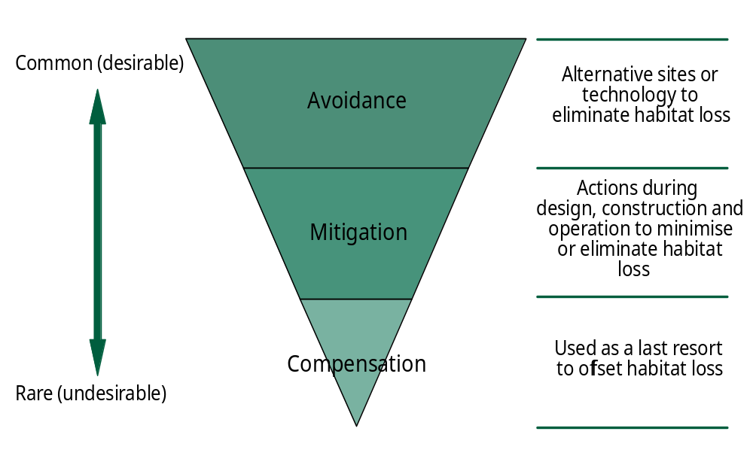
Framework for Impact Mitigation

Slide 25
Step 5: Reporting
Different name of EIA reports
Environmental Impact Assessment Report (EIA Report)
Environmental Impact Statement (EIS)
Environmental Statement (ES)
Environmental Assessment Report (EA Report)
Environmental Effects Statement (EES)

Slide 26
Contents of the Report
a description of the project;
an outline of the main alternatives studied by the developer, and an indication of the main reasons for this choice,
a description of the aspects of the environment likely to be significantly affected by the proposed project;
a description of the likely significant environmental effects of the proposed project;
measures to prevent, reduce and possibly offset adverse
environmental effects;
a non-technical summary;
an indication of any difficulties (technical deficiencies or
lack of know-how) encountered while compiling the required information.

Slide 27
Step 6: Review
Review the quality of the EIA report.
Take public comments into account.
Determine if the information is sufficient.
Identify any deficiencies to be corrected.
Who Perform the review?
environmental agency — Canada (comprehensive studies), standing commission — Netherlands, inter-agency committee — USA, planning authority — UK
independent panel — Canada (public inquiries)
Public comment and input

Slide 28
Step 7: Decision Making
To provide key input to help determine if a proposal is acceptable
To help establish environmental terms and conditions for project implementation

Slide 29
Step 8: Monitoring
Ensure the implementation of conditions attached to a decision.
Verify that impacts are as predicted or permitted.
Confirm that mitigation measures are working as expected.
Take action to manage any unforeseen changes.

Slide 30
Key components of Monitoring
Establish baseline conditions.
Measure impacts of a project as constructed.
Verify conformity with established with conditions and acceptable limits.
Establish links to environmental management plans.
Carry out periodic checks and third-party audits.

Slide 31

Public Involvement in the EIA Steps
To consult people likely to be affected by proposal.
To ensure that significant issues are identified; project related information is gathered, alternatives are considered.
To avoid biases/inaccuracies in analysis; identify local values/preferences; assist in consideration of mitigation measures; select best alternative.
To consider and comment on EIA Report
To monitor the implementation of EIA Report’s recommendations and decision’s conditions.

Slide 32
End of a Short Summary of EIA
What is EIA? State its aims and objectives.
Draw the entire EIA process and describe the steps.
How the concern of public is taken account in EIA?

