Slide 1
Environmental Systems
Lecture 2

Slide 2
This lecture will help you understand:
Environmental systems
Ecosystems and their services
How living and nonliving entities interact
Landscape ecology, GIS, and ecological modeling
The water, carbon, nitrogen, and phosphorus cycles
Human impacts on biogeochemical cycles

Slide 3
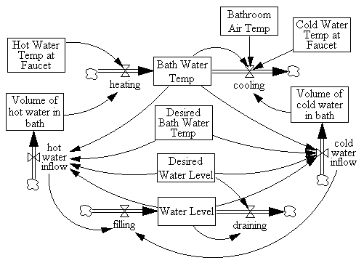
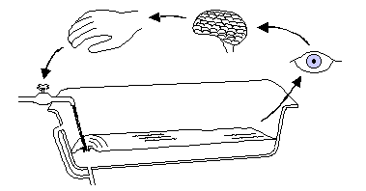
What is a system?
System: a collection of matter, parts, or components which are included inside a specified, often arbitrary, boundary. Example: Ecosystem
Systems often have inputs and outputs.
For dynamic systems, by definition, one or more aspects of the system change with time.
  Example of a simple dynamic system: bathtub or your ‘bank’ account.
Flux
The boundary of a dynamic system is chosen for convenient conceptual separation for the system
Pool

Slide 4
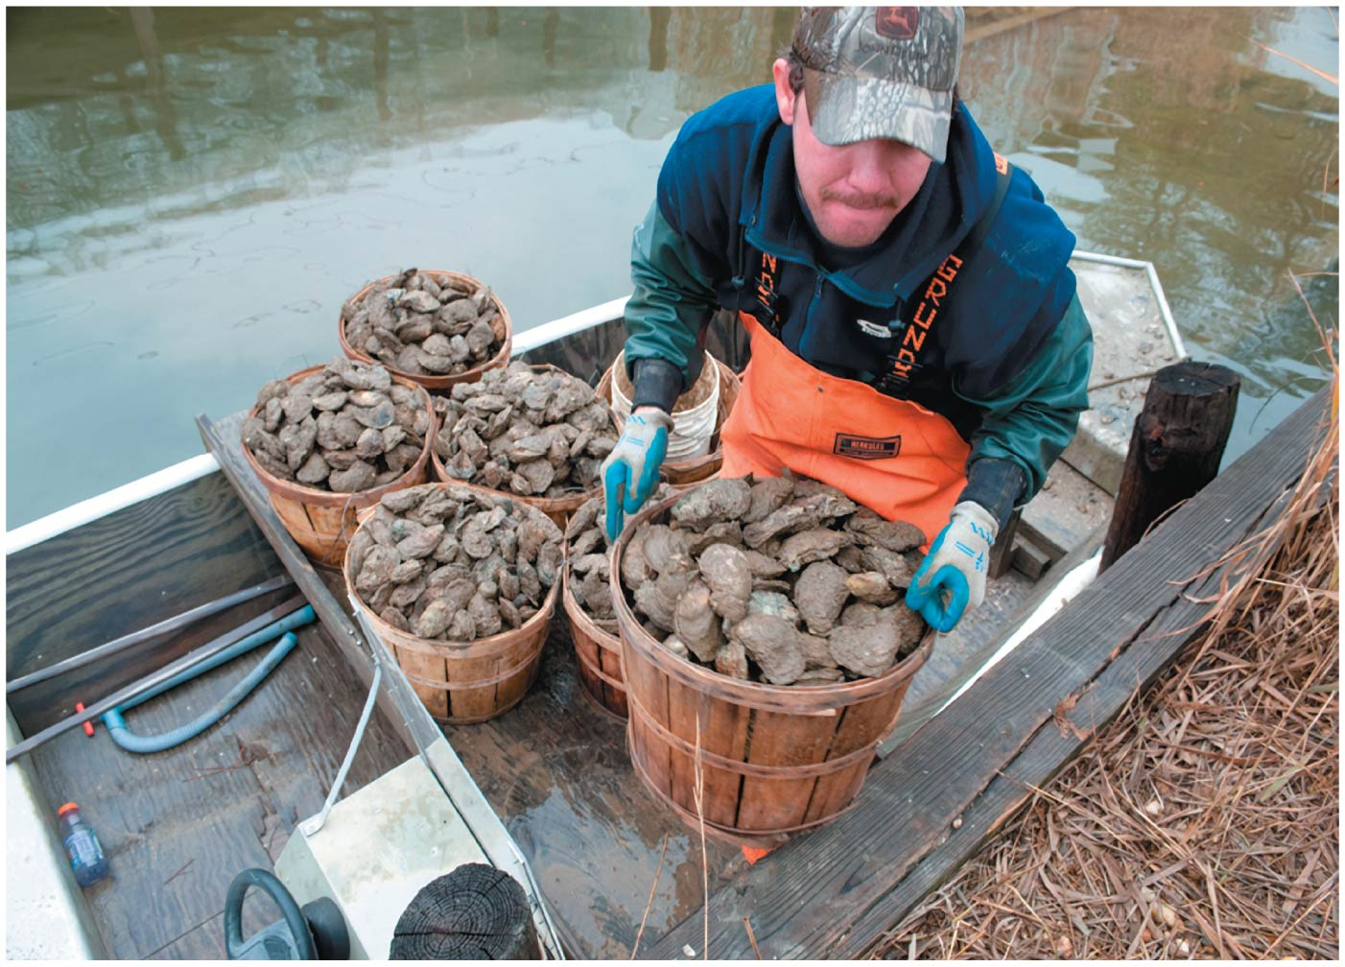

Slide 5
Central Case Study: The Vanishing Oysters of the Chesapeake Bay
Chesapeake Bay used to be the world’s largest oyster fishery
  By 2010, output reduced to 1% of historical levels
Numerous causes of the decline:
  Overharvesting
  Habitat destruction
  Disease
More recently, nutrient addition (nitrogen and phosphorus) from fertilizer, fossil fuel emissions, storm water runoff
  Hypoxia = low concentrations of oxygen in water

Slide 6
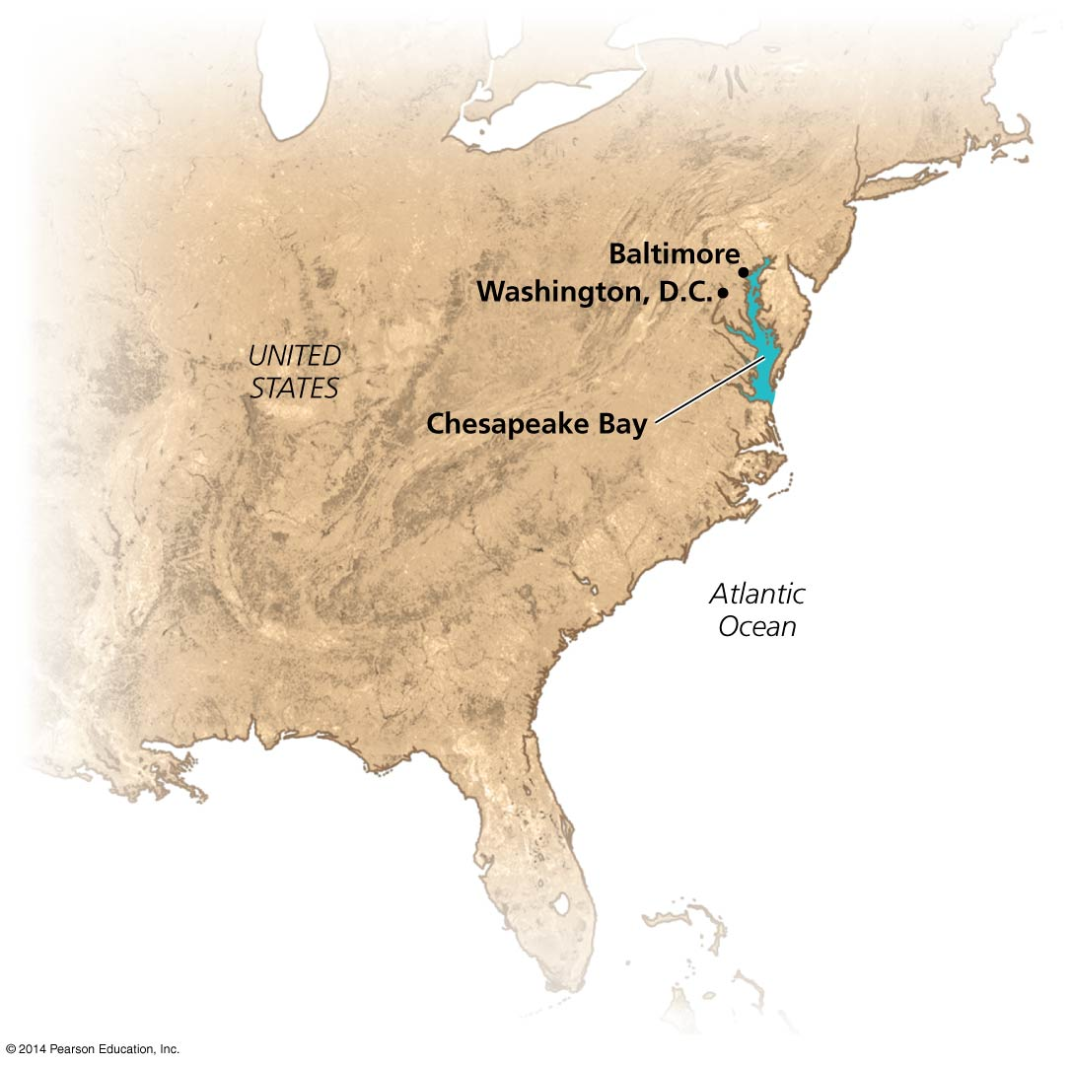

Slide 7
Earth’s Environmental Systems
Our planet’s environment consists of complex networks of interlinked systems
  Matter and molecules
  Organisms, populations, interacting species
  Nonliving entities (rocks, air, water, etc.)
A systems approach assesses questions holistically
  Helps address complex, multifaceted issues
  But systems can show behavior that is hard to understand and predict

Slide 8
Systems involve feedback loops
System = a network of relationships among parts, elements, or components
  They interact with and influence one another
  They exchange energy, matter, or information
Systems receive inputs of energy, matter, or information
  They process these inputs and produce outputs
  Feedback loop = a circular process in which a system’s output serves as input to that same system
  Negative and positive feedback loops do not mean bad and good

Slide 9
Systems involve feedback loops
Negative feedback loop = system changes and moves in one direction; that movement acts as an output, and as an input back into the system; the input then moves the system in the other direction
Input and output neutralize one another
  Stabilizes the system
  Example: body temperature
Most systems in nature

Slide 10
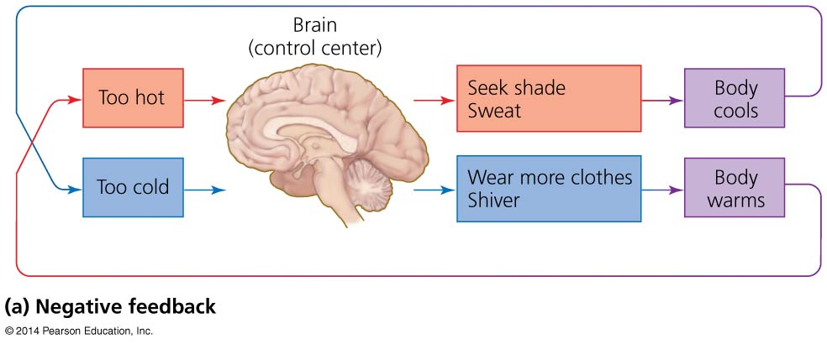

Slide 11
Systems involve feedback loops
Positive feedback loop = system output causes the system to change in the same way and drives it further toward one extreme or another
  Exponential population growth, spread of cancer, melting sea ice
Rare in nature
  But is common in natural systems altered by humans

Slide 12
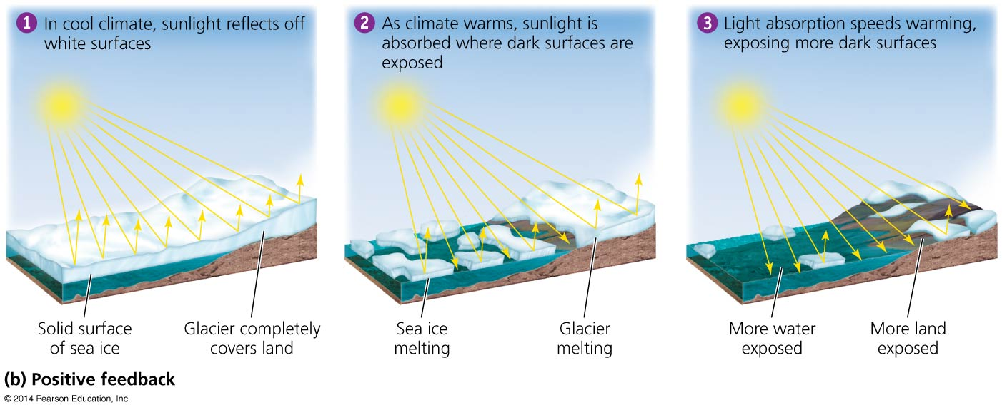

Slide 13
Systems show several defining properties
Dynamic equilibrium = when system processes move in opposing directions; balancing their effects
Homeostasis = when a system maintains constant (stable) internal conditions
Emergent properties = system characteristics that are not evident in the components alone
  The whole is more than the sum of the parts
It is hard to fully understand systems; they connect to other systems and do not have sharp boundaries

Slide 14
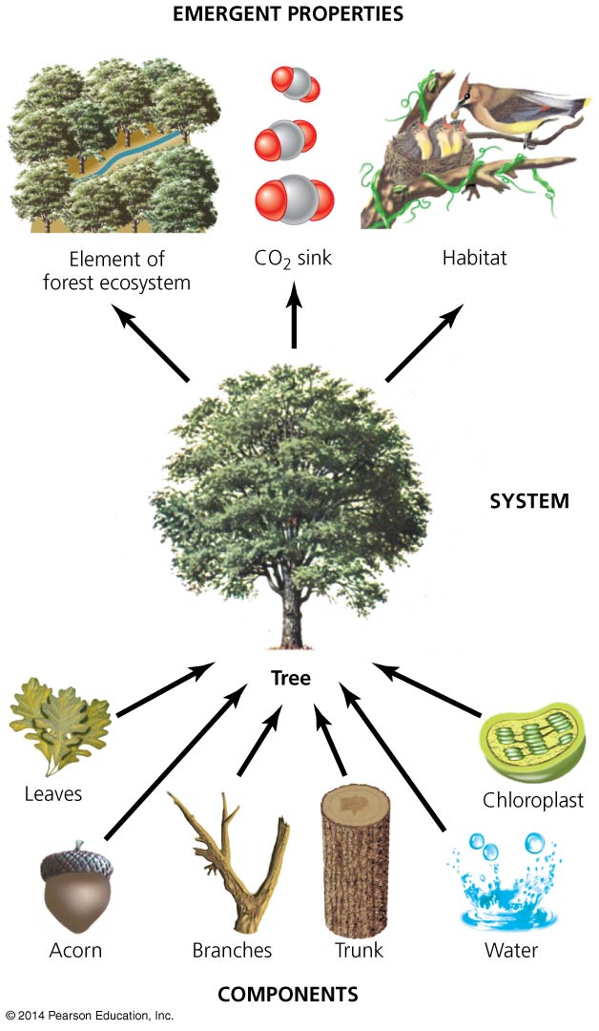

Slide 15
Environmental systems interact
Environmental systems often interact and can profoundly impact each other
The Chesapeake Bay is fed by river systems and the surrounding farms, cities, and forests
  Runoff = precipitation that flows over land and enters waterways
  Airshed = the geographic area that produces air pollutants that are likely to end up in a waterway
  Both move nutrients from land to rivers to the Bay
Defining the boundaries of a system depends on the questions being asked

Slide 16
Environmental systems interact
Addition of excess nutrients to a water body
leads to:
  Blooms of algae
  Increased production of organic matter that dies and sinks
  Decomposition and loss of dissolved oxygen

Slide 17
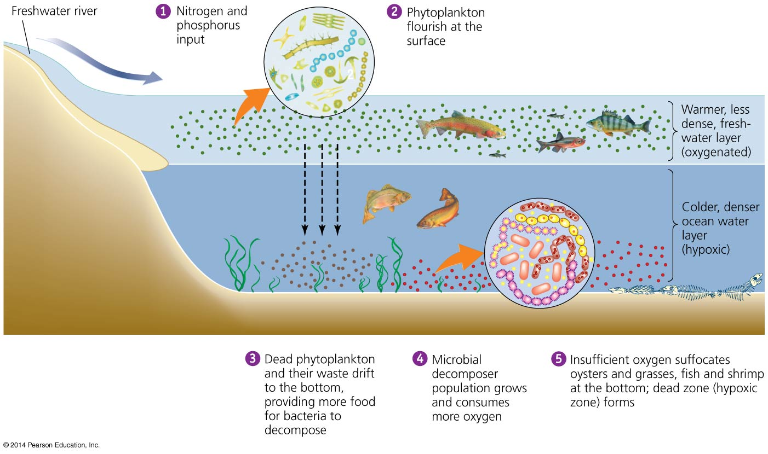

Slide 18
Environmental systems interact
Inputs to the Chesapeake Bay from adjacent systems cause eutrophication and loss of oxygen (hypoxia)

Slide 19
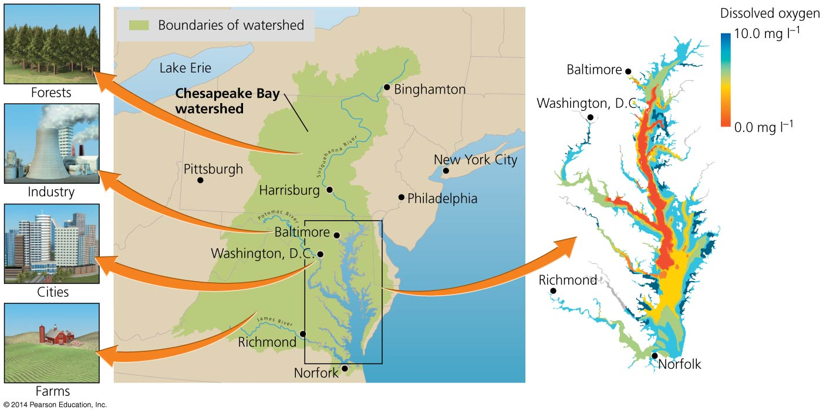

Slide 20
We may perceive Earth’s systems in various ways
Categorizing environmental systems helps make Earth’s dazzling complexity comprehensible
The Earth can be divided into structural spheres
  Lithosphere = rock and sediment
  Atmosphere = the air surrounding our planet
  Hydrosphere = liquid, solid, or vapor water
  Biosphere = the planet’s living organisms and the abiotic (nonliving) portions of the environment
Boundaries overlap, so the systems interact

Slide 21
Ecosystems
Ecosystem = all organisms and nonliving entities that occur and interact in a particular area at the same time
  It includes abiotic and biotic components
Focuses on movement of energy and matter
  Energy flows through an ecosystem
  Matter is cycled among the ecosystem components
Notes:
21
21

Slide 22
Ecosystems are systems of interacting living and nonliving entities
Energy from the sun flows in one direction, arriving as radiation and leaving as heat
Matter is recycled within ecosystem, through food-web relationships and decomposition
Notes:
22
22

Slide 23
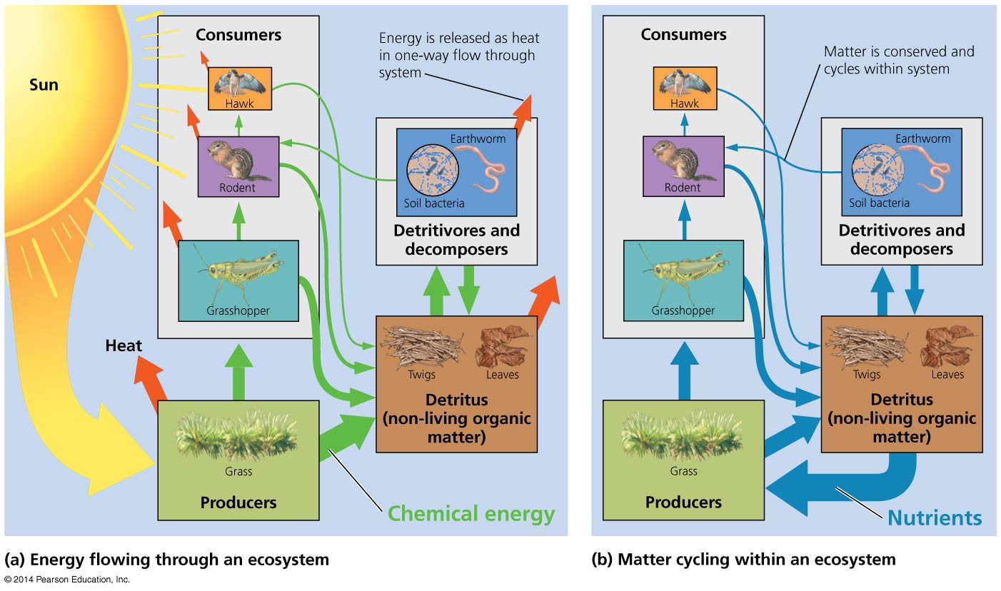

Slide 24
Energy is converted to biomass
Primary production = conversion of solar energy to chemical energy in sugars by autotrophs
Gross primary production (GPP) = total amount of energy captured by autotrophs
Net primary production (NPP) = energy remaining after respiration—used to generate biomass
  Available for consumption by heterotrophs
Secondary production = biomass generated by heterotrophs from consuming autotrophs
Productivity = rate at which ecosystems generate biomass
Notes:
24
24

Slide 25
Energy is converted to biomass
Ecosystems differ in net primary productivity
  High net primary productivity = ecosystems whose plants rapidly convert solar energy to biomass

Slide 26
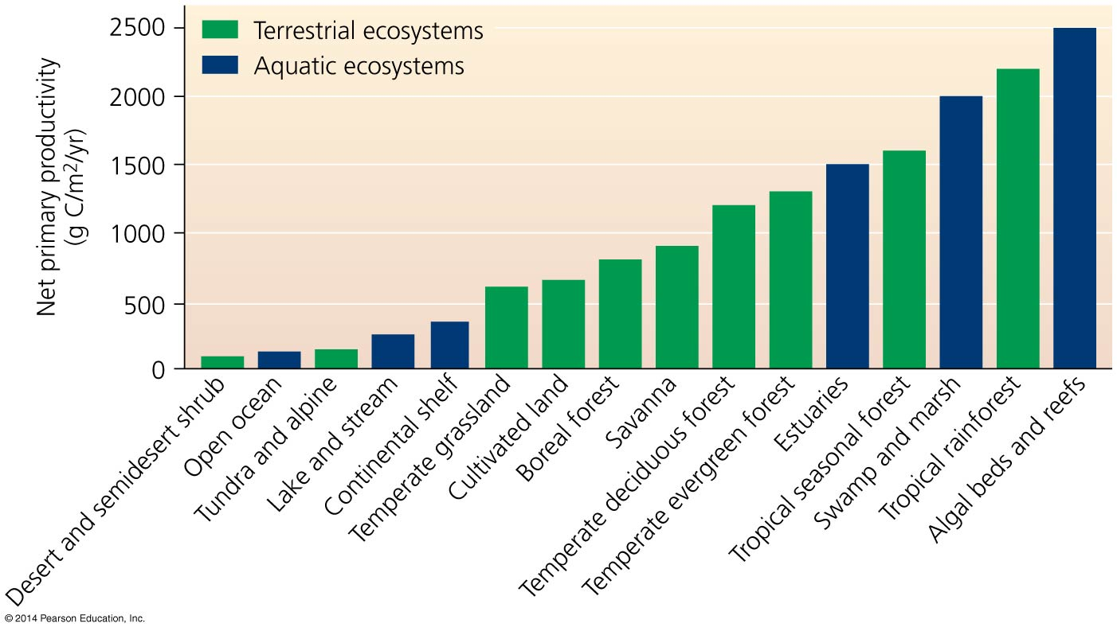

Slide 27
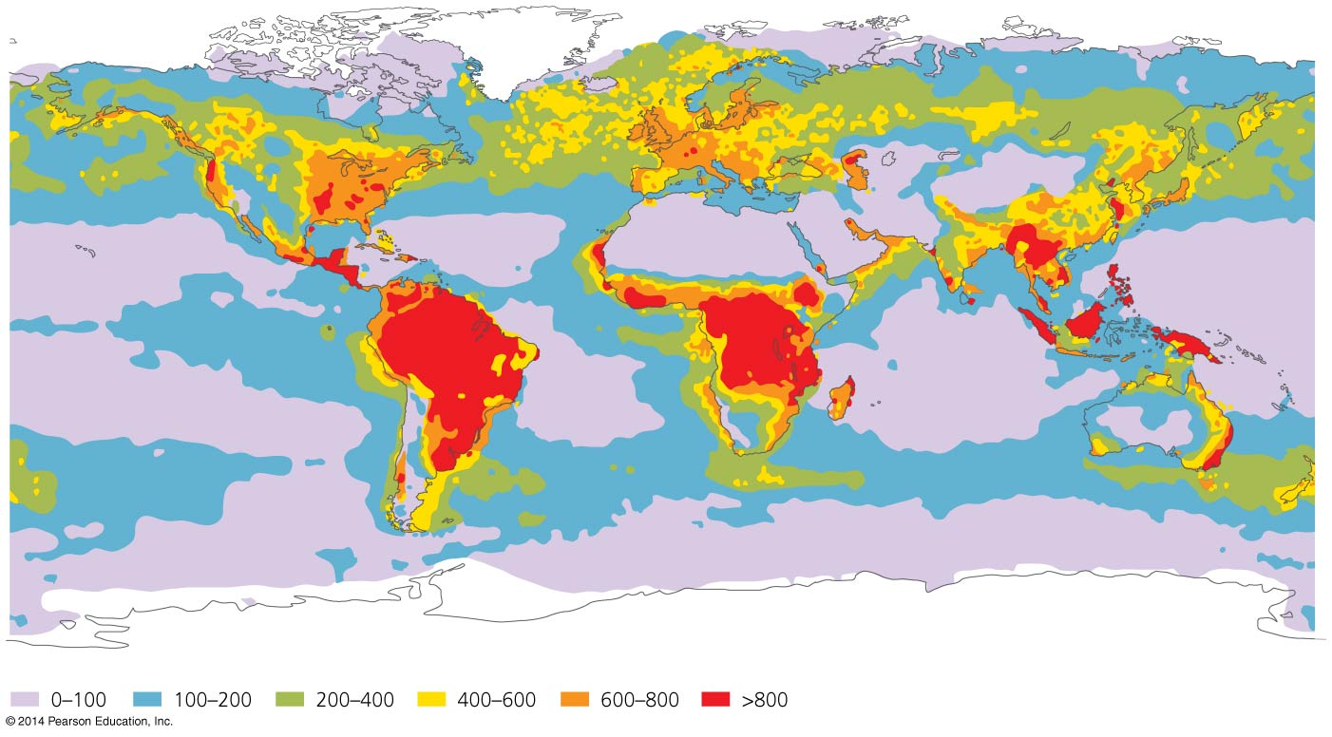
NPP increases with temperature and precipitation on land, and with light and nutrients in aquatic ecosystems

Slide 28
Nutrients influence productivity
Nutrients = elements and compounds required for survival that are consumed by organisms
Macronutrients = nutrients required in larger amounts
  Nitrogen, carbon, phosphorus
Micronutrients = nutrients needed in smaller amounts
Nutrients stimulate plant production
  Nitrogen and phosphorus are often limiting for plant and algal growth; oceans are limited by nitrogen; freshwater by phosphorus
Notes:
28
28

Slide 29
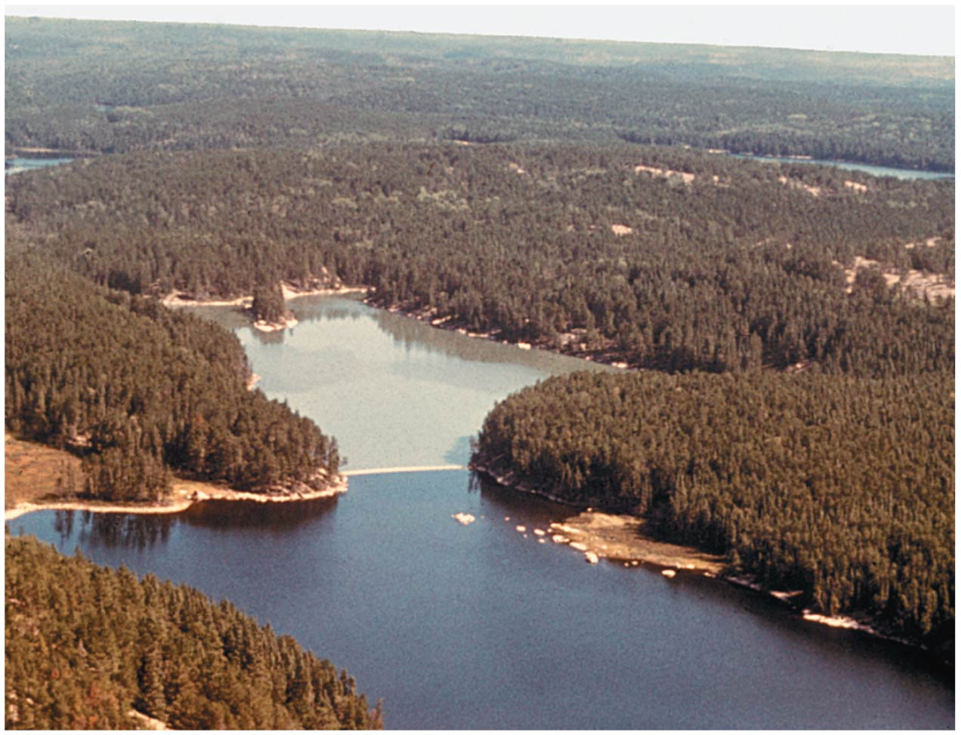

Slide 30
Nutrients influence productivity
Over 500 hypoxic dead zones occur globally
  Most are off the coasts of Europe and the U.S.
  Mostly due to farm, city, and industrial pollution
  Some are seasonal; others are permanent
Fisheries and ecosystems are devastated
  Causes over $2 billion/year in lost harvests

Slide 31
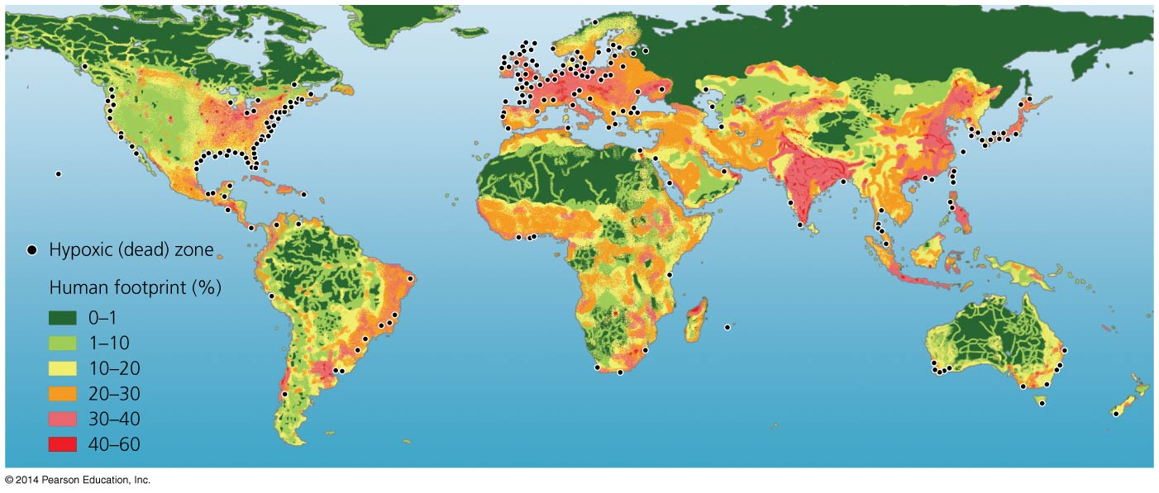

Slide 32
Ecosystems interact with one another
Ecosystems vary greatly in size
  For example, from a puddle of water to a bay
The term “ecosystem” is most often applied to self-contained systems of moderate geographic extent
Adjacent ecosystems may share components and interact
  For example, rain water from a forest moves nutrients into a lake
Ecotones = transitional zones between two ecosystems
  Elements of each ecosystem mix
Notes:
32
32

Slide 33
Landscape ecologists study geographic patterns
Landscape ecology = studies how interacting ecosystems affect the abundance, distribution, and interaction of organisms
Patches = separate areas of similar habitat
  Are spread spatially in complex patterns (a mosaic)
Notes:
33
33

Slide 34
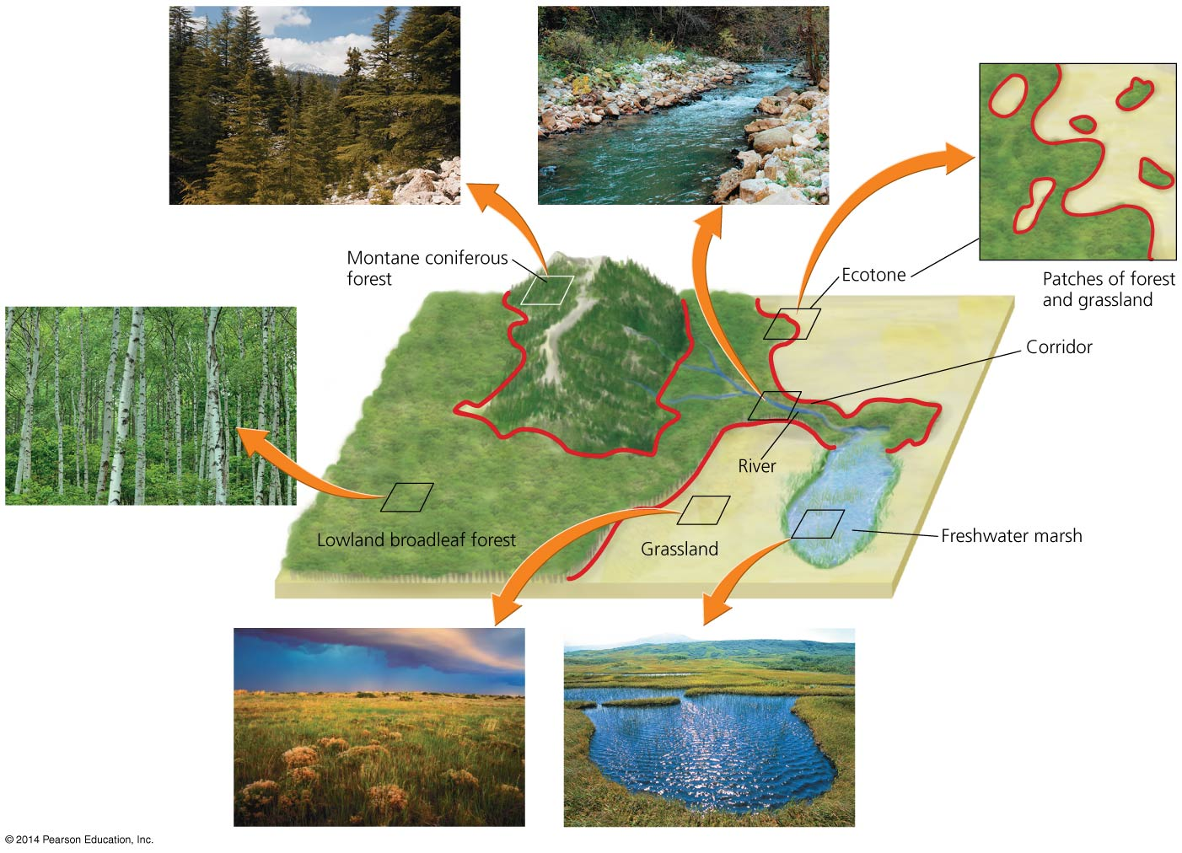

Slide 35
Remote sensing helps us apply landscape ecology
Remote sensing allows scientists to take a landscape perspective
Geographic information system (GIS) = computer software used in landscape ecology research
  Analyzes how elements of a landscape are arranged
  Divides landscape into layers
  Helps in planning and land-use decisions
Notes:
35
35

Slide 36
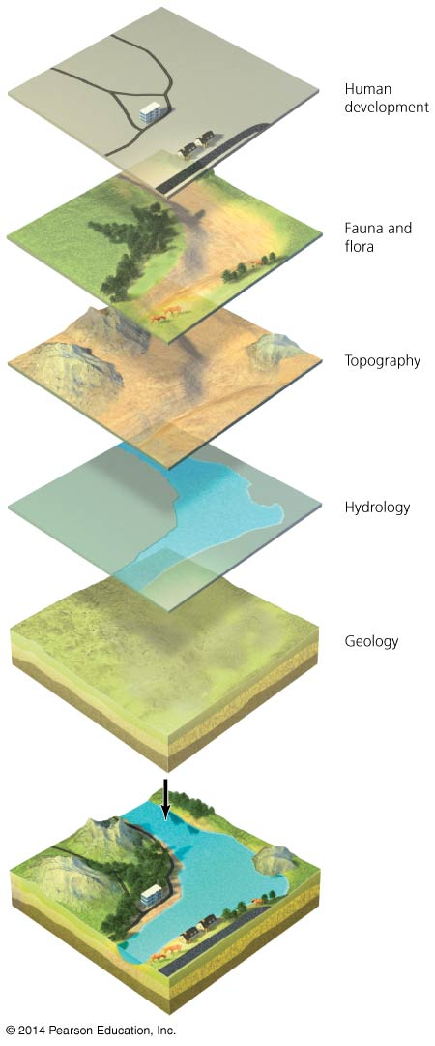

Slide 37
Modeling helps ecologists understand systems
Model = a simplified representation of a complex natural process
  Helps us understand the process and make predictions
Ecological modeling = constructs and tests models to explain and predict how ecological systems work
Researchers gather data and form a hypothesis about relationships
  Models predict how the system will behave
  New data refine and increase the model’s accuracy

Slide 38
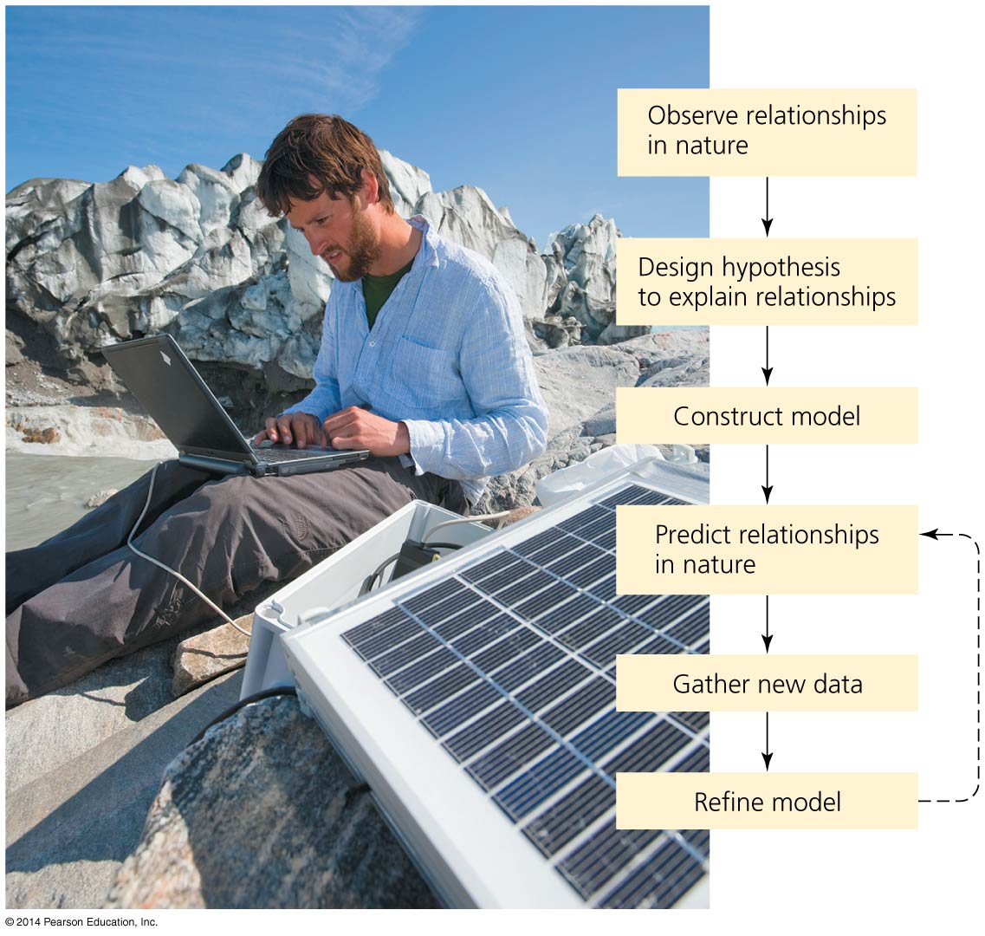
Ecological modeling resembles the scientific method

Slide 39
Ecosystems services sustain our world
Human society depends on healthy, functioning ecosystems
  They provide goods and services we need to survive
Ecosystem services are provided by the planet’s systems
  Soil formation, water and air purification, pollination
  Breakdown of some pollutants and waste
  Quality of life issues (inspiration, spiritual renewal)
  Nutrient cycling

Slide 40
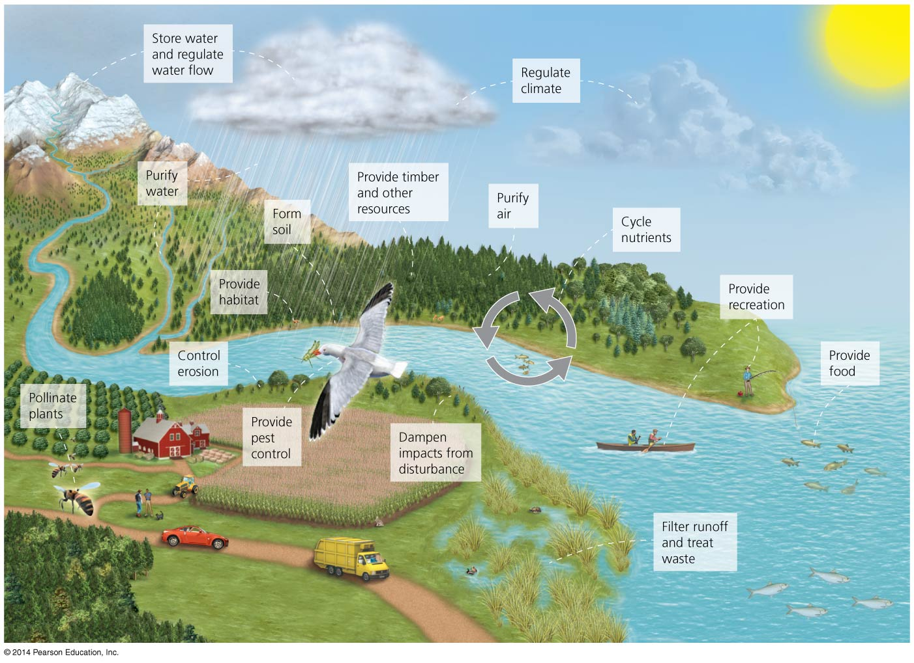

Slide 41
Nutrients circulate through ecosystems in biogeochemical cycles
Matter is continually circulated in ecosystems
Nutrient (biogeochemical) cycles = the movement of nutrients through ecosystems
  May move through the atmosphere, hydrosphere, lithosphere, and biosphere
Pools (reservoirs) = where nutrients reside for varying amounts of time (the residence time)
Flux = the rate at which materials move between pools
  Can change over time
  Is influenced by human activities
Notes:
41
41

Slide 42
Nutrients circulate through ecosystems in biogeochemical cycles
Source = a pool that releases more nutrients than it accepts
Sink = a pool that accepts more nutrients than it releases

Slide 43
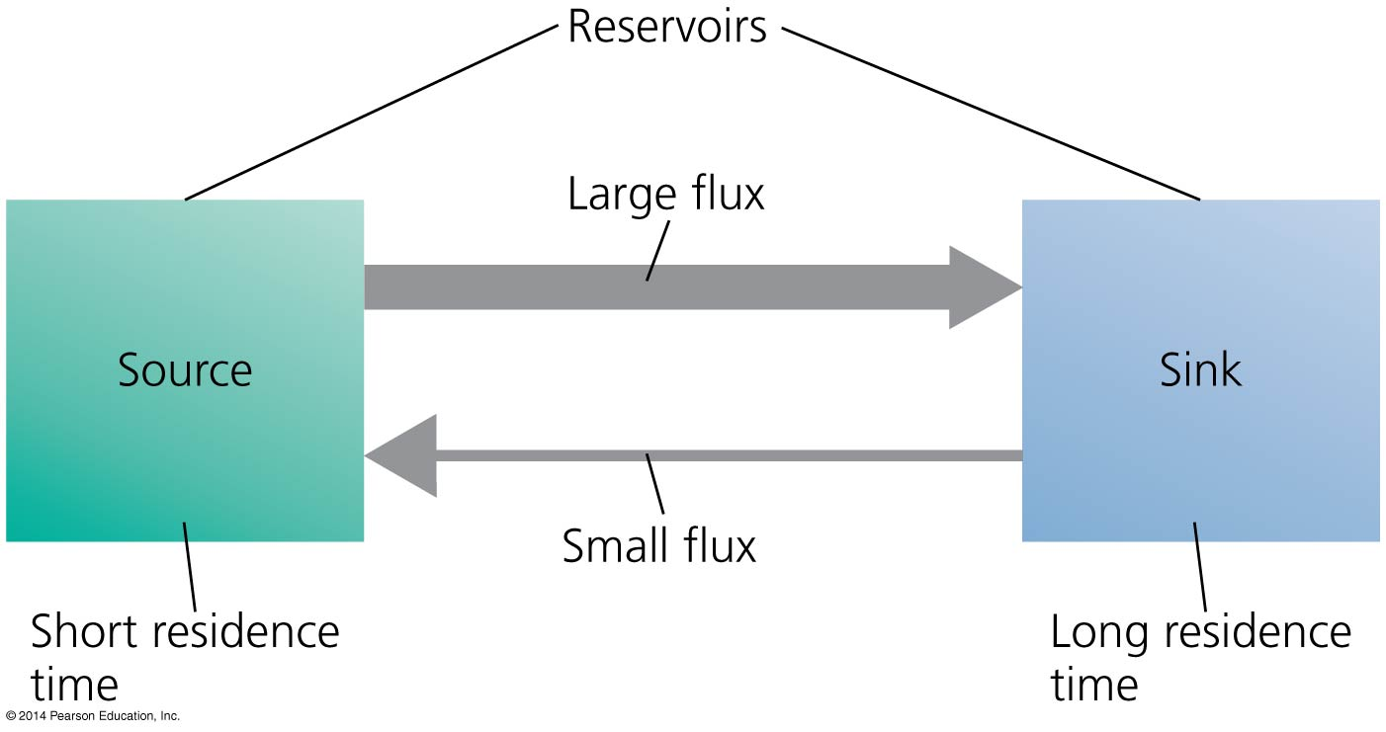

Slide 44
The carbon cycle circulates a vital organic nutrient
Carbon is found in carbohydrates, fats, proteins, bones, cartilage, and shells
Carbon cycle = describes the route of carbon atoms through the environment
Photosynthesis by plants, algae, and cyanobacteria
  Removes carbon dioxide from air and water
  Produces oxygen and carbohydrates
  Plants are a major reservoir of carbon
Respiration returns carbon to the air and oceans
  Plants, consumers, and decomposers
Notes:
44
44

Slide 45
Sediment storage of carbon and The oceans
Decomposition returns carbon to the sediment
  The largest reservoir of carbon
  May be trapped for hundreds of millions of years
Aquatic organisms die and settle in the sediment
  Older layers are buried deeply and undergo high pressure
  Ultimately, it may be converted into fossil fuels
Oceans are the second largest reservoir of carbon
  Compounds enter the oceans from runoff from land, detritus from marine organisms
  Carbon dioxide is dissolved directly into the water from the atmosphere, making the water more acidic

Slide 46
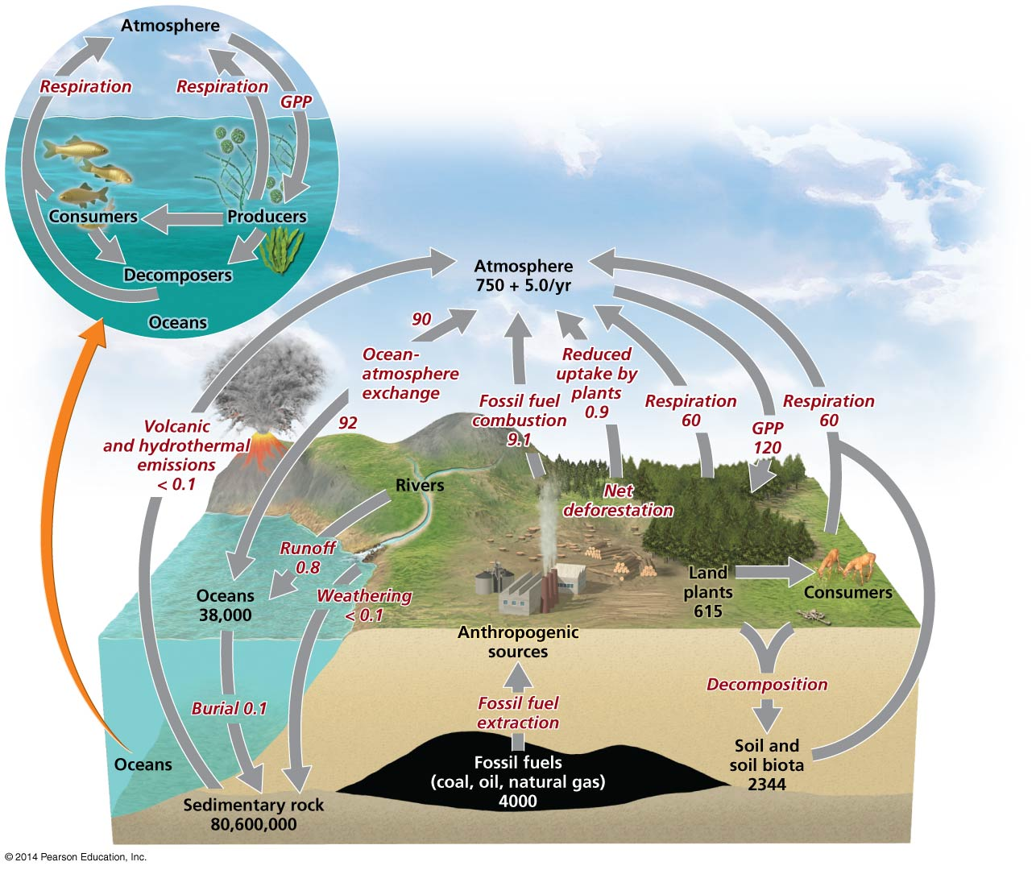

Slide 47
We are shifting carbon from the lithosphere to the atmosphere
Burning fossil fuels moves carbon from the ground to the air
Cutting forests and burning fields move carbon from vegetation to the air
Today’s atmospheric carbon dioxide reservoir is the largest in the past 800,000 years
  It is the driving force behind climate change
Uncertainties remain—there is a missing carbon sink: 1–2 billion metric tons of carbon are unaccounted for
  It may be taken up by plants or soils of northern temperate and boreal forests

Slide 48
The nitrogen cycle involves specialized bacteria
Nitrogen comprises 78% of our atmosphere
  It is contained in proteins, DNA, and RNA
Nitrogen cycle = describes the routes that nitrogen atoms take through the environment
  Nitrogen gas cannot be used by most organisms
Nitrogen fixation = lightning or nitrogen-fixing bacteria combine (fix) nitrogen with hydrogen to form ammonium, which can be used by plants

Slide 49
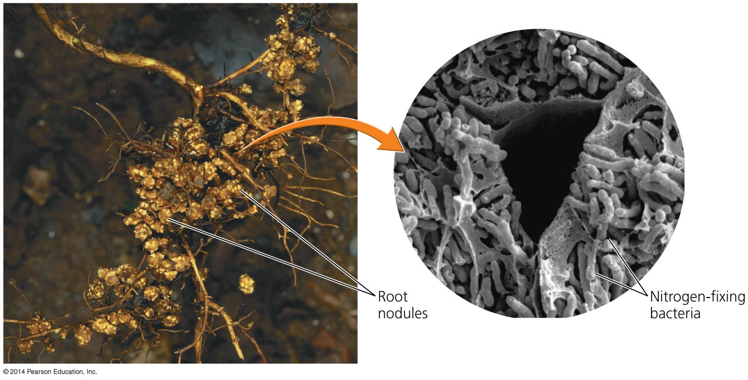

Slide 50
Nitrification and denitrification
Nitrification = process by which bacteria convert ammonium ions, first into nitrite ions, then into nitrate ions
  Plants can take up nitrate most easily
Animals obtain nitrogen by eating plants or other animals
Decomposers get nitrogen from dead and decaying plants or other animals, releasing ammonium ions to nitrifying bacteria

Slide 51
Nitrification and denitrification
Denitrifying bacteria = bacteria that convert nitrates in soil or water to gaseous nitrogen, releasing it back into the atmosphere and completing the nitrogen cycle

Slide 52
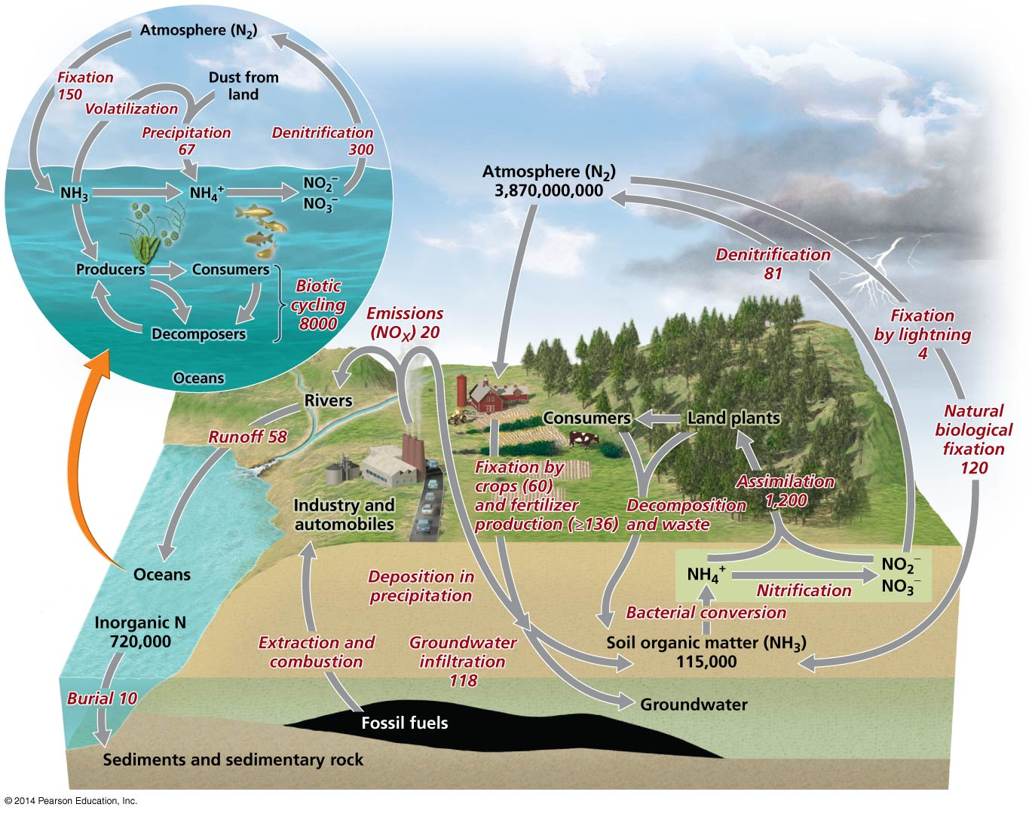

Slide 53
We have greatly influenced the nitrogen cycle
Nitrogen fixation was a crop production
bottleneck = the limiting factor in crop production
Haber-Bosch process = production of fertilizers by combining nitrogen and hydrogen to synthesize ammonia
  Humans overcame the bottleneck on crop productivity

Slide 54
We have greatly influenced the nitrogen cycle
Overuse of fertilizers has negative side effects:
  Increases the flux of nitrogen from the atmosphere to the land
  Causes eutrophication in estuaries and coastal ecosystems and fisheries
  Washes essential nutrients out of the soil
Burning fossil fuels adds nitrogen compounds to the atmosphere that contribute to acid precipitation

Slide 55
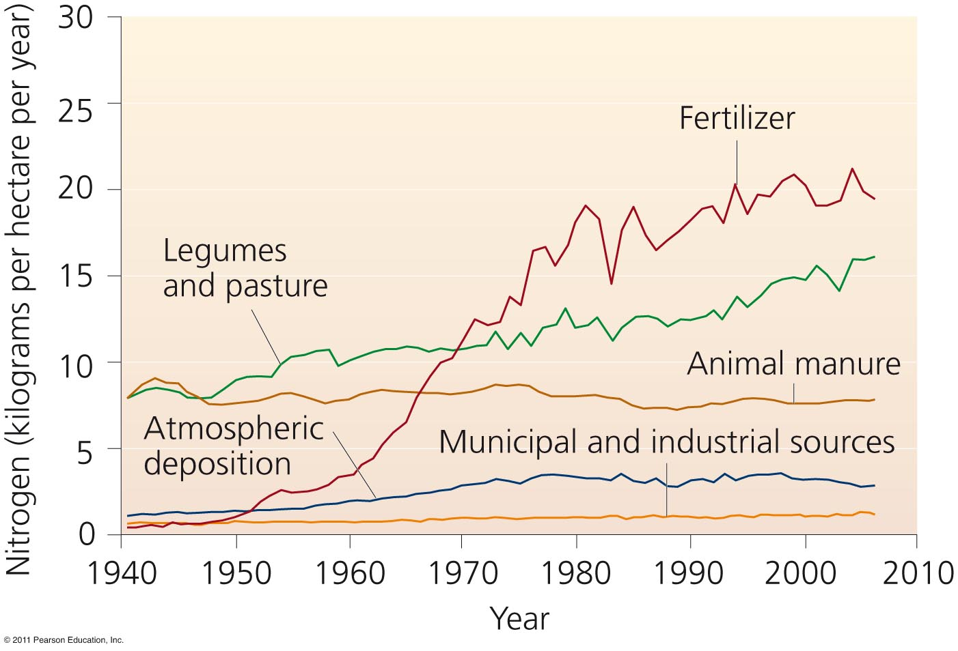
Please confirm that it is OK to use this art from the previous edition (permissions issue) - PIT
Human activity has doubled the amount of nitrogen entering the environment, overwhelming nature’s denitrification abilities

Slide 56
The phosphorus cycle circulates a limited nutrient
Phosphorus (P) is a key component of cell membranes, DNA, RNA, ATP, and ADP
Phosphorus cycle = describes the routes that phosphorus atoms take through the environment
Most phosphorus is within rocks
  It is released by weathering
  There is no significant atmospheric component
There is naturally low environmental concentrations
  Phosphorus can be a limiting factor for plant growth

Slide 57
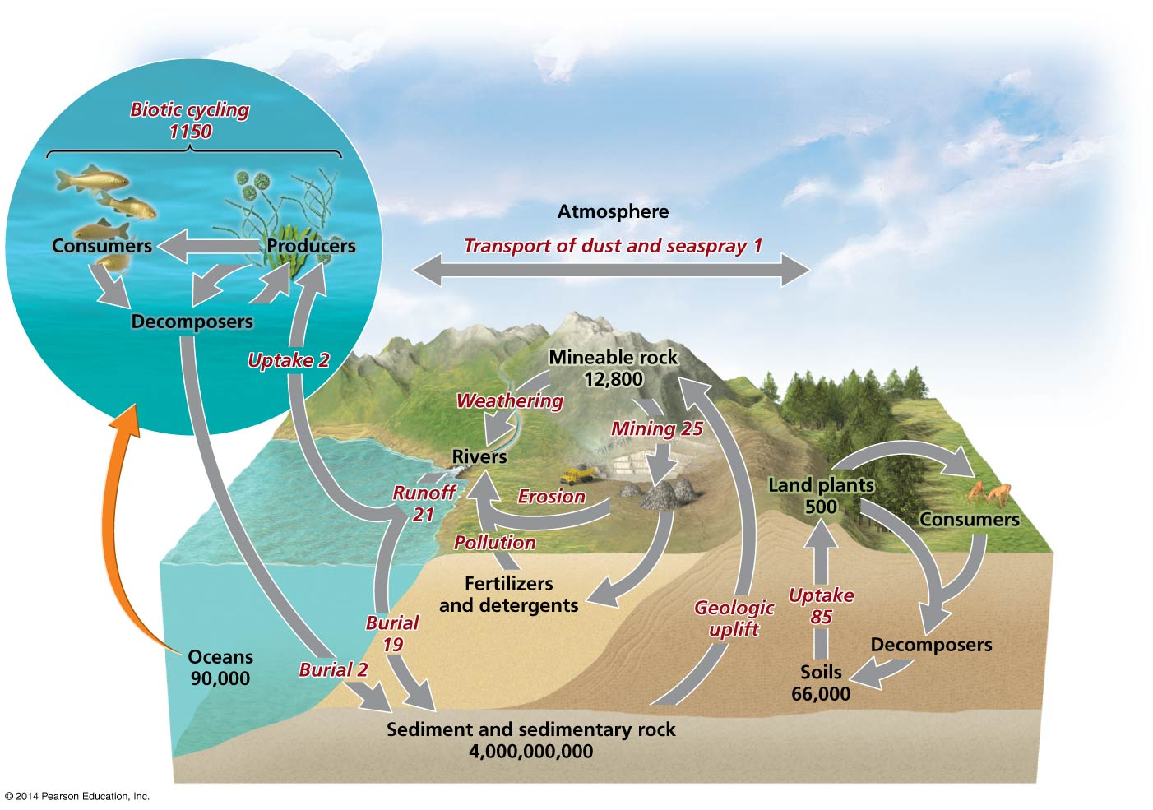

Slide 58
We influence the phosphorus cycle
Humans add phosphorus to fertilizers to promote crop growth
Runoff from farm fields and lawns contains phosphorus
  Increases phytoplankton growth
  Results in eutrophication and hypoxia
Wastewater discharge also releases phosphorus
  Detergents have traditionally contained high levels of phosphates

Slide 59
Tackling nutrient enrichment requires diverse approaches
We rely on synthetic fertilizers and fossil fuels
  Nutrient enrichment will be an issue we must address
There are a number of ways to control nutrient pollution
  Reduce fertilizer use on farms and lawns
  Apply fertilizer at times that minimize runoff
  Plant vegetation “buffers” around streams
  Restore wetlands and create artificial ones
  Improve sewage treatment technologies
  Reduce fossil fuel combustion
These approaches have varying costs

Slide 60
Other biogeochemical cycles
Sediment cycle
Iodine cycle
Sulfur cycle

Slide 61
Medical Geology
“If you want to learn about the health of a population, look at the air they breathe, the water they drink, and the places where they live.”
― Hippocrates, 5th Century BC

Slide 62
Medical Geology
Deals with the geologic factors that have a bearing on human, animal and plant health
“Is the scientific discipline that examines the impacts that geologic materials and processes have on human and ecosystem health.” (Bunnell, 2004)
Medical geology deals with the cause of the disease not its cure
________________________________________
[Bunnell, J.E; 2204, Medical Geolgoy:Emerging Discipline on the Ecosystem-Human Health Interface. EcoHealth, V. 1, p. 15-18]
Notes:
What is medical geology?

Slide 63
Medical Geology
Impetus from geochemical research after WW II
Geochemical data triggered interest of geologists and health care professionals to study possible relation between geochemical nature of an area and incidence of disease
Earlier, during the 1930s and subsequent period, animal and plant scientists made much progress in studying health impact caused by excess or deficiency of trace elements in animals and plants
Notes:
Some of the early studies attempted to establish correlation between geological factors and diseases, such as cardiovascular disease and water quality (1960s and 1970s); soil geochemistry and cancer in the Caspian region (1972); heart disease and heavy metals in Georgia (1970) and many more.
Any book on animal and plant science has detailed discussion of metal toxicity and provide guidelines on recommended dose of trace elements for cattle.

Slide 64
Trace Elements and Health
Well Studied Trace Elements
Fluorine
Iodine
Selenium
Arsenic

Slide 65
Iodine
Sources: alcohol, iodized table salt, seafood, kelp & other seaweed (raw or processed in items like ice cream)
Benefits: helps metabolize fats, produce energy, and keep thyroid glands healthy
Hazards: too little can result in hypothyroidism, causing weight gain, lack of energy, reduced mental focus, and in some cases goiter. Globally 2.11 million people suffer from goiter (WHO, 1990)
Notes:
Goiter is prevalent in the southwestern part of Sri Lanka where an estimated 10 million people suffer from goiter (Fordyce, et al, 2003 in Skinner & Berger (ed), Geology and Health, p. 62.

Slide 66
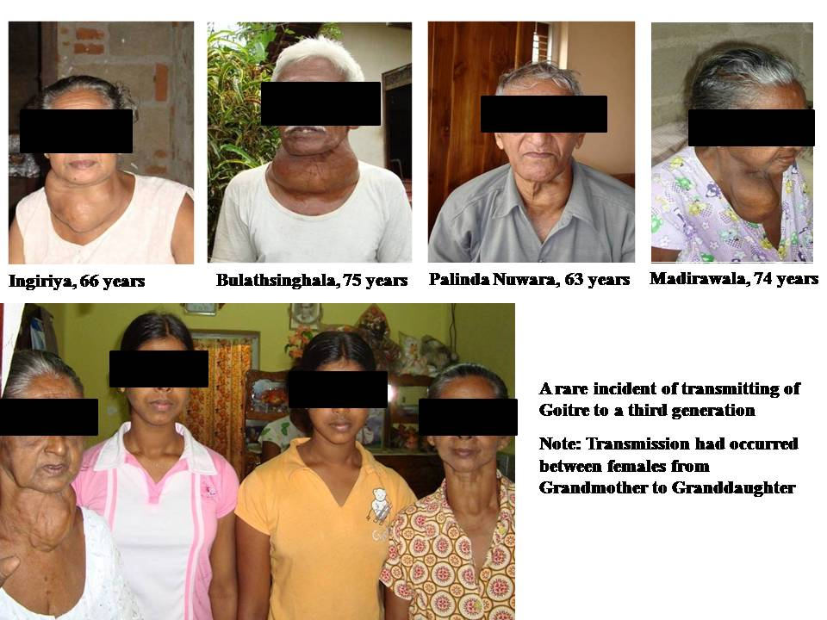
Globally goiters affect as many as 200 million of the 800 million people who have a diet deficient in iodine.
150 microgram of iodine in salt/day is recommended dose to maintain proper thyroid function to allow for median urinary iodine (UI) concentration of between 100-200 microgram/L. When UI falls below 100 microgram/L goiter is indicated.
One tablespoonful of iodine is all a person would need in his lifetime.
Notes:
Globally goiters affect as many as 200 million of the 800 million people who have a diet deficient in iodine.
150 microgram of iodine in salt/day is recommended dose to maintain proper thyroid function to allow for median urinary iodine (UI) concentration of between 100-200 microgram/L. When UI falls below 100 microgram/L goiter is indicated.
One tablespoonful of iodine is all a person would need in his lifetime.
In the US table salt has been supplemented with iodine since the 1920s to maintain UI concentration of 150 microgram/L.

Slide 67
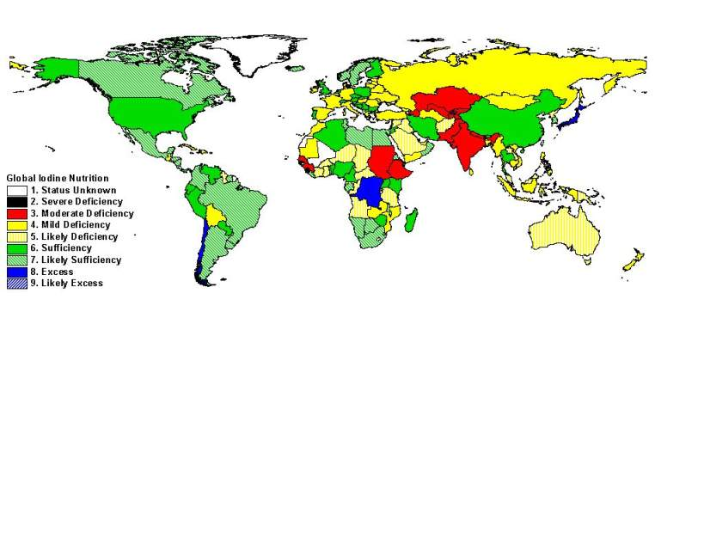
Global Iodine Nutrition
Source: Accessed April 7, 2006 http://indorgs.virginia.edu/iccidd/mi/regions/world_map.htm,

Slide 68
Fluorine
Sources: drinking water, seafood, teas. Regularly added to drinking water and toothpaste for its proven ability to reduce the formation of dental cavities by up to 70%
Benefits: required to maintain strong bones and teeth
Hazards: excessive amounts can result in mottled teeth, too little can cause osteoporosis
Notes:
Read the slide
We’ll see some pictures of serious health problems caused by fluorine later.

Slide 69
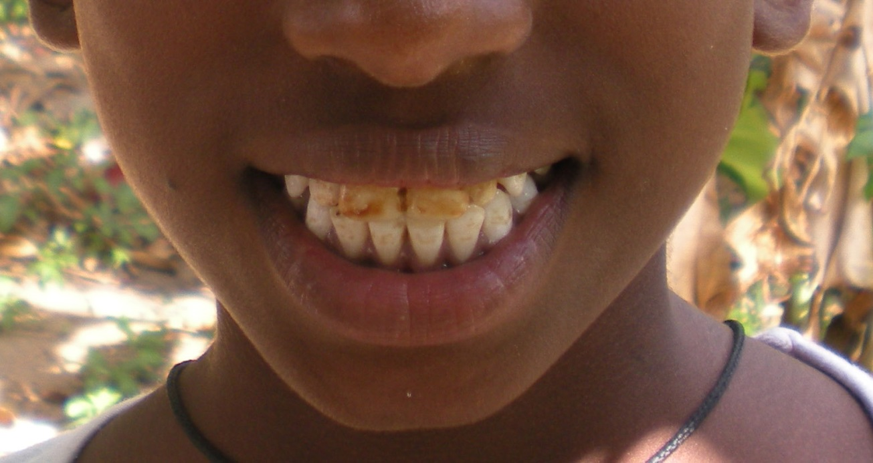
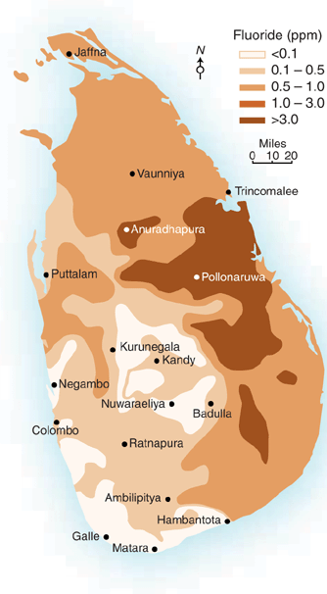
Dental fluorosis is caused by high intake of F (>4 ppm). It ranges from discoloration and mottling of teeth surface to serious staining and pitting. EPA’s MCL for drinking water is 4 ppm but it is too high and NAS in 2006 recommended to lower it below 2 ppm.
In US approximately 200,000 people were using drinking water with F concentrations equal to or exceeding 4 ppm (mg/L).
This man in China has a very advanced case of dental floozies caused by ingesting high levels (>100 ppm) of F.
About 10 million people in the southern China suffer from dental fluorosis.
Notes:
Dental fluorosis is caused by high intake of F (>4 ppm). It ranges from discoloration and mottling of teeth surface to serious staining and pitting. EPA’s MCL for drinking water is 4 ppm but it is too high and NAS in 2006 recommended to lower it below 2 ppm. In US approximately 200,000 people were using drinking water with F concentrations equal to or exceeding 4 ppm (mg/L).
This man in China has a very advanced case of dental floozies caused by ingesting high levels (>100 ppm) of F.
About 10 million people in the southern China suffer from dental fluorosis.

Slide 70
Assignment
Assess one biogeochemical cycle from Carbon, Nitrogen, Phosphorus, Sediment cycle, Iodine cycle or Sulfur cycle and discuss the influence of Sri Lankan’s impact to it
Presentation of 8 minutes
Report of 4 pages maximum
  1.5 line spacing
  12 pt Times New Roman

