Slide 1
Environmental Management
Meththika Vithanage
Office of the Dean, Faculty of Applied Sciences
University of Sri Jayewardenepura
Assoc. Research Professor
University of Southern Queensland, Toowoomba, Australia
Notes:
This template can be used as a starter file to give updates for project milestones.
Sections
Right-click on a slide to add sections. Sections can help to organize your slides or facilitate collaboration between multiple authors.
Notes
Use the Notes section for delivery notes or to provide additional details for the audience. View these notes in Presentation View during your presentation.
Keep in mind the font size (important for accessibility, visibility, videotaping, and online production)
Coordinated colors
Pay particular attention to the graphs, charts, and text boxes.
Consider that attendees will print in black and white or grayscale. Run a test print to make sure your colors work when printed in pure black and white and grayscale.
Graphics, tables, and graphs
Keep it simple: If possible, use consistent, non-distracting styles and colors.
Label all graphs and tables.

Slide 2
Course Objectives
Understand the importance of environmental management and engineering obligation to the society in terms of the environmental requirements.
Analyse and report environmental impact in engineering practice and demonstrate sustainability in the process of making engineering decisions

Slide 3
Environment
The term environment refers to an organization’s natural and human surroundings. An organization’s environment extends from within the organization itself to the global system, and includes air, water, land, flora, fauna, as well as human beings.

Slide 4
Natural Environment
4 spheres
Biosphere = Space occupied by life
Atmosphere = Space occupied by air
Lithosphere = Space occupied by solid
Hydrosphere = Space occupied by water

Slide 5
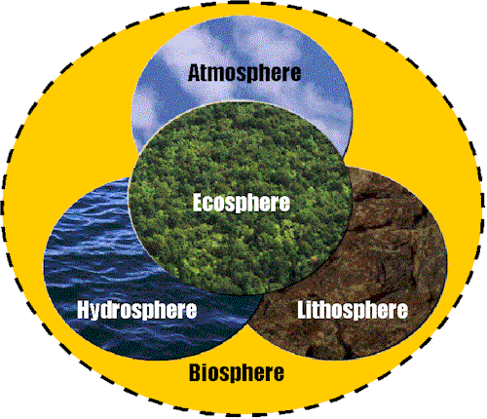

Slide 6
Human Population Growth and the Environment
Human Population - An Explosive Growth
Human Needs - Limited Resources
Our Natural Environment Under Attack
Roles of Technology and Engineering
An Uncertain Future

Slide 7
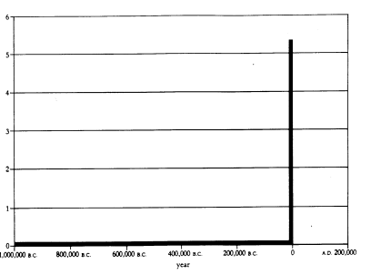
Humans are Recent Arrivals
Earth - 5 Billion Years
Multi-cell Biota - 600 Million Years
Human Beings ~ 2 Million Years
Human Population Growth into Billions - Last 200 years
6 Billion
6 Billion
A Million Years Of Human Growth (1)

Slide 8
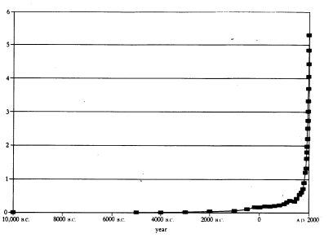
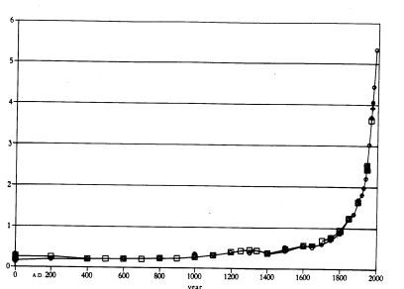
A Closer Look
12,000 years
200 Million by 1 A.D.
2,000 Years
1 Billion in 1800 A.D.
The Industrial Revolution
1 Billion
200 million

Slide 9
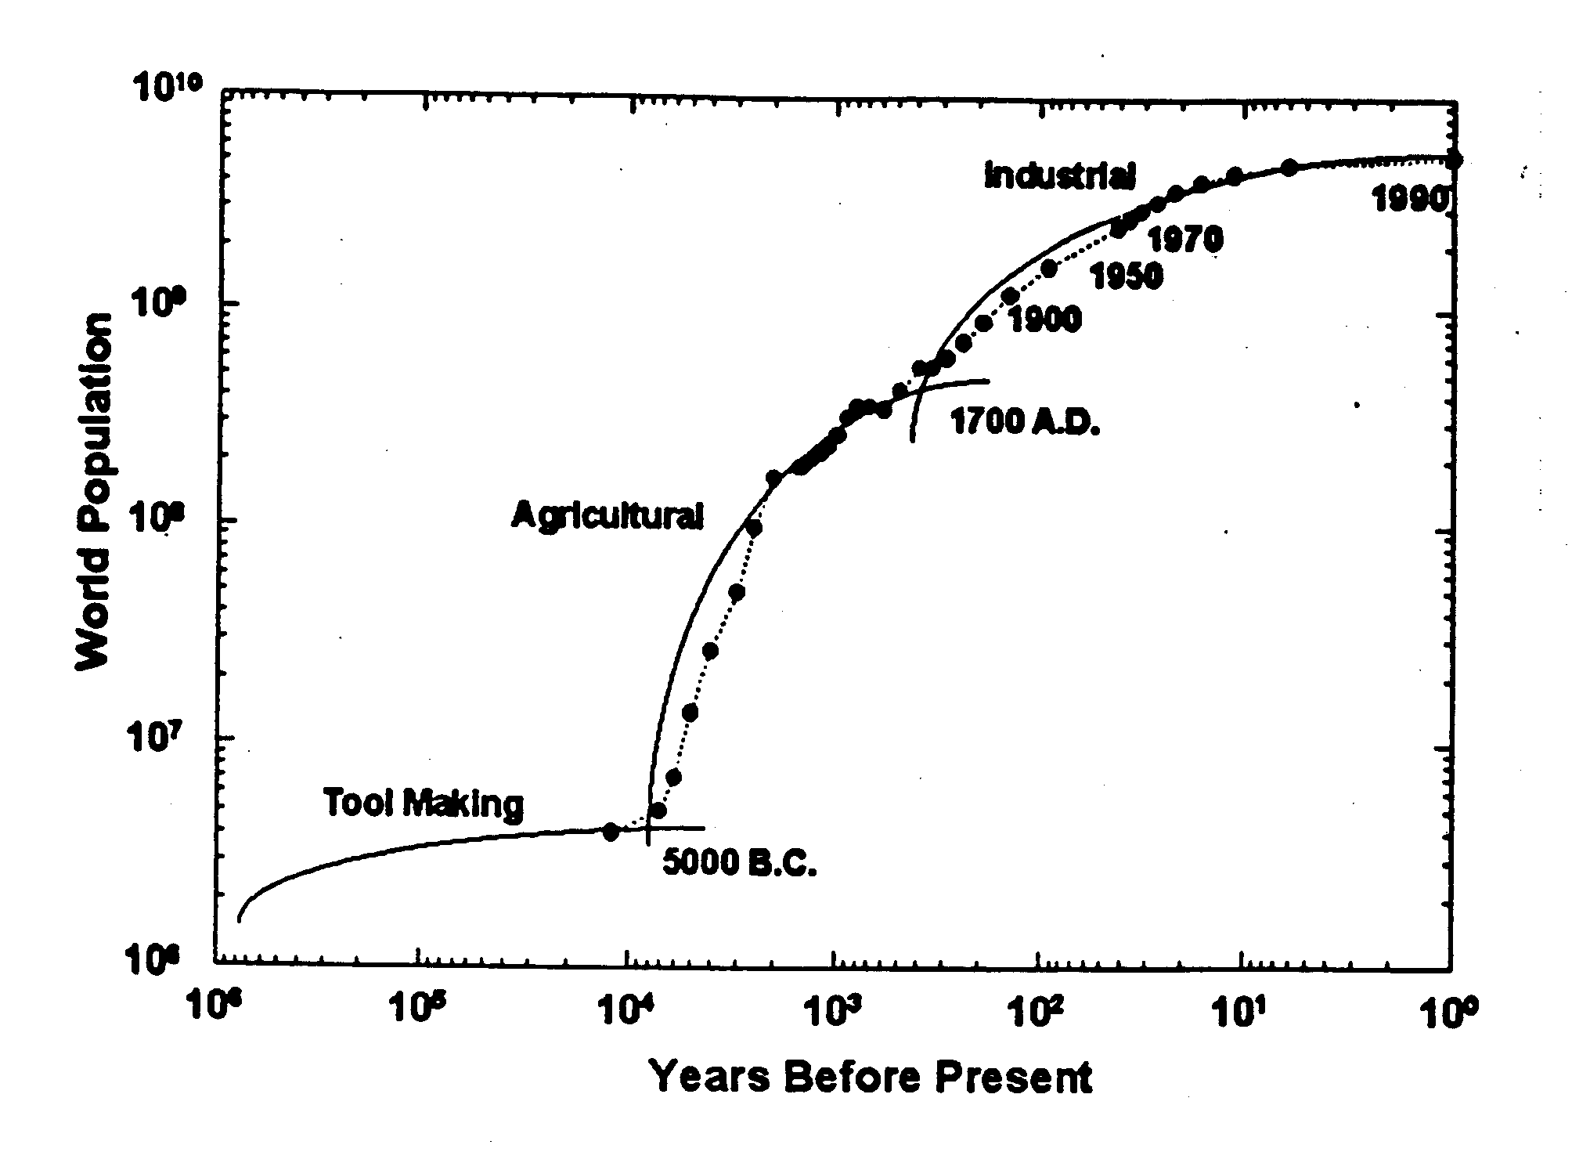
Three Technological Eras

Slide 10
What’s Behind Population Growth
Three Factors
  Fertility
  Infant Mortality
  Longevity
Animal Domestication and Agriculture
  Provided for a few to feed many
Industrial Revolution
  Growth of Cities and Infrastructure
    Water
    Energy
    Transportation
  Increased Productivity
  Nutrition
  Sanitation
  Medicine

Slide 11
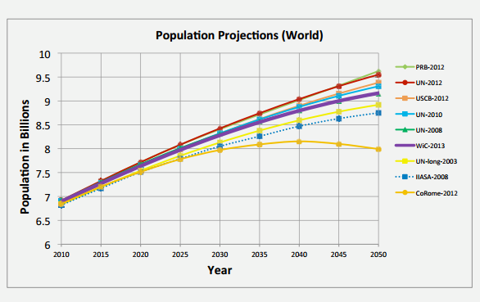
Population Predictions
Most predictions: 9-12B by 2050 10-15B by 2100
UN (Low) requires global fertility at less than zero growth in 15 years
Large uncertainties

Slide 12
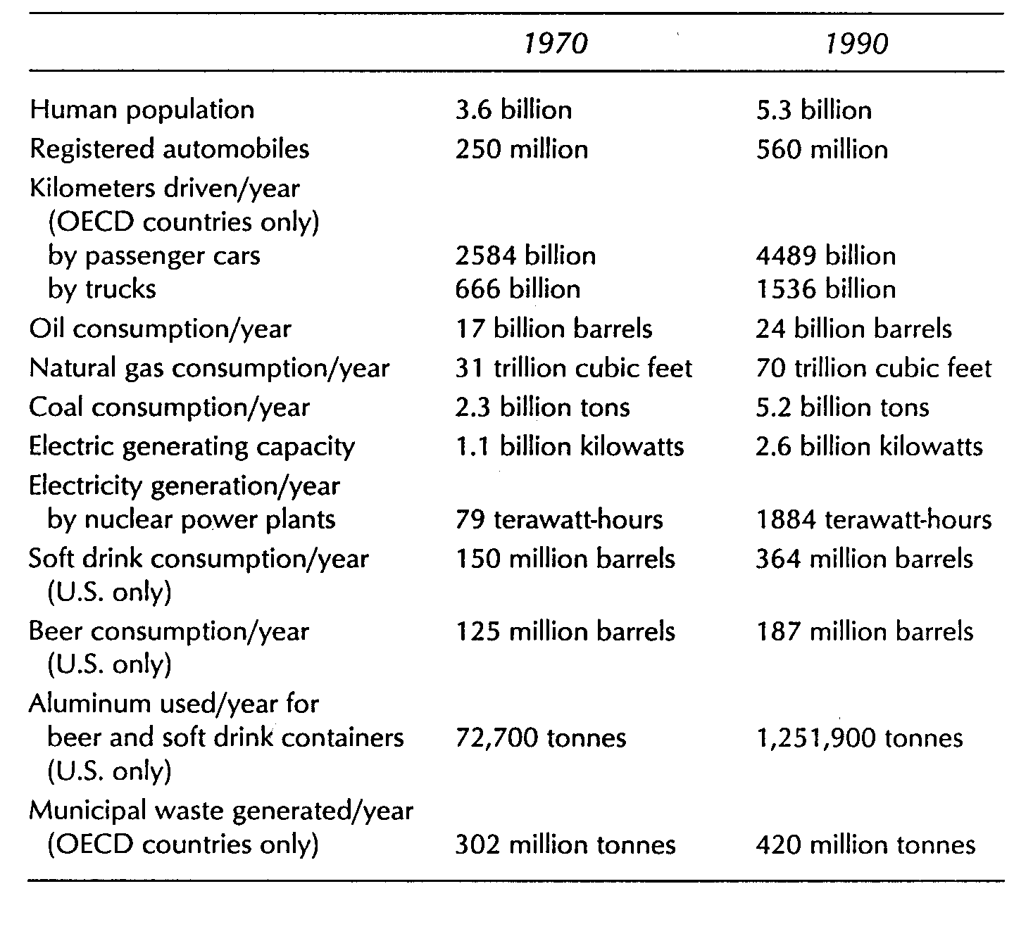
Resource Consumption
High consumption
Getting worse
Rate increase faster than population growth

Slide 13
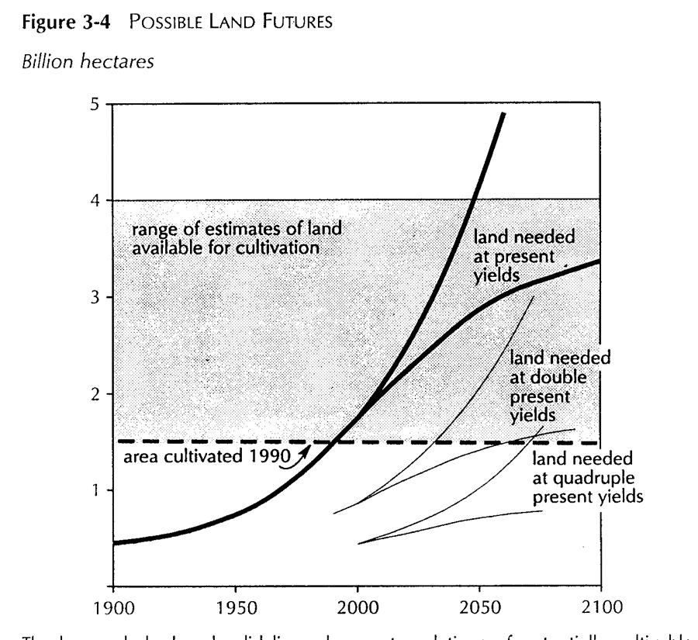
Resource Limits - Land
Deforesting to acquire more arable land
Would run out in next century at current yields
Probably need to double yields

Slide 14
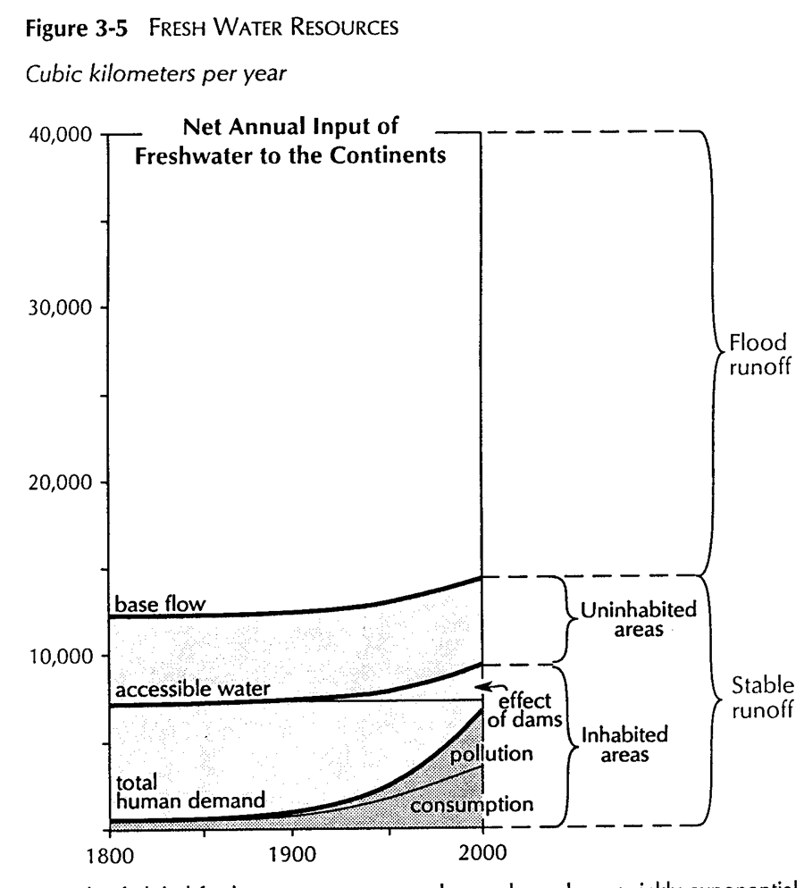
Resource Limits - Water
In 1950 people used half of accessible water
Are now dependent on dams
Pollution loses 33% of potential water
Getting close to limits

Slide 15
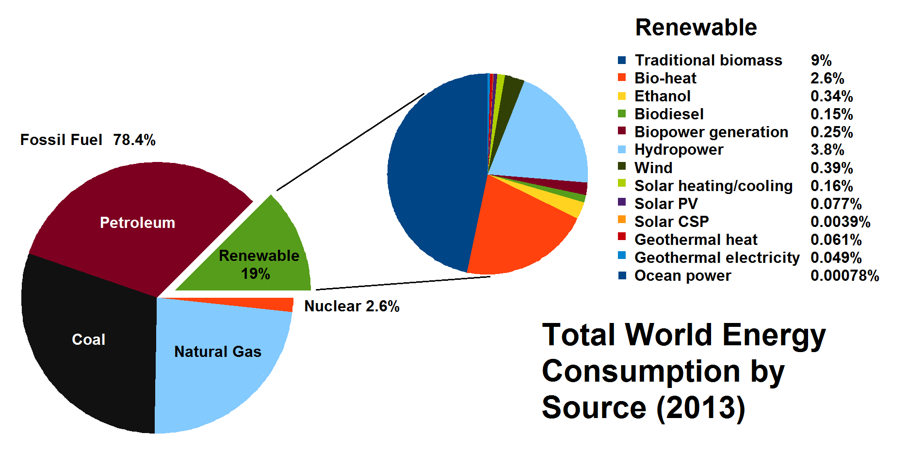
Energy Consumption
Energy growth very high last fifty years
Mostly hydrocarbon fuels
Nonrenewable resource consumption and climate change issues

Slide 16
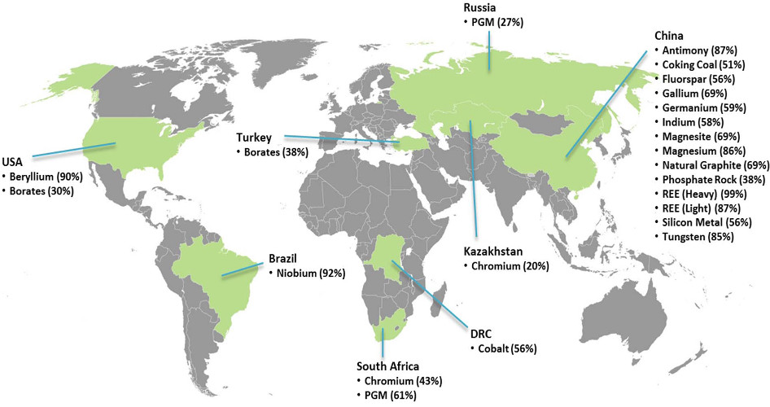
Critical raw materials

Slide 17
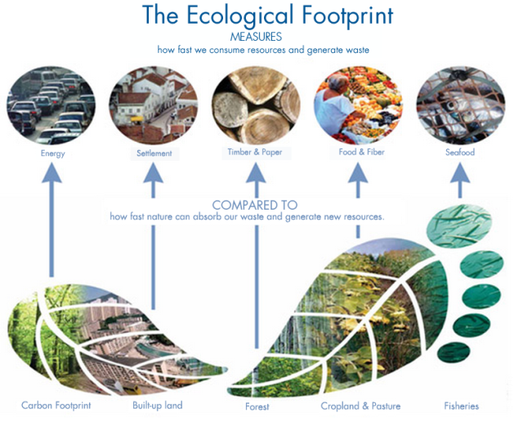
Planet Earth is Impacted
Ecological Footprints
  United States - 5 hectares/person
  Developing nations - 0.5 hectare/person

Slide 18
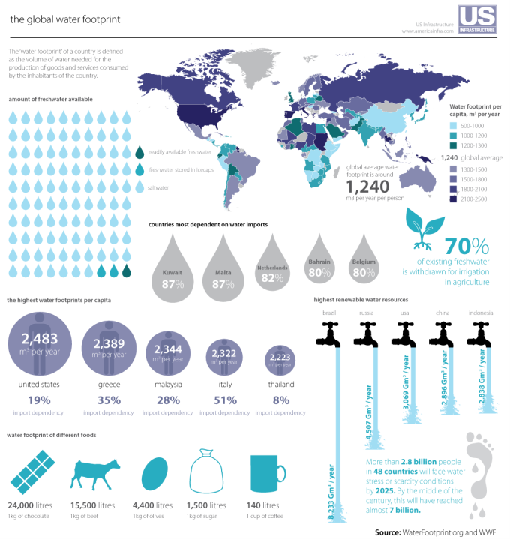

Slide 19
Our ‘Commons’ are in Danger
Atmospheric pollution and climate change
Water pollution, including ground aquifers
Deforestation and loss of oxygenation
The oceans, coral reefs and their bounty
National parks, wildernesses and wetlands
Nonrenewable natural resource depletion
  Fossil fuels, mineral ores, topsoil…..

Slide 20
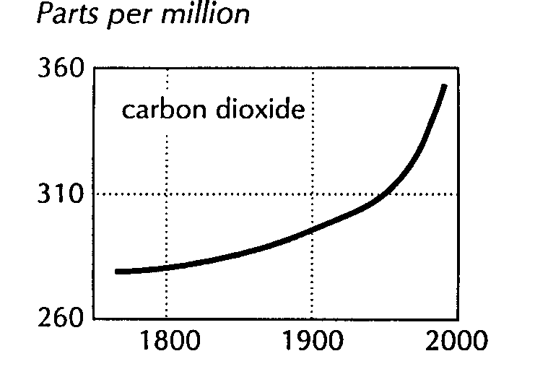
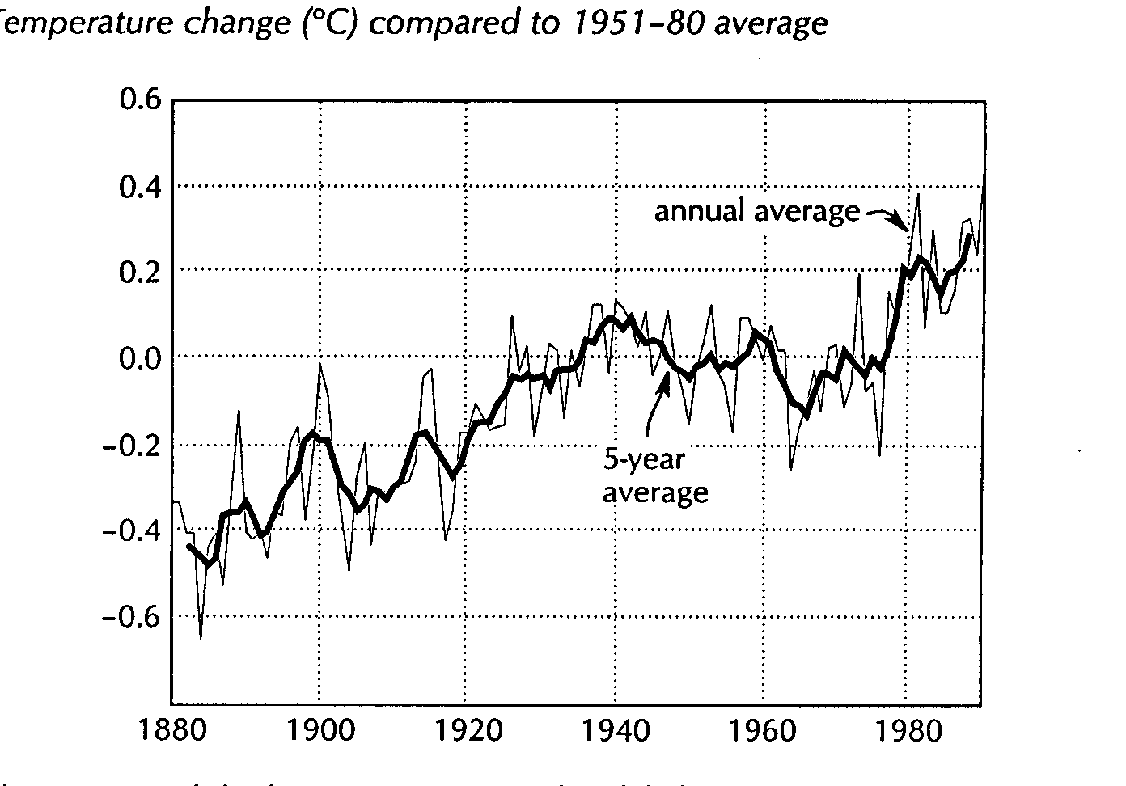
Global Warming - A Good Example
Atmospheric CO2 is increasing, and creates greenhouse effect
3-5°C rise predicted by computer models for this century would have major environmental impact
Observed change of 0.25-0.4°surface and 0.0-0.2°C troposphere rise in last 20 years doesn’t agree with models and may or may not be due to CO2
Humans - 6 billion tons/year of CO2 (up 500% from 1950, and increasing)
  Other sources 200B tons/year
  Total atmosphere load - 775B tons
  Total earth load with oceans - 42,000B tons
0.6°C rise in last 100 years

Slide 21
Technology’s Roles
Detailed explicit information and understanding of what is occurring
  Sensors, data processing, computers, models, predictions, communication, information…...
Alternate technologies that mitigate and eliminate deleterious effects
  Energy, water, transportation, communication…
Sustainable Development

Slide 22
Engineers are vital
Developing and applying
  the means by which to measure, analyze and predict future conditions
  the technologies by which to mitigate and eliminate undesired effects
Describing, explaining and communicating
  To policy makers
  To the non-technical public
Creating the framework for a sustainable environment

Slide 23
What is Engineering?
“Engineering…is the direction of the sources of the power of nature for the use and convenience of man. It is the link, the bridge between man and nature; a bridge over which man passes into nature to control it, guide it, understand it, and the bridge over which nature and its forces pass to get into man’s field of interest and service”
Nicholas Murray Butler, Nobel Laureate and President of Columbia University, 1901-1945

Slide 24
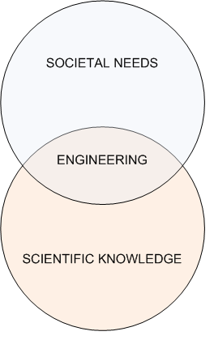
Engineering
The central focus of the engineering profession is the application of scientific knowledge to meet societal needs.
Engineering connects pure science to society
Engineering therefore has a social responsibility
Notes:
Unlike science, in engineering the environment in which engineers plan, design, build, manufacture, maintain and operate continually changes and
so the engineer must be prepared within an ‘acceptable level of risk’ for all possibilities and outcomes.
In a controlled laboratory there is much less chance of an uncertain event.
The biggest risk factors in engineering are planning for the unknown behaviour of humans and natural systems.

Slide 25
Engineering Assumptions
Mind-Reality Interface
Knowledge is Possible
Knowledge is Power
Divide and Conquer
Nature is Passive
The Whole is Equal to the Sum of its Parts
Technical and Scientific Knowledge are Value Free
All Mistakes are Fixable
“Cross that bridge when we come to it”
Knowledge accumulates and drives out ignorance

Slide 26
Assumptions Challenged
Nature is not passive
Whole not equal to the sum of the parts
Knowledge is not value free
Ignorance increases with increased knowledge
Some mistakes are less fixable than others
Greater Knowledge=Greater Responsibility

Slide 27
Environment Management Concept
Definition
Its an attempt to control human impact on and interaction with the environment in order to preserve natural resources
Environmental management focuses on the improvement of human welfare for present and future generations
Administrative functions that develop, implement, and monitor the environmental policy of an organization
Notes:
What is the project about?
Define the goal of this project
Is it similar to projects in the past or is it a new effort?
Define the scope of this project
Is it an independent project or is it related to other projects?
* Note that this slide is not necessary for weekly status meetings

Slide 28
A General Scheme For Environmental Management
Identification of objectives and define problems
Determination of appropriate Action Plan
Implementation and progress evaluation
Monitoring and Adjust Management
Future Environmental Management and planning

Slide 29
Sustainable Development
Sustainable development is development that meets the needs of the present without compromising the ability of future generations to meet their own needs
It is a pattern of resource use, that aims to meet human needs while preserving the environment so that these needs can be met not only in the present, but also for generations to come.
The development initiatives be initiated in such a way that the future generations can enjoy the benefits of Nature without any compromise.
Using the resources to the extent to which it is sustained.
Notes:
* If any of these issues caused a schedule delay or need to be discussed further, include details in next slide.

Slide 30
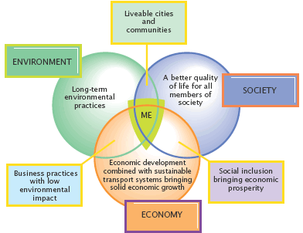
Notes:
Duplicate this slide as necessary if there is more than one issue.
This and related slides can be moved to the appendix or hidden if necessary.

Slide 31
Current Condition
Rapid growing Population
Economic Development
  Uncontrolled Growth of Urbanization
  Industrialization/ Globalisation
  Expansion and Massive Intensification of agriculture
  Destruction of Forests
Rapid Growth of Population
50% of population to be in Urban cities by 2020
UN projection half of world population to stay in Urban cities by 2008

Slide 32
Environmental Issues
Forest and Agricultural Degradation of land
Resource depletion (water, mineral, forest, sand, rocks etc.) is an economic term referring to the exhaustion of raw materials within a region.
Environmental Degradation
Public health
Loss of biodiversity
Loss of resilience in ecosystems
Livelihood security for the poor

Slide 33
Environmental Degradation
is defined as any change or disturbance to the environment perceived to be deleterious or undesirable.
Environmental degradation is the deterioration of the environment through
  depletion of resources such as air, water and soil
  the destruction of ecosystems
  the extinction of wildlife.

Slide 34
What is Ecology?
Ecology is a branch of science that systematically studies the relationships between living organisms and the physical and chemical environment in which they live.

Slide 35
Why Study Ecology?
  to provide a broader and deeper understanding of the natural process by which natural resources are created and maintained
  to understand some of the natural laws that impose limitations on the interaction of organisms (including humans) with their living and nonliving environment
  to show the specific ways in which human interaction with nature has been incompatible
  to identify some of the important links between ecology and economics, two disciplines which are imperative for a holistic view of natural resource problems and issues.

Slide 36
ECOSYSTEM: A Starting Point of Ecological Study
An ecosystem includes living organisms in a specified physical environment, the multitude of interactions between the organisms, and the non-biological factors in the physical environment that limit their growth and reproduction, such as air, water, minerals, and temperature.

Slide 37
Major components of an ecosystem:
  Abiotic (nonliving) components
    The atmosphere (air)
    The hydrosphere (water)
    The lithosphere (earth crust)
  Biotic (living) component
    Producers – organisms capable of photosynthesis
    Consumers – herbivores and carnivores
    Decomposers – microorganism
  The Biosphere = Abiotic + biotic = Life

Slide 38
Abiotic components of an ecosystem serve as;
  Habitat (space) and immediate source of water and oxygen to organisms.
  Reservoir of the six most essential elements for life (C, O, H, N, S, P). These elements constitute 95% of living organisms; and found in fixed amount.
  An agent for “material” recycling!

Slide 39
Ecosystem Functions
Ecosystem function ⇒ movement or transformation of matter and energy
  Requires constant flow of external energy
  Solar radiation – fuels the natural ecosystem
  The movements of matter and energy are represented by various forms of cycles.

Slide 40
The Biotic Cycle
Matter and energy flow in the biotic cycle
  The role of the producers
  The role of the consumers
  The role of the decomposers
Material recycling at the biotic cycle level
  Material recycling is not 100% efficient

Slide 41
Implications
In a natural ecosystem, living and non-living matter has reciprocal (bearing on two parties equally) relationships. For that matter, survival and ‘proper’ ecosystem functioning dictate mutual interactions (interdependence) among organisms and between them and the abiotic environment.

Slide 42
Other well known cycles
Atmospheric Cycles – carbon, nitrogen, sulfur, etc.
Geologic Cycle, recycling of phosphate
Hydrologic cycles
Biogeochemical cycles

Slide 43
The Basic Lessons of Ecology
The substance that we often identify as natural resources (air, water, food, minerals, valleys, mountains, forests, waterfalls, wilderness, etc.) evolved from a multitude of complex interactions of living and non-living organisms, that are powered by the energy from the sun over a period measured on geological time scale.
  Hence, natural resources are not just factors of production

Slide 44
The interactions among the elemental components of the biosphere are governed by three principles:
  First, all matter in the ecosphere is mutually linked. Hence, human economy cannot be viewed in isolation as the Circular Diagram model depicts it.
  Second, material recycling is essential for the growth and revitalization of all the components of the ecosphere. No such thing as waste in nature.
  Third, the various components of the biosphere go through gradual process of developmental stages--from pioneer to climax.

Slide 45
The biosphere cannot escape the fundamental laws of matter and energy:
  First law:
    natural resources are finite
    pollution is an inevitable by – product of any transformation of matter – energy (including the human economy).
  Second law:
    energy cannot be recycled
    no perfect machine – limit on energy conversion technology

Slide 46
Human Influences on Ecosystems
We normally separate non-human (natural) aspects of ecosystems from human (anthropogenic) influences
Many ways to describe perturbations
  chemical − biological − physical
  land use − pollution − global
Response may be complex due to the interrelationships

Slide 47
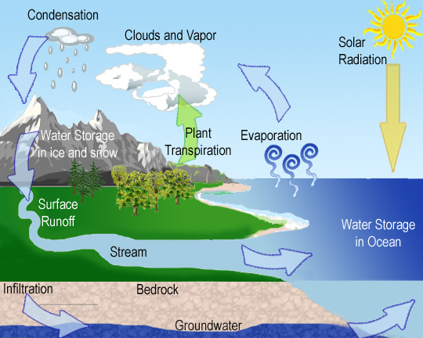
WATER

Slide 48
Water resources
Usage of Ground and Underground water by the Industry - causes huge droughts and contamination to a massive area by exploiting an excessive amount of ground water and then replacing it with toxic discharge.
85% of rural drinking water and 55% of urban water comes from underground sources has caused the national water table to suddenly and very dramatically drop.
The rivers are slowly being polluted and destroyed by sewage, chemicals and other agricultural and industrial waste.

Slide 49
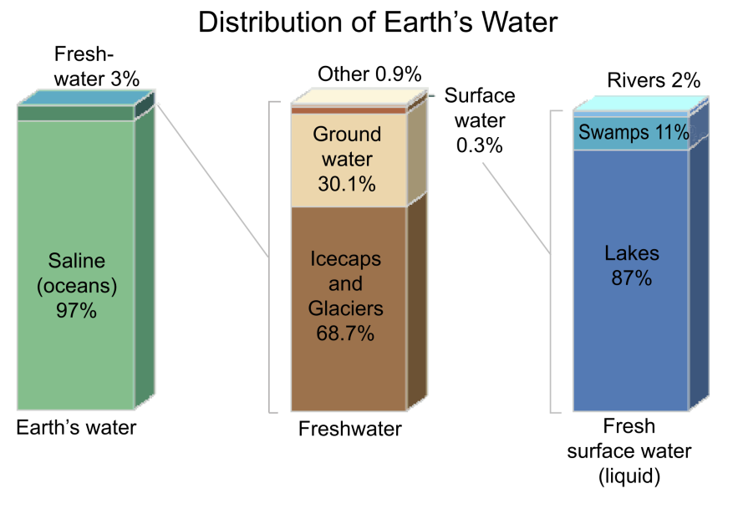

Slide 50
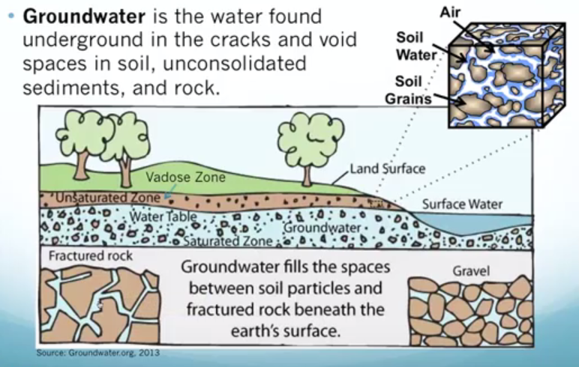
Groundwater

Slide 51
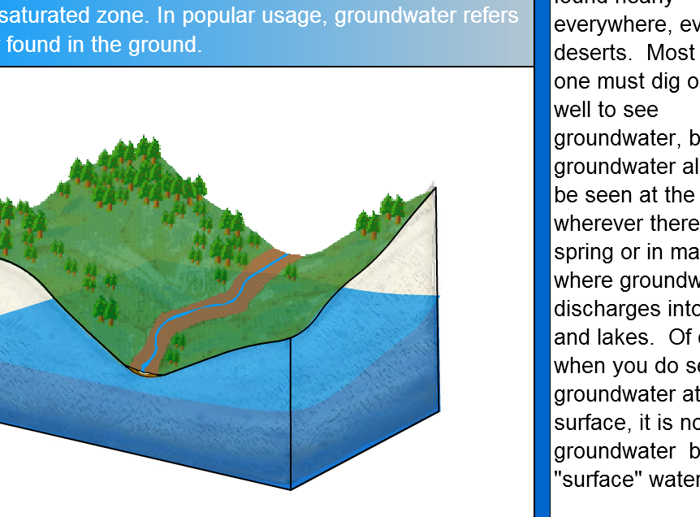
Recharge & Discharge

Slide 52
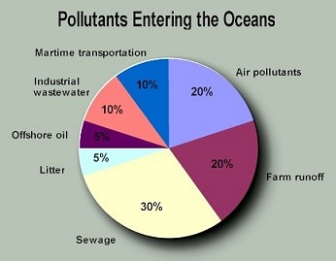
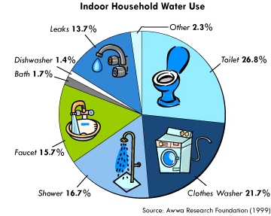
Water Graphics

Slide 53
Major Reasons behind Water Scarcity
Population growth and Food production (Agriculture)
Increasing construction/ infrastructure development Activities
Massive urbanization and industrialization throughout the country
Climatic change and variability- Depleting of natural resources due to changing climate conditions (Deforestation etc.)
Lack of implementation of effective water management systems.

Slide 54
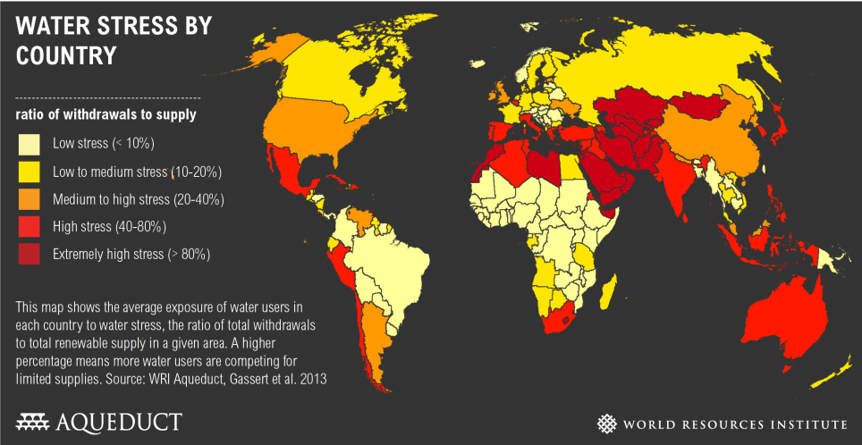
Water Stress

Slide 55
Water
Both quality and quantity of water endangered.
Quality – Degradation of oceans & waterways
  Municipal sewage, Industrial wastes
  Urban runoff, Agricultural runoff
  Atmospheric fallout, Overharvesting
  Dam sedimentation, Deforestation
  Overgrazing, Over-irrigation
More than a billion people lack clean water.
Quantity –
Earth is a closed system with a fixed water supply; growing populations use more water.
The world is facing water bankruptcy.

Slide 56
The major sources of water pollution
Domestic effluents,
Sewage,
Industrial effluents,
Agricultural effluents,
Thermal pollution,
Oil pollution and,
Pollution created by Radio-active elements

Slide 57

The Hanford site is a legacy of World War II and the Cold War. In 1943, the federal government selected Hanford as a top secret site for the Manhattan Project, which called for enriching plutonium for nuclear weapons
In August 1945, concentrated plutonium manufactured at Hanford powered the nuclear bomb dropped on Nagasaki, Japan.
The U.S. Department of Energy eventually built nine nuclear reactors along the Columbia River to produce plutonium and other materials.
The river provided electricity from the Grand Coulee Dam abundant water to cool the nuclear reactors.
From 1943 to 1989, the federal government and its contractors generated unprecedented volumes of hazardous and radioactive waste.
For example, Hanford released approximately 725,000 curies of radioactive iodine-131 between 1944 and 1957.
The 1979 accident at the Three Mile Island nuclear power plant in Pensylvania released between 15 and 24 curies of iodine-131.

Slide 58
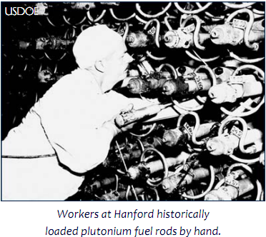
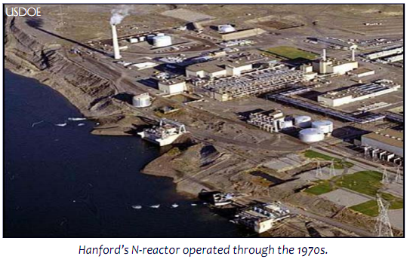
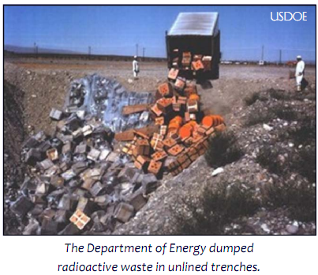
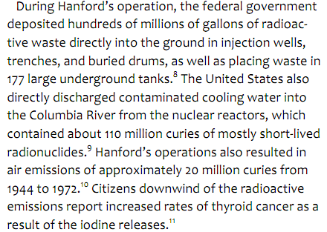

Slide 59
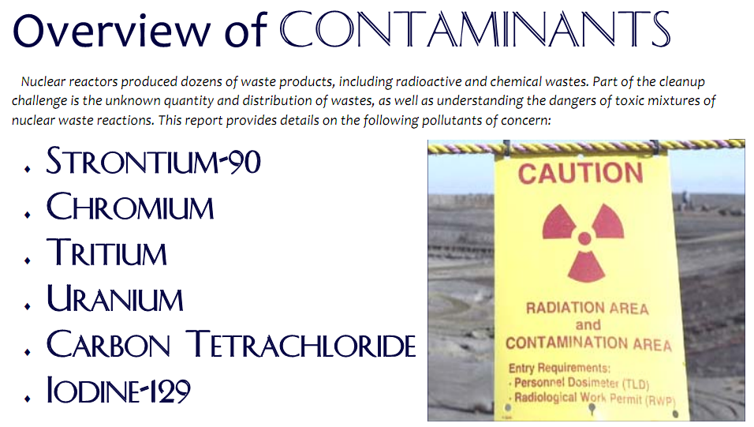

Slide 60
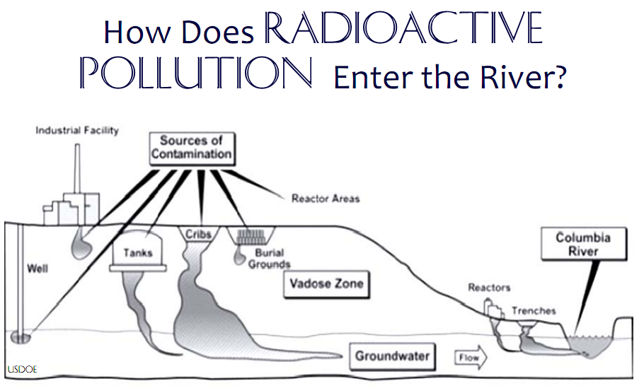

Slide 61
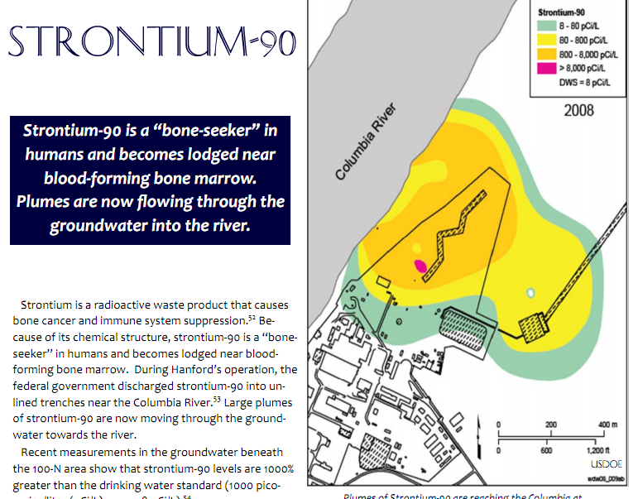

Slide 62
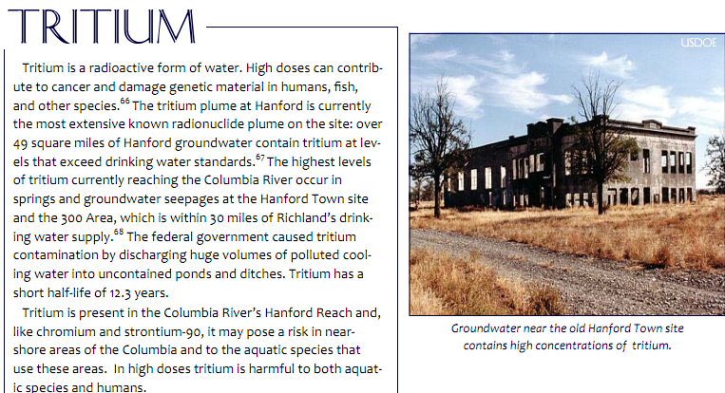

Slide 63
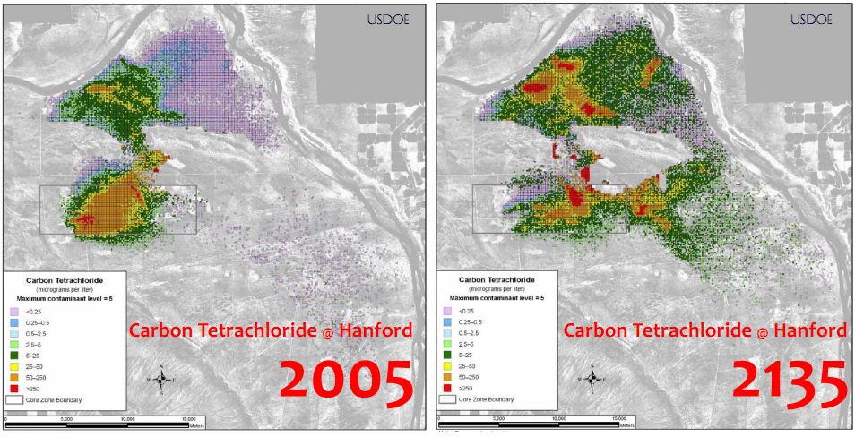

Slide 64
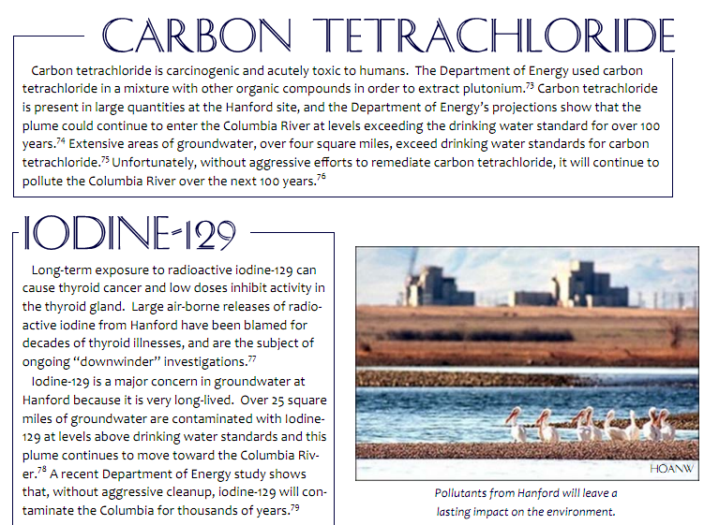

Slide 65
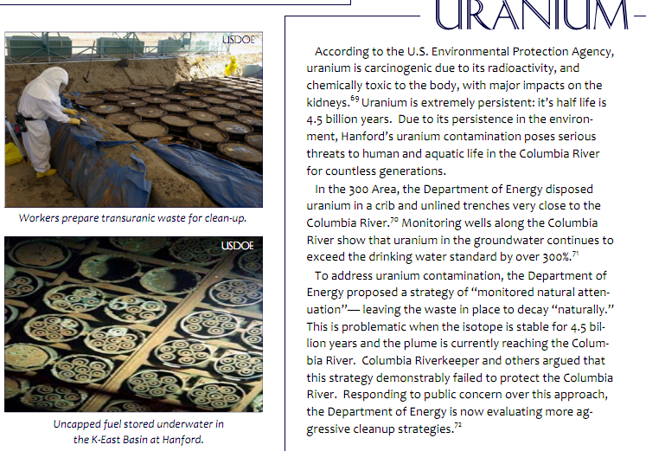

Slide 66
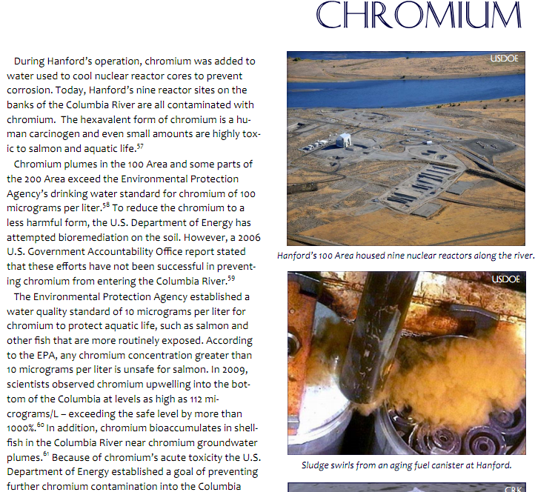

Slide 67
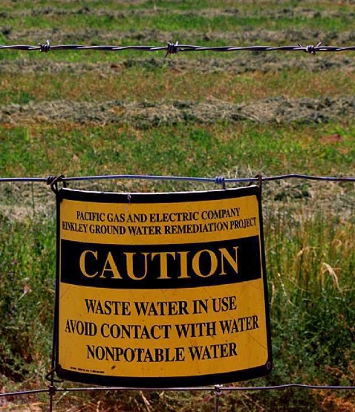
Hinkley Incident
Pacific Gas & Electric (PG&E) was in trouble
Four decades after the world's largest utility started dumping 370 million gallons of cancer-causing chemicals into unlined ponds in Hinkley, California, the company's actions had finally been uncovered by Erin Brockovich
The case was settled in 1996 for US$333 million, the largest settlement ever paid in a direct-action lawsuit in U.S. history.
A study released in 2010 by the California Cancer Registry showed that cancer rates in Hinkley "remained unremarkable from 1988 to 2008".

Slide 68
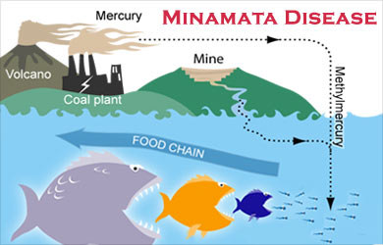

Minamata Incident

Slide 69
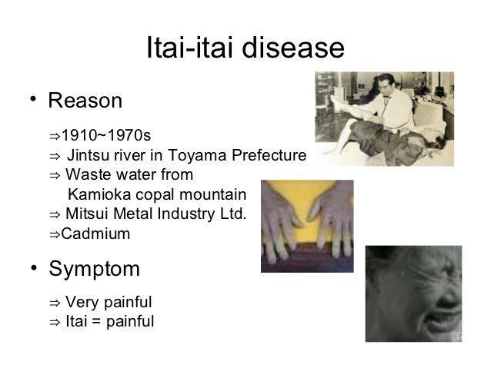

Slide 70
A few remedies to control water pollution
Industries should enforce standards for water effluents,
The Pollution Control Boards must enforce the laws,
Adequate sewage disposal facilities should be developed so that sewage is not directly released into the water stream,
The sewage and water treatment plant should be established,
For small and medium size industries combined treatment plant should be established,
6. A pollution tax should be imposed especially for industries responsible for water pollution

