Slide 1
Random Variables,
Distributions, and
Density Functions
Ref: Probability and Random Processes, Millers and Childers

Slide 2



The Cumulative Distribution Function

Slide 3
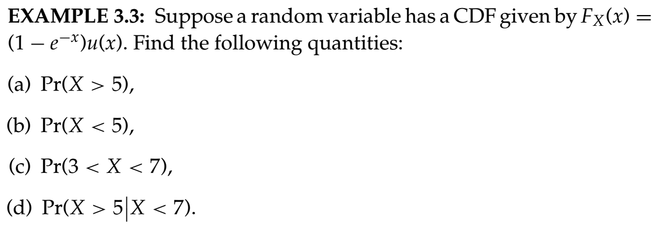
The Cumulative Distribution Function

Slide 4

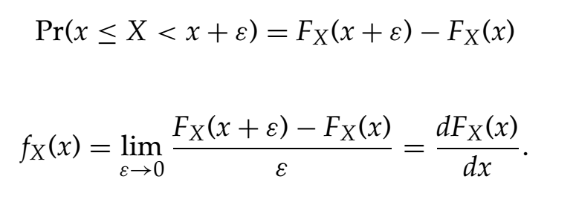
The Probability Density Function (PDF)

Slide 5
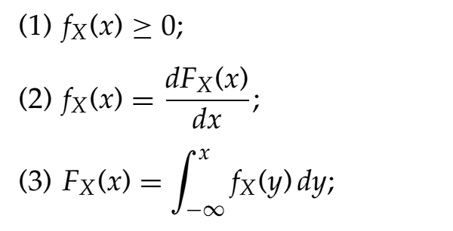

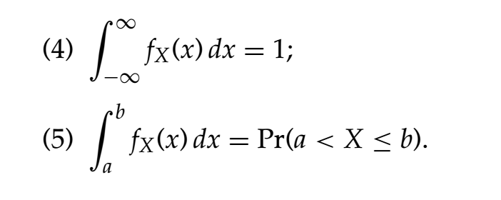
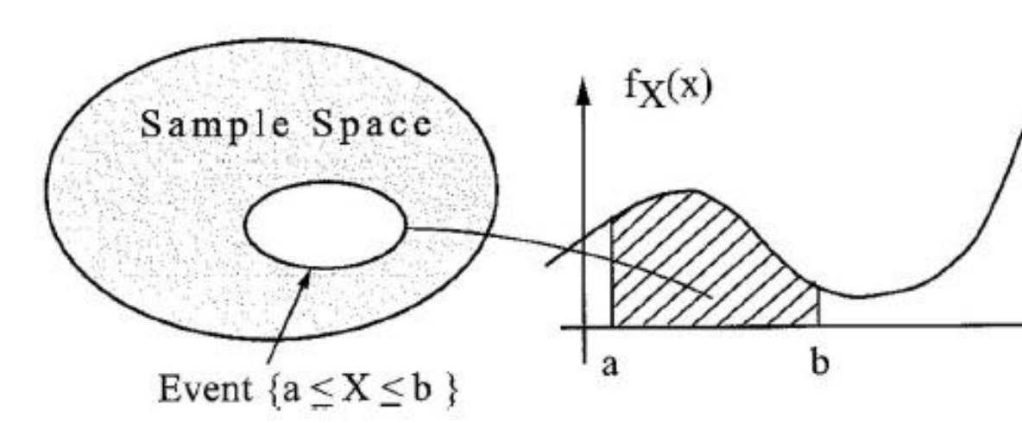
The Probability Density Function (PDF)

Slide 6

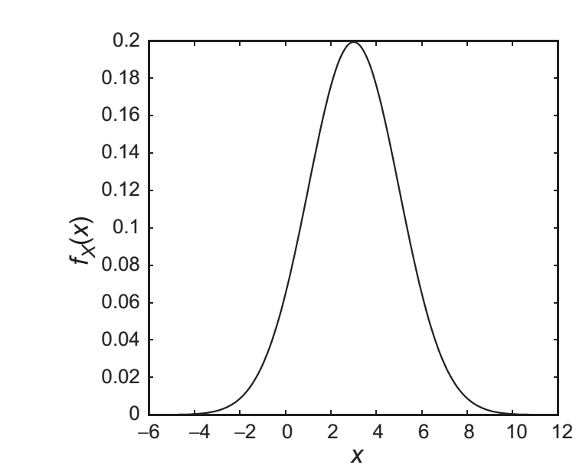


The Gaussian Random Variable
Show that:

Slide 7
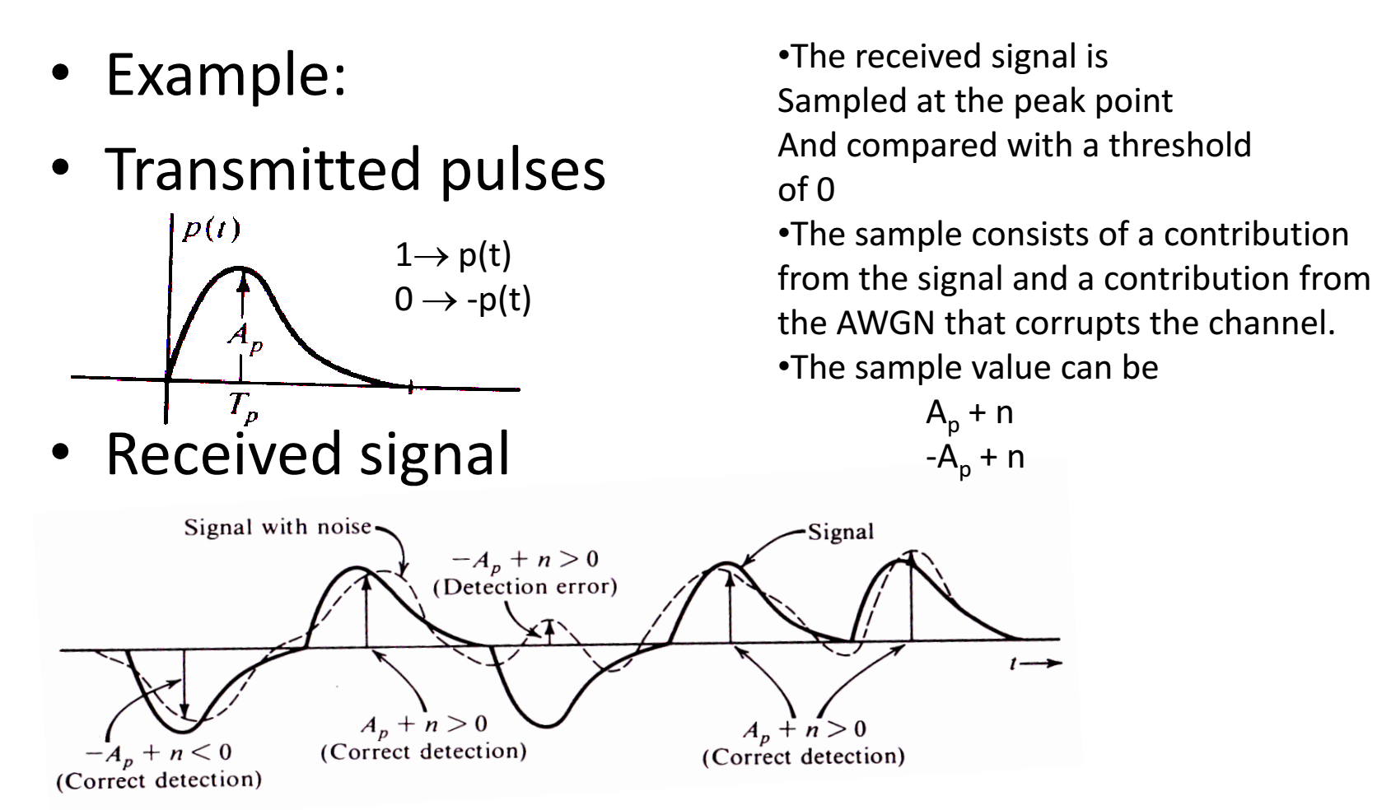
Find the probability of error.

Slide 8




