Slide 1
Introduction to Management-1

Slide 2
What is Management ? Any Thoughts?

Slide 3

What is an Organization?
A group of people working together in a structured and coordinated fashion to achieve a set of goals.

Slide 4




Types of Organizational Resources
Organizational
Resources
Physical Resources
Human Resources
Information Resources
Financial Resources

Slide 5

Organizational Resources
Human resources
  Managerial talent and labor
Financial resources
  Capital investments to support ongoing and long-term operations
Physical resources
  Raw materials; office and production facilities, and equipment
Information resources
  Usable data, information linkages

Slide 6
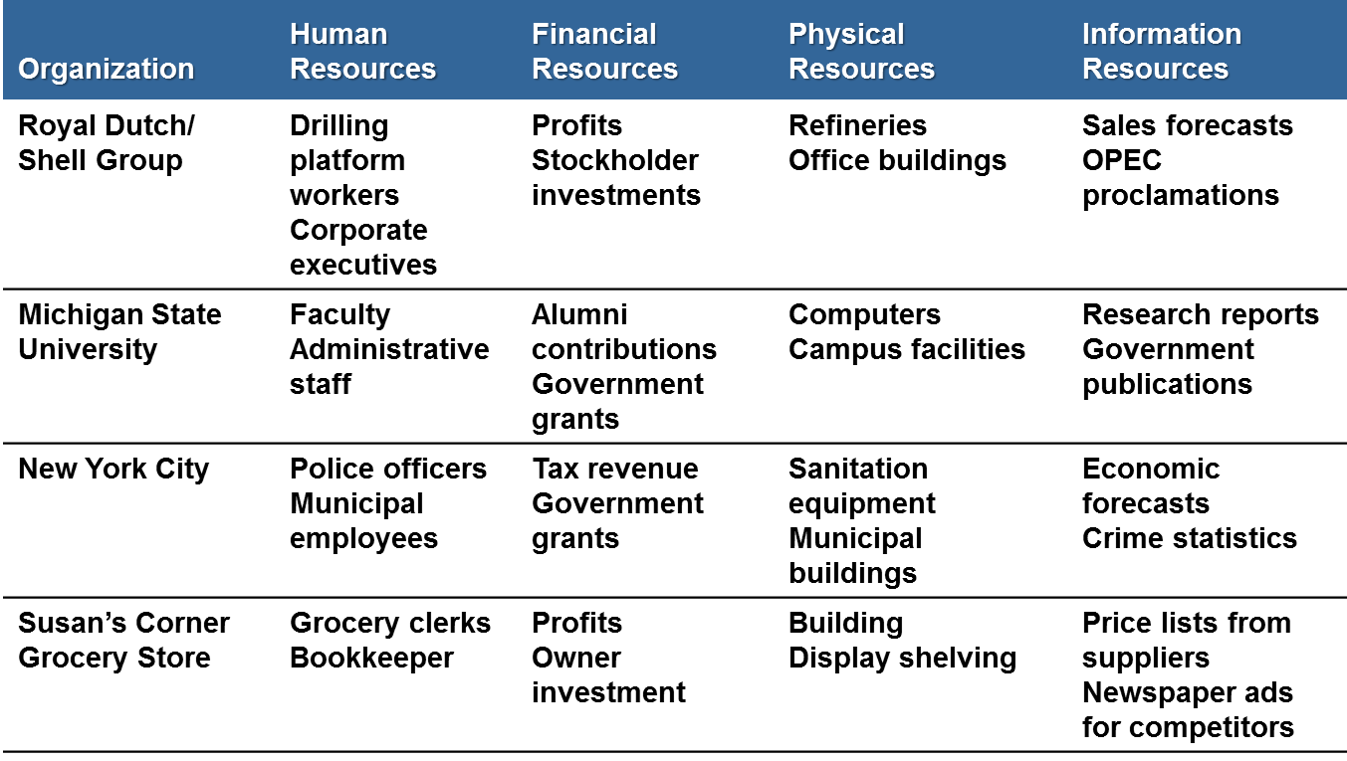
Examples of Resources Used by Organizations

Slide 7
How do Managers combine and co-ordinate the various kinds of resources?
Carrying out four basic Managerial functions/activities:
Planning and Decision Making
Organising
Leading
Controlling

Slide 8
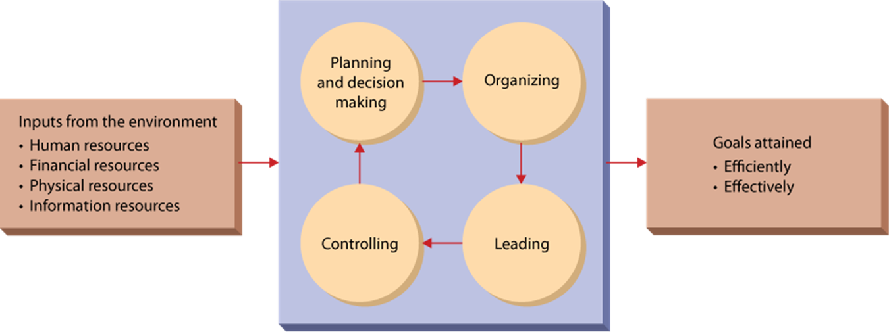
Management in Organisations

Slide 9
What is Management?
A set of activities
  planning and decision making, organizing, leading, and controlling
directed at an organization’s resources
  human, financial, physical, and information
with the aim of achieving organizational goals in an efficient and effective manner.

Slide 10
The Basic Purpose of Management
EFFICIENTLY
Using resources wisely and in a cost-effective way
And
EFFECTIVELY
Making the right decisions and
successfully implementing them

Slide 11
Management Processes
Planning
Defining Goals
Establishing Strategy
Developing Plans , to coordinate activities

Slide 12
Organizing
What tasks are to be done
Who is to do them
How the tasks are to be grouped
Who reports to whom
Where decisions are to be made

Slide 13
Leading
Motivating employees
Directing Activities of others
Selecting the most effective communication channel
Resolving conflicts

Slide 14
Controlling
The process of monitoring performance
Comparing it with Goals
Correcting any significant deviations

Slide 15
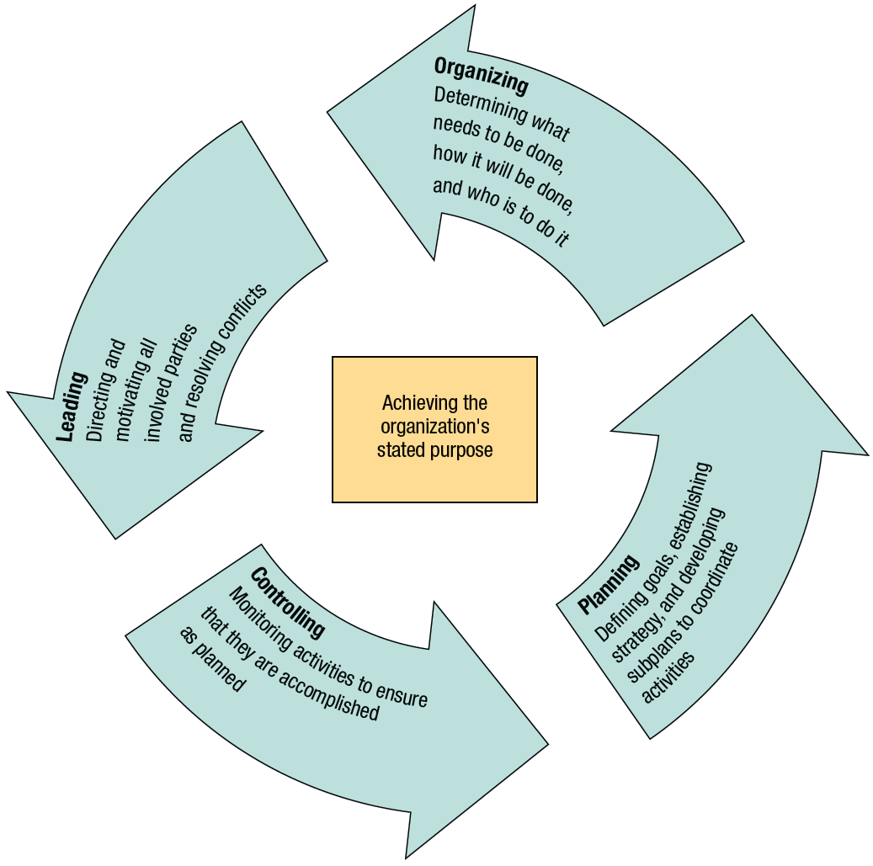
Management Process Activities

Slide 16
Who is a Manager?
Someone whose primary responsibility is to carry out the management process.
  Plans and makes decisions, organizes, leads, and controls human, financial, physical, and information resources

Slide 17
Kinds of Managers
Top Managers
Eg: President, Vice President ,Chief Executive Officer
Create Organisational goals, overall strategy and operating policies.
Middle Managers
Implementing the policies and plans developed by top management & supervising activities of lower level managers.
E.g: Plant Manager,Operations Manager,dvion Head.
First Level Managers
E.g:Supervisor,Office Manager
Supervise and coordinate the activities of operating employees.

Slide 18
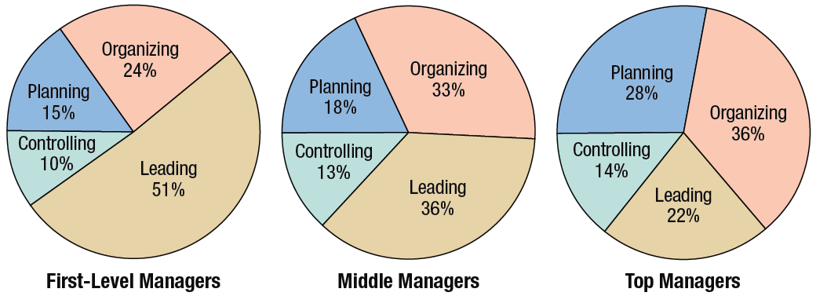
Distribution of Time per Activity by Organisational Level

Slide 19
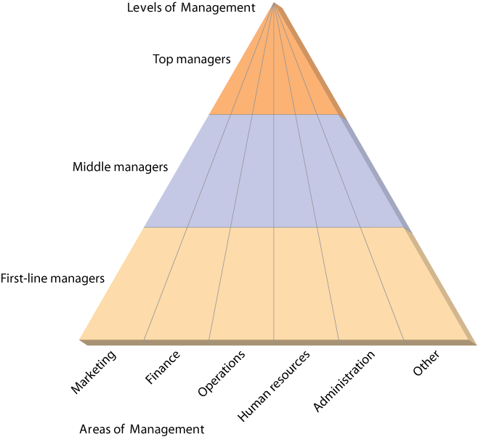
Kinds of Managers by Level and Area

Slide 20
Managerial Skills
Technical Skills
Interpersonal Skills
Conceptual Skills
Diagnostic Skills
Communication Skills
Decision Making Skills
Time Management Skills

Slide 21

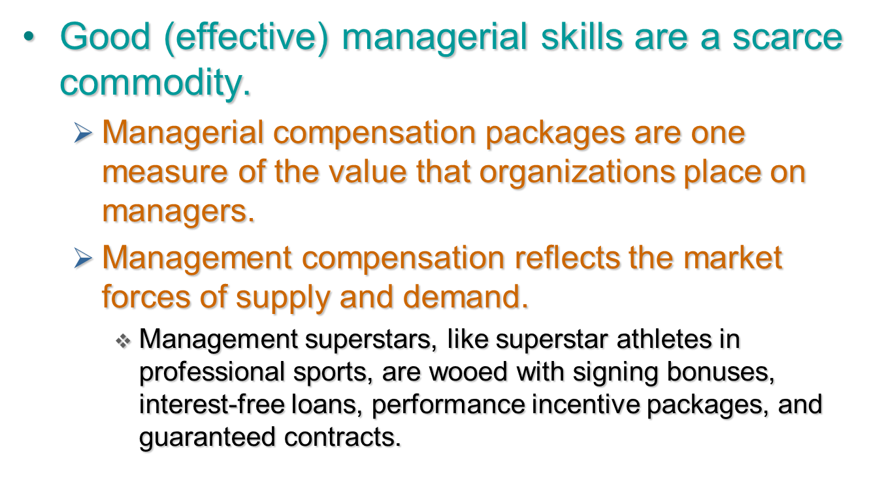

Slide 22
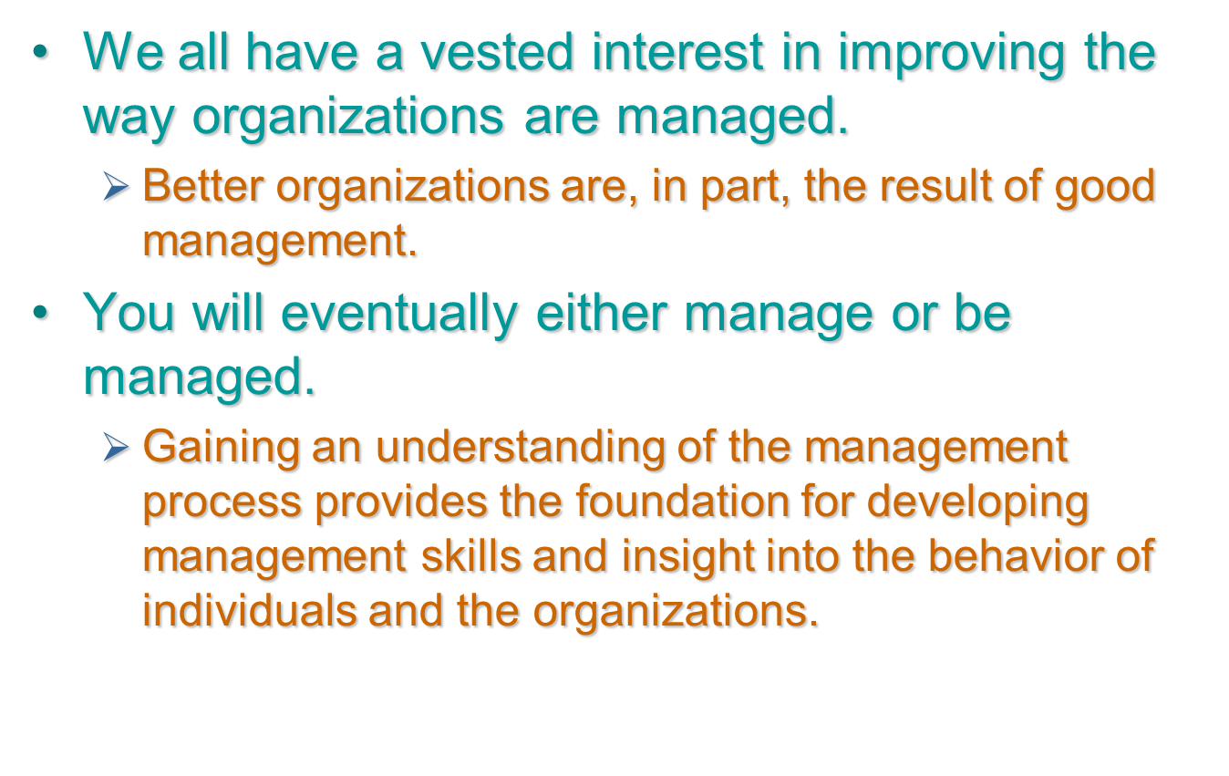
Why Study Management?

Slide 23
Managerial Skills and Expertise Required by engineers
Costing, estimating
Supervise others
Make formal presentations
Motivate others
Plan and schedule project
Plan and chair formal meetings
Evaluate projects
Analyse project risks
Plan and control budgets

Slide 24
Contd…
Project financing
Analyse corporate risks
Corporate (business) strategy
Plan design and development
Use of health & safety law
Negotiate contracts with client/customer
Negotiate with supplier/contractor
Negotiate with senior management
Plan personnel requirements
Recruit and select personnel
Appraise personnel

Slide 25
Thank you!

