Slide 1
Communications Engineering 1
Introduction to Telecommunications

Slide 2
Reference Text
B.P Lathi and Zhi Ding, Modern Digital and Analog Communications Systems, 4th edition, Oxford: Oxford University Press.

Slide 3
Telecommunications
One of the fastest-growing areas of technology in the world.
Rapid growth.
Businesses and individuals can access information at electronic speed from almost
anywhere in the world.
Businesses can provide better services and products to their customers.

Slide 4
Information
Information is created or used in every human and machine activity
Information is distributed or exchanged in communication
Information in a message is related (inversely) to the probability associated with it
  USA will attack Iraq tomorrow
  Iraq will attack USA tomorrow

Slide 5
Evolution and Milestones
Mid 1800s: the telegraph, whereby letters were translated into sounds manually, and vice-versa
1857: The Ceylon Telegraph Department is established
1858: The fist telegraph circuit established between Galle and Colombo
1864: James Clerk Maxwell predicts the existence of radio waves
1864: The International Telegraph Union founded, the precursor to today’s International Telecommunications Union (ITU)
1866: The first transatlantic telegraph cable is laid
1876: the telephone is invented
1877: first private line telephones installed for business use
1878 : First commercial telephone exchange opened with 21 subscribers
1879: National Bell Telephone Company formed in the US
1885: American Telephone and Telegraph Company (AT&T) is established in New York City

Slide 6
Evolution and Milestones
1886: Heinrich Rudolph Hertz demonstrates that rapid variations of electric current could
be projected into space in the form of radio waves similar to those of light and heat.
1897: Wireless telegraph is patented by Marconi
1891: The Strowger machine-switching system is patented
1898: Wireless telegraphic connection between England and France established
1901: Marconi successfully transmits radio signal across the Atlantic Ocean from Cornwall to Newfoundland
1902: First bidirectional communication across the Atlantic
1911: The Central Telegraph Office (CTO) building is opened in Colombo Fort
1914: First voice over radio transmission
1925: John Logie Baird demonstrated the transmission of moving pictures, and television was born
1924: Public broadcasting is inaugurated in Sri Lanka
1927: Public demonstration of TV transmission by wire
1932: The International Telegraph Union is renamed as The International Telecommunications Union (ITU)

Slide 7
Evolution and Milestones
1934 : Federal Communications Commission (FCC) created in the US for telecom regulation
1936 : First coaxial cable installed between New York and Philadelphia for multi-channel telephone systems
1940: Broad band carrier systems are introduced allowing for simultaneous calls over a single pair of wires
1945 : Arthur C. Clarke introduces the concept of using satellites for communications
1946: First commercial multi-channel high frequency microwave radiotelephone system introduced
1960 : Bell Laboratories demonstrates a transUS telephone call by bouncing signals off the moon
1948: First public demonstration of the transistor by Bell Telephone Laboratories
1949 : The ITU becomes a member of the United Nations family of organizations
1955 : Initial trial installation of an electronic switch
1956: First transatlantic cable goes into service with 36 channels between Newfoundland and Scotland
1962: world’s first international telecommunications satellite, Telstar is launched

Slide 8
Evolution and Milestones
1967: Bell Laboratories introduces a wireless telephone extension
1968: First computer network using packet switching is established at the Lawrence Livermore National Laboratory
1969: Bell Labs creates the UNIX operating system The first network, ARPANET linking four sites is established. ARPANET would become the technical core of the Internet
1973: Development of a common Internetwork Protocol
1973:The first “Mobile Phone” call by Motorola
1974: The term Internet is adopted
1975: Sri Lanka’s first satellite earth station is opened at Padukka
1976 : AT&T installs its first digital switch.
1978: Field trials of the first cellular system, AMPS
1980: International Direct Dialing (IDD) is established in Sri Lanka
1983: The fist cellular system goes into operation in the US.
1985: Sri Lanka subscribes to the SEA-ME-WE submarine cable
1986: First optical fiber cable is laid in Sri Lanka
1987: GSM, the first digital cellular system Standard is made available

Slide 9
Evolution and Milestones
1988 : The first transatlantic fiber optic cable is installed between USA and England/France with 40,000 channels
1988: The first cellular license is issued in Sri Lanka
1991: The first US digital cellular system introduced
1992 – US introduces the first CDMA-based digital cellular system introduced
1993 – The first digital mobile network is established in the U.S. The first web browser, Mosaic, is introduced.
1995 : 100 million cellular subscribers in the U.S. 30 million users on the Internet worldwide
1996: Email and Internet services established in Sri Lanka
1999: The Internet envelopes the business community as companies scramble to ensure that they are ready to
do business via this "World Wide Web".
The first release of UMTS (3G) standards is completed.
Sri Lanka Telecom installs the 500,000th telephone line in Sri Lanka

Slide 10
Evolution and Milestones
2000: World’s first 3G/UMTS call
2001: NTT DoCoMo launches the first commercial WCDMA 3G mobile network
2002: SK Telecom in Korea launches the world's first commercial CDMA2000 3G network
Mobilkom Austria launches Europe's First UMTS-Network
2003: Korean mobile operator KTF announced plans to begin transmitting TV direct to 3G mobile phones via the CDMA2000 system
2006: SLT installs 1 millionth telephone line in Sri Lanka

Slide 11
Current Trends
Your first individual mini project.

Slide 12
Basic Block Diagram of a Communication System.
Information Source
Channel
Receiver
Information
Destination
Transmitter

Slide 13
Basic Block Diagram of a Communication System.
Transmitter
Channel
Receiver
Source (transmitter) :
Generates the information to be communicated in the form of a signal
Different sources generate information with different characteristics
Source signals need to be analyzed

Slide 14
Signal Classifications
Continuous time/ Discrete time
Analog/ Digital
Periodic/ Aperiodic
Transient (Energy)/ Eternal (Power)
Deterministic/ Random
Odd/ Even
Explained on the board.

Slide 15
Frequency domain representation of signals.
Self Study: Revise signals and systems (Semester 3).

Slide 16
Basic Block Diagram of a Communication System.
Transmitter
Channel
Receiver
Channel or network
The conduit over which the information will be carried
Must be capable of carrying the information generated by the source
Causes loss of information in different ways
Need to analyze the information carrying capacity of channels
  It can be a pair of wires, a coaxial cable, an optical ﬁber, open air, etc.

Slide 17
Properties..
Channels may carry information
in one direction only (simplex)
e.g., radio, TV broadcasts
in both directions sequentially (half-duplex)
e.g., normal conversation
in both directions simultaneously (full-duplex)
e.g., data transfer between two computers

Slide 18
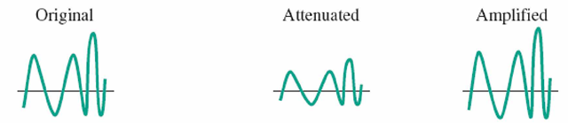
Channel Impairments
Attenuation: When a signal, simple or composite, travels through a medium, it loses some of its energy so that it can overcome the resistance of the medium. To compensate for this loss amplifiers are used to amplify (strengthen) the signal.
Distortion (Bandwidth limitations): Distortion is waveform perturbation caused by an imperfect channel response of a communication system.
Eg: Local loop in our telephone network is designed to carry frequencies from 0.3 to 3.4 kHz without significant distortion.

Slide 19
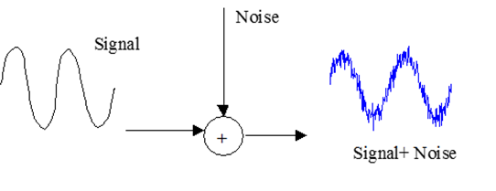
Channel Impairments
3. Interference: Interference is contamination by other signals from man-made sources, including other transmitters, power lines and machinery, switching circuits, etc.
4. Noise: Noise refers to random signals produced by natural processes both internal and external to a communication system.

Slide 20
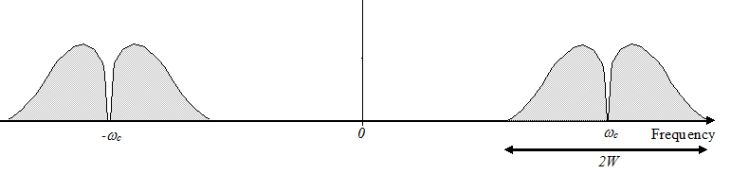
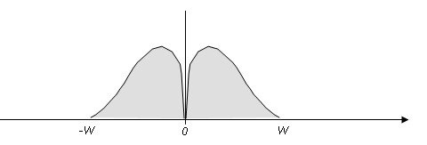
Bandwidth
  The difference between the highest and lowest frequencies that can be transmitted across a transmission medium
  Measured in Hertz (Hz)
  Passband bandwidth: Difference between the upper and lower cutoff frequencies
  Baseband bandwidth: Equal to its upper cutoff frequency
Bandwidth= 2W
Bandwidth= W

Slide 21
Basic Block Diagram of a Communication System.
Transmitter
Channel
Receiver
Destination (receiver)
Receives the information sent by the source
Loss of information may result in errors
The receiver may try in different ways to correct these errors

Slide 22
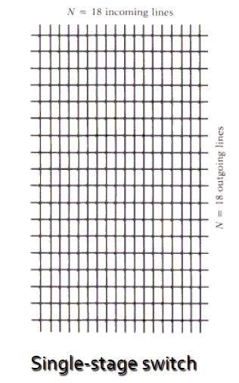
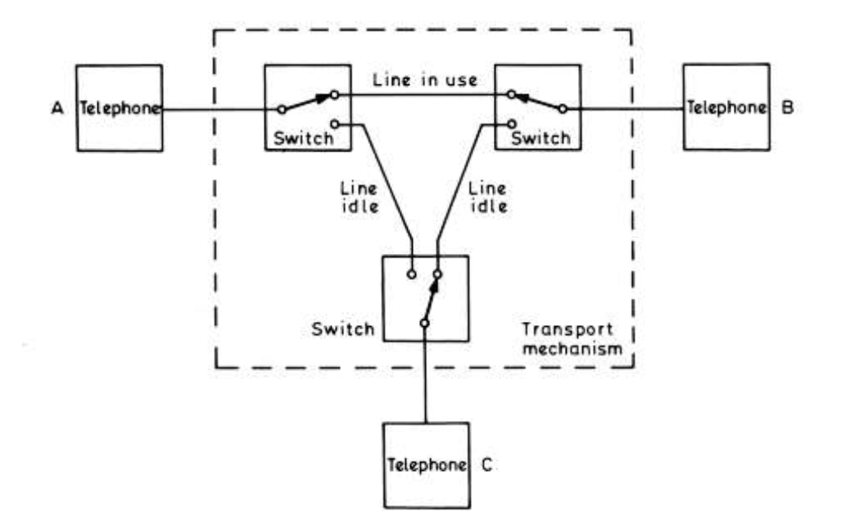
Circuit Switching Vs Packet Switching:
Circuit switching
Establishes an end-to-end connection
After circuit is set-up transmitted signals encounter no delays
Technique designed for real-time communication. E.g, voice

Slide 23
Circuit Switching Vs Packet Switching:
Circuit switching
What’s good
–No processing delay at nodes
–Real time communication
What’s bad
–Dedicated resources from end -to -end
–Equal bandwidth in both directions (symmetrical)
Charging is based on duration
The bad points above encouraged the development of packet switching technology

Slide 24
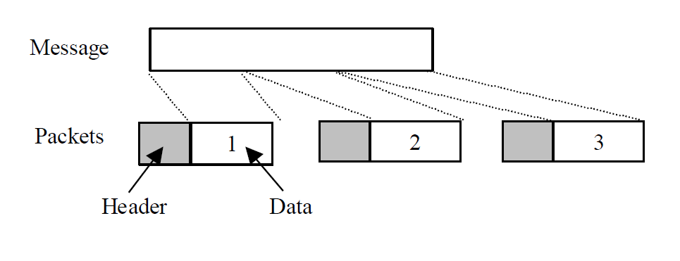
Circuit Switching Vs Packet Switching:
Packet switching
Data is packetized
Each packet has a destination address
Switches look at the address and switch packets
Each packet may take a different route
Non real-time data communication

Slide 25
Circuit Switching Vs Packet Switching:
Circuit switching
What’s good
No dedicated resource. Sharing.
Can have non-symmetrical channels.
What’s bad
Delay at intermediate nodes
Non real-time communication
Charging is based on volume of data transferred
Can have an always – on connection

Slide 26
References
B.P Lathi and Zhi Ding, Modern Digital and Analog Communications Systems, 4th edition, Oxford: Oxford University Press.
Notes on Elementary Concepts in Telecommunications, Prof. Dileeka Dias, Department of Electronic & Telecommunication Engineering, University of Moratuwa.

Slide 27
END

