Slide 1
EMPLOYEE HEALTH AND SAFETY

Slide 2
Your safety and health at work:
All employees must know their rights and responsibilities regarding their safety and health at work.
They should be aware of the general laws applicable to them.
All employees have entitlement to rest breaks and paid vacations
If you’re off sick from work and anxious about your job, you’ll find out practical information on what can be done
In the case of corporations that produce large items the health and safety at work for their staff may involve the right foot gear, shades, ear protectors and other protecting apparel
Safety and health at work for those employed by a legal company or accounting company would involve confidentiality, and cover against angry clients.
Health and safety at work for those in the medical field involves proper disposal of dangerous waste, ensuring to sterilize areas after patients have used them and consistent private cleanliness to avoid spreading contagions.

Slide 3
MANAGEMENT’S ROLE IN EMPLOYEE SAFETY
There are a number of strategies that can be used by organizations to ensure a healthy and safe workplace and ensure compliance with legal requirements. Some are:
Design
Safe and healthy systems of works
Exhibit
Strong management commitment
Inspect
Workplace for health and safety problems
Establish
Procedures and controls for dealing with health and safety issues

Slide 4
MANAGEMENT’S ROLE IN EMPLOYEE SAFETY(cont)
Develop
Training programs
Set up
Health and safety committees
Monitor
Safety policies
Draw up
Action plan and checklist

Slide 5
SUPERVISOR’S ROLE IN EMPLOYEE SAFETY
Supervisors Must:
Monitor their workplaces frequently to identify unsafe or unhealthful conditions
Take prompt action to correct hazardous conditions
If a serious hazard is detected take immediate interim action to safeguard
  employees
Encourage employees to report unsafe or unhealthful conditions
Seek suggestions from employees for improvement of workplace conditions
Investigate workplace accidents:
Investigate workplace mishaps and take prompt corrective action necessary to
  ensure the safety and health of employees
Institute actions to prevent recurrence of accidents

Slide 6
Ensure employees are adequately trained to perform the work safely:
Prior to permitting employees to work with machine tools, chemicals, powered machinery, electrical systems, lasers and other such equipment, or enter confined spaces, operate forklifts, work in elevated locations or perform similar hazardous work, they must receive specialized training. Contact the Safety Office to obtain the requirements for such training.
Inform employees of the procedures to follow in the event of an emergency
Inform employees of any unique hazards in the workplace and how to identify them
Inform employees of how to report unsafe or unhealthful conditions
Inform employees of actions to take in the event of a work-related injury
Maintain records of safety training provided, such as lesson plans, rosters, list of audio-visual and other materials used
Ensure that employees perform work in a safe manner:
Monitor employee behavior to ensure that work is being performed safely
Take prompt action to correct any unsafe or unhealthful actions or behavior.

Slide 7
RESPONSIBILITIES AND RIGHTS OF EMPLOYER AND EMPLOYEES
Employees must:
1. Work safely to protect them self and
others from injury and follow all OHS
instructions, for example:
Wear all personal protective equipment provided.
Follow safe work procedures.
2. Report any OHS issues, including hazards,
injuries, illnesses and near misses.
Employers must:
1. Properly orientate, train and supervise staff to ensure safe work practices are understood and followed by all employees.
2. Consult with all employees, including YW, about decisions that will affect safety in the workplace.
3. Provide suitable personal protective equipment (PPE) to make sure workers can do their job safely and train workers how to use PPE correctly.

Slide 8
WHAT CAUSES ACCIDENTS?
Unsafe Conditions and Unsafe Acts.
Unsafe conditions and other work related factors
Unsafe conditions are a main cause of accidents. They include thing like:
1) Improperly guarded equipment
2) Defective equipment
3) Hazardous procedures in, on , or around machines or equipment
4) Unsafe storage – congestion, overloading
5) Improper illumination – glare insufficient light.
6) Improper ventilation – insufficient air change, impure air source.
Unsafe conditions: The mechanical and physics accidents.

Slide 9
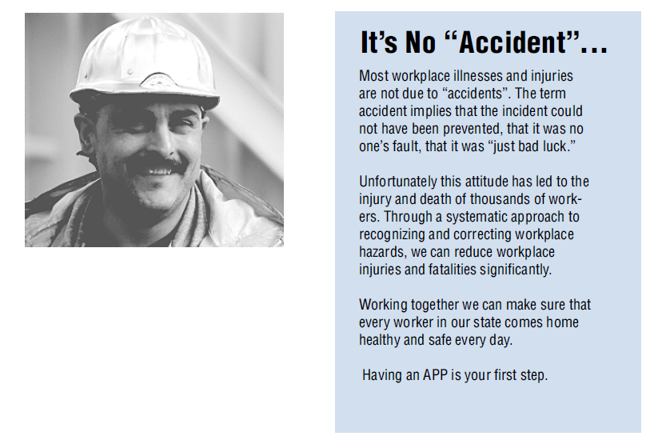
It’s No “Accident”

Slide 10
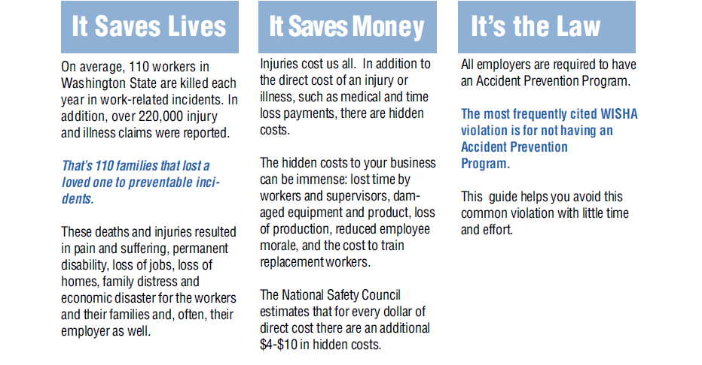
Having an Accident Prevention
Program is Good for Your Business

Slide 11
HOW TO PREVENT ACCIDENTS?
Improving Workplace Safety with the 10-Step Accident Prevention Plan
Written Safety & Health Policy
Orientation and Training
Timely Notification of Accidents:
Recordkeeping and Data Analysis
Safety and Health Program Coordination
Visible, Active Senior Management Leadership:
Employee Involvement and Recognition
Disability Management
Regular Communications
Timely Notification of Accidents

Slide 12
PROBLEMS AND REMEDIES
Typical workplace exposure hazards
Chemicals and other hazardous materials.
Excessive noise and vibrations.
Temperature extremes.
Biohazards including those that are normally occurring (such as mold) and manmade .
Ergonomics hazards such as poorly designed equipment that forces workers to do their jobs while contorted in unnatural positions.
And, the more familiar safety-related hazards such as slippery floors and blocked passageways.

Slide 13
PROBLEMS AND REMEDIES
Employers can take a number of steps to prevent the entry or spread of infectious diseases like SARS into their workplaces. These include:
Closely monitor government travel alerts. The government issues travel advisories (which recommend deferring nonessential travel) and travel alerts (which simply inform travelers of health concerns and provides precaution).
Provide a daily medical screenings for employees returning from SARS infected areas.
Deny access to your facility for 10 days to employees or visitors returning from affected areas, particularly those have had contact with suspected infected individuals
Tell employees to say home if they have a fever or respiratory system symptoms.
Clean work area and surfaces regularly.
Stagger breaks. Offer several lunch periods to reduce overcrowding.
Emphasize to employees the importance of frequent hand washing, and make sanitizers containing easily available throughout the workplace.

Slide 14
Thank you

