Slide 1
First Aid ON THE SHOP FLOOR

Slide 2
What is First Aid ?
The Encyclopaedia Britannica states First Aid as "measures to be taken immediately after an accident not with an idea to cure but in order to prevent further harm being done". It uses the available human and material resources at the site of accident to provide initial care to the victim of injury or sudden illness until more advance care is provided.
First Aid has the following main objectives:
(i) To preserve life
(ii) To prevent the victim's condition from worsening
(iii) To promote recovery

Slide 3
Goals of First Aid
2. To prevent further injury or deterioration.
3. To reassure the victim and make him or her as comfortable as possible.
1. To restore and maintain vital functions. The ABC of basic life support (Airway, Breathing, and Circulation) are always the first priority.
● Airway must be open so that air containing oxygen enters the body
● Breathing must take place so that oxygen passes through the lungs into the blood stream
● The heart must circulate the oxygen carrying blood

Slide 4
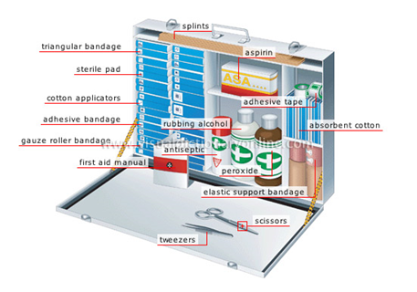
First Aid Kit
Following are the contents of a First Aid Kit :
Cotton wool
Adhesive tape
Crepe bandage
Sterile Dressing
Bandage
Thermometer
Scissors
Glove
Soap
Pain reliever
Antacid

Slide 5
Action Plan
This Action Plan is a vital aid to the first aider in assessing whether the victim has any life-threatening conditions and if any immediate first aid is necessary. They are DRABC .
D - Check for DANGER
To you
To others
To victim
R - Check RESPONSE
Is victim conscious?
Is victim unconscious?

Slide 6
A - Check AIRWAY
Is airway clear of objects?
Is airway open?
B - Check for BREATHING
Is chest rising and falling?
Can you hear victim's breathing?
Can you feel the breath on your cheek?
C - Check for CIRCULATION
Can you feel a pulse?
Can you see any obvious signs of life?

Slide 7
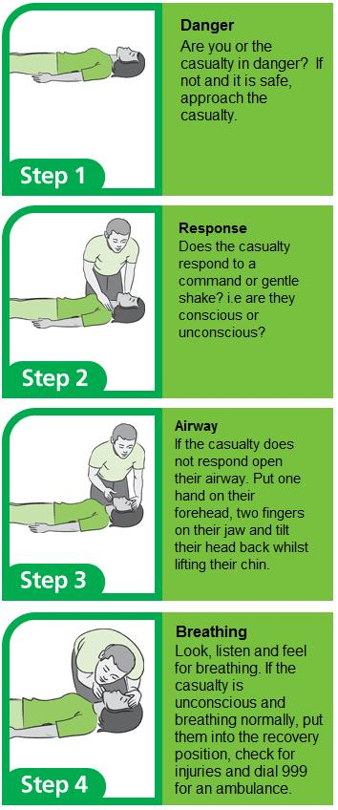

Slide 8
Fainting or losing consciousness
Fainting is a brief loss of consciousness and is the result of an interference with the function of the brain. There are many causes of unconsciousness, the most common of which are: fainting, head injury, epilepsy, stroke, poisoning, diabetes and conditions associated with lack of oxygen. If you have seen a person fainting then:
Don’ts :
Don’t give the patient anything to eat or drink
Don’t allow the person who has just fainted to get up until the victim is fully conscious
If the area is warm, don’t crowd around the victim

Slide 9
Do’s :
Catch the person before he/she falls
Pinch the person and see if she moves or opens her eyes
Examine the injuries and causes of unconsciousness
Tilt head back and keep arms at right angle to body
Raise the legs 8 – 12 inches. This promotes blood flow to the brain.
Loosen any tight clothing
Keep the victim warm if it is cold outside
Keep a record of the casualty’s condition

Slide 10
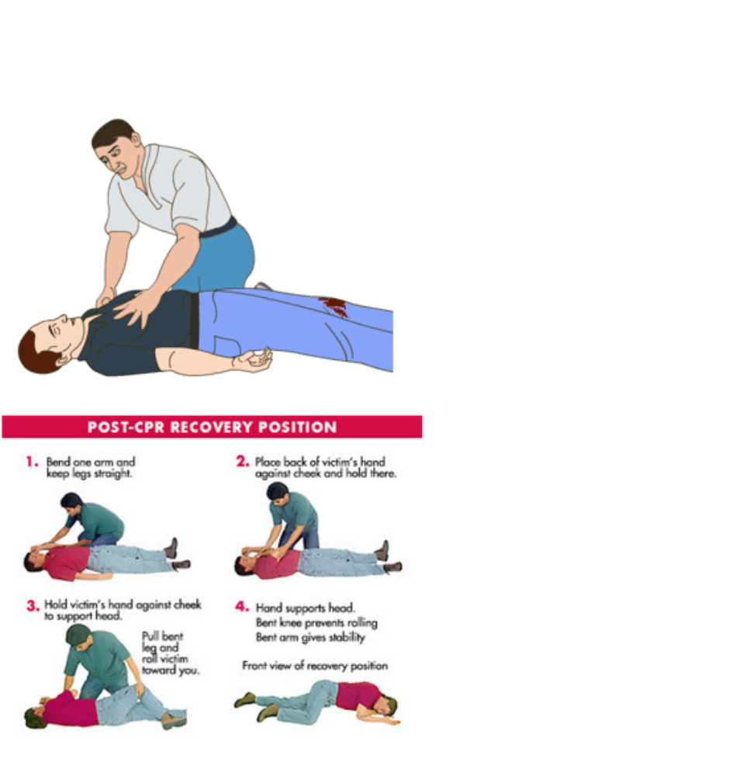
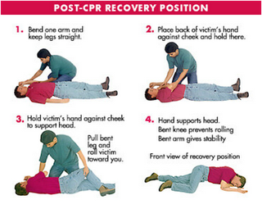

Slide 11
Burns
A burn is damage to the skin caused by contact with dry heat. It may be caused by fire, flames, steam, hot liquids, hot metal, sunlight, electricity or chemicals. The degree of burn varies:
(i) First Degree (Superficial) - Involves only top layer of the skin and is red and dry and the burn is generally painful. The area may swell. Most burns are first degree burns.
(ii) Second degree (Partial - Thickness) - Involves both the epidermis and dermis. The area is red and blisters may open and weep fluid, making the skin appear wet. These types of burns are usually painful and the area often swells.
(iii) Third Degree (Full Thickness) - Destroys both the layers of the skin with muscles, bones, blood vessels and nerves. These burns may look brown or charred with tissues underneath sometimes appearing white.

Slide 12
Do’s :
Immediately immerse the burnt area in cool water or by applying clothes soaked in cool water.
Remove jewellery and constrictive clothing before swelling or blisters occurs.
Cover the area with a dry, sterile dressing and not cotton or other fluffy material.
Drop, Cover and Roll if caught fire or cover the person with a blanket immediately
Don’ts :
Don’t place a burn under extreme water pressure
Don’t remove the cloth that is stuck to the burnt area.
Don’t apply butter ointment, oil, ice in the area affected

Slide 13
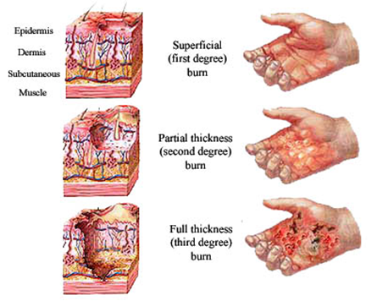
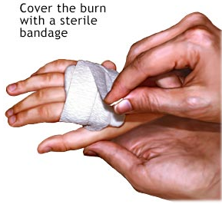

Slide 14

Bleeding
Cuts, scrapes and puncture can result in bleeding. Severe bleeding can be life threatening. To stop bleeding restore to:
Direct pressure
Elevation - Lie victim down and raise the injured part above the heart and handle gently if you suspect a fracture.
The blood gets thicker after bleeding for a few minutes. This is called clotting. Clotting slows down bleeding. Bandaging is done to stop bleeding and to stop dirt infecting the wound. Change the bandage at least once a day and tetanus injection needs to be taken if required.

Slide 15
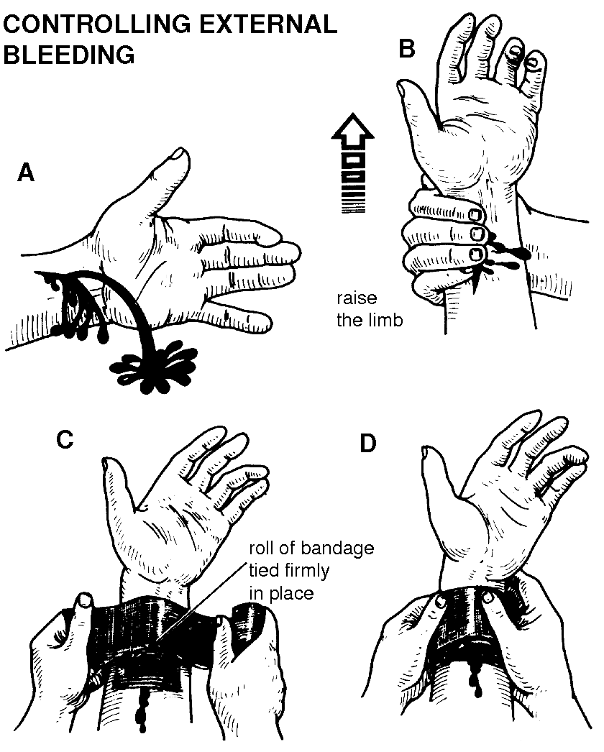
Warning :
❑ If bleeding from a limb doesn’t stop, apply pressure with hand to pressure point.
❑ If embedded object in wound, apply pressure either side of wound and place pad around it before bandaging.
❑ Wear gloves, if possible to guard against infection
❑ If the victim becomes unconscious, follow DRABC

Slide 16

Electrocution
Electricity can be very dangerous unless used with care. When an accident occurs with electricity, the First Aider must remember that it is not safe to touch the casualty until the power has been turned off.
The signs and symptoms include surface and internal burns and breathing and heart beat stopped. The best way to treat the person electrocuted is to cut off the power supply and remove the victim from the source with non-conductive material.
Carry out the DRABC exercise and cover the area affected with clean dressing and send him/her to the hospital immediately if necessary.

Slide 17

Fractures and Sprains
Fracture refers to an injury affecting the skeleton and can be caused by the application of direct and indirect force. The general signs and symptoms are:
★ Pain at or near the site of injury increased by movement.
★ Movement may be difficult or impossible
★ Swelling and later bruising of the injured part
★ Deformity at the site of the fracture
★ Shock may occur

Slide 18
Do’s :
★ Check the danger, response, airway, breathing and the blood circulation of the victim (DRABC)
★ Always control severe bleeding before immobilizing any fractures
★ Place sufficient padding to support fracture site
★ Immobilize fracture sites
★ Do not force bones back into the wound
★ Give proper padding before the patient is shifted to the hospital
★ Apply ice pack on the affected area to reduce pain and control swelling
★ Treat to prevent shock

Slide 19
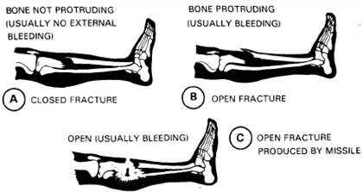
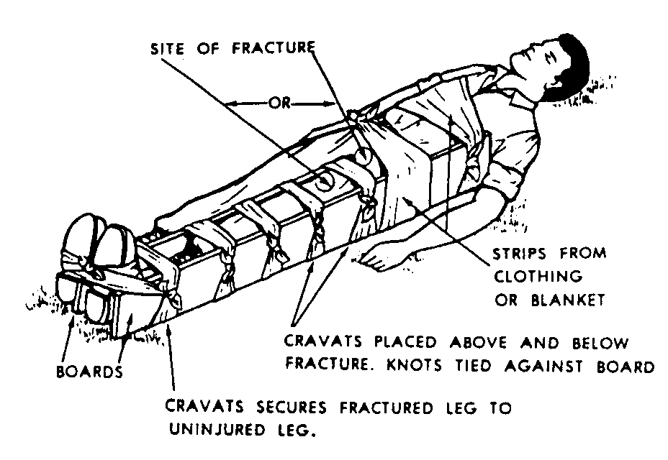
Types of Fractures

Slide 20

Poisoning
Poisoning is any substance that causes injury, illness or death when introduced into the body. There are different types of poisoning:
Ingested poisons are introduced through the mouth by eating or drinking poisonous substances.
Inhaled poisons are introduced through the lungs by inhaling industrial gases, fumes from fire, chemical vapors and petrol and engine exhaust.
Absorbed poisons are absorbed through the skin via contact with poisonous sprays such as pesticides and insecticides.

Slide 21
Do’s :
Check the danger, response, airway, breathing and the blood circulation of the victim
Give milk or water to dilute down the poison
Monitor vital signs and prevent shock
Observe the amount and color of vomitus
Check for foreign matter in his or her mouth and remove it so that he/she can breath freely
Place the patient in the recovery position and wait for medical assistance.
Send to hospital
Don’ts :
Don’t induce vomiting.

Slide 22
Heat Stroke
It strikes suddenly with very little warning. When the body's cooling system fails, the body temperature rises fast. This creates an emergency condition.
The signs are: the temperature of the body is very high, hot and dry. The skin is red with no sweating and fast pulse rate, dilated pupils, confusion and sometimes there might be loss of consciousness.
Do’s :
Lower the body temperature by removing/loosing the clothing or fanning the person.
Put ice pack or cold compresses to the neck, under the armpits and to the groin area.
Drink lots of fluid and those who perspire more should drink as much fluid as possible.
Stay away from places that are hot.

Slide 23
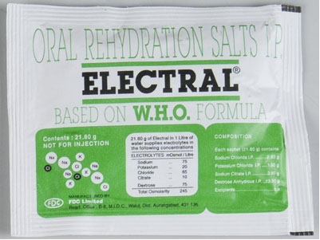
Oral Rehydration Solution (ORS)
ORS has been a lifesaver in case of dehydration (loss of salt and water in the body). ORS is prepared by dissolving a pinch of salt in a glass of water (the amount of salt added should just be enough for the water to taste like tear drops) and one tablespoon of sugar to it. ORS helps in restoring back the electrolyte balance of our body and re-hydrate it.

