Slide 1
ET 2006 : Data Structures & Algorithms
Lecture 4: Sorting & Complexity Analysis
Malaka Walpola

Slide 2
Outline
Simple Sorting Algorithms
  Insertion Sort
  Bubble Sort
  Selection Sort
Analyzing Algorithms
  Analysis of Insertion Sort
Asymptotic Notation
Analysis of Bubble Sort
Analysis of Selection Sort

Slide 3
Learning Outcomes
After successfully studying contents covered in this lecture, students should be able to,
  explain the insertion sort, bubble sort & selection sort algorithms
  explain the major factors considered for analyzing algorithms
  explain the use of asymptotic analysis to examine the growth of functions
  express the time & space complexity of simple (non recursive) algorithms using asymptotic notation

Slide 4
Simple Sorting Algorithms

Slide 5
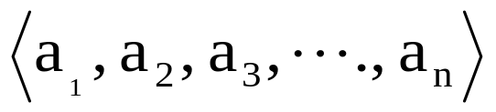
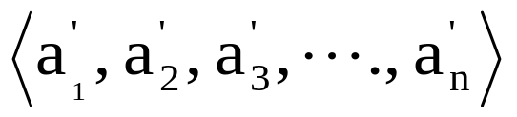
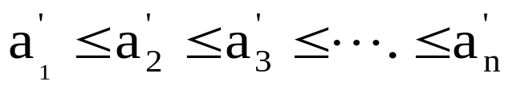
The Sorting Problem
Input:
  A sequence of n numbers
Output:
  A permutation (ordering) of the input sequence such that
A More General Version
  Input:
  Output:
  *Source [1]

Slide 6
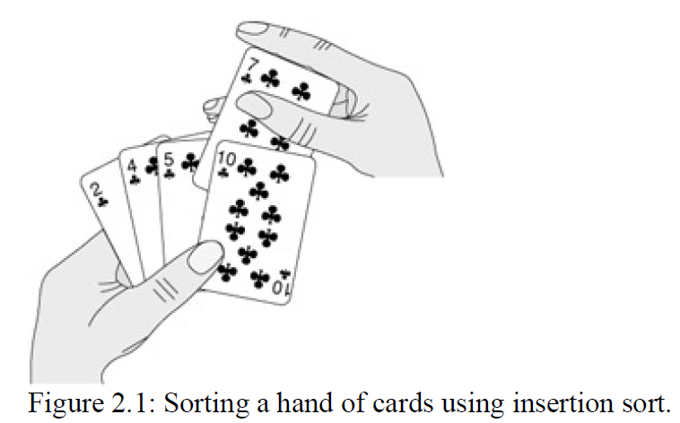
Insertion Sort
Suitable for Sorting Small Number of Elements
The Idea
  Remove an element from input and insert it in proper location
  Image taken from [1]

Slide 7
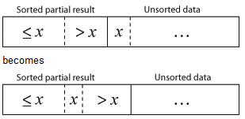
Insertion Sort
The Idea
  Image taken from [3]

Slide 8
The Algorithm
INSERTION-SORT(A)
for j = 1 to A.length-1
key = A[j]
//Insert A[j] into the sorted sequence A[0, 1, ……, j-1].
i = j-1
while i > -1 and A[i] > key
A[i+1] = A[i]
i = i-1
A[i+1] = key

Slide 9
Bubble Sort
The Idea:
  Bubble up the largest(smallest) element to the bottom(top) of the list in each iteration
  Repeatedly step through the list
    Compare each pair of adjacent items
    Swap them if they are in the wrong order
    Repeated until no swaps are needed, which indicates that the list is sorted

Slide 10
The Algorithm
BUBBLE-SORT(A)
do
swapped = false
for i = 1 to A.length-1
if A[i-1] > A[i]
temp = A[i]
A[i] = A[i-1]
A[i-1] = temp
swapped = true
while swapped

Slide 11
Selection Sort
The Idea:
  Progression
    First select the smallest element in the list and swap it with L[0]
    Next select the second-smallest element and swap it with L[1]
    Continue…; finally select the second-largest element, swap it with L[n-2], leaving the largest element at L[n-1]
    List L[ ] is now sorted in ascending order
  Repeatedly step through the list
    Select (i+1)^{th} smallest element and swap it with item in index i

Slide 12
The Algorithm
SELECTION-SORT(A)
for i = 0 to A.length-1
//Select (i+1)th smallest element
int minJ = i;
for j = i+1 to A.length-1
//if this element is less, then it’s the new min
if (A[j] < A[minJ])
minJ = j;
//swap (i+1)th smallest element with element in index i
if(minJ != i)
int temp = A[minJ])
A[minJ] = a[i])
a[i] = temp

Slide 13
Analyzing Algorithms

Slide 14
Analyzing Algorithms
What are the factors that affect the running time of a program?
  The processing
  CPU speed
  Memory
  Size of input data set
  Nature of input data set

Slide 15
Analyzing Algorithms
Factors to Consider
  Speed/Amount of work done/Efficiency
  Space efficiency/ Amount of memory used
  Simplicity
We want an analysis that does not depend on
  CPU speed
  Memory

Slide 16
Analyzing Algorithms
Why?
  We want to have a hardware independent analysis
Thus, we use Asymptotic Analysis
  Ignore machine dependant constants
  Look at the growth of the running time
    Running time of an algorithm as a function of input size n for large n
  Written using Asymptotic Notation

Slide 17
Analyzing Algorithms
Kinds of Analysis
  Worst-case: (usually)
  Average-case: (sometimes)
    Need assumption of statistical distribution of inputs.
  Best-case: (bogus?)

Slide 18
Analysis of Insertion Sort
Code | Cost | Times
INSERTION-SORT(A)
1. for j = 1 to A.length-1
2. key = A[j]
3. //…………
4. i = j-1
5. while i > -1 and A[i] > key
6. A[i+1] = A[i]
7. i = i-1
8. A[i+1] = key
n = A.length
t_{j} = the number of times the while loop test in line 5 is executed

Slide 19


Analysis of Insertion Sort
Code | Cost | Times
INSERTION-SORT(A) | ---- | ---
1. for j = 1 to A.length-1 | C₁ | n
2. key = A[j] | C₂ | n-1
3. //………… | 0 | n-1
4. i = j-1 | C₄ | n-1
5. while i > -1 and A[i] > key | C₅
6. A[i+1] = A[i] | C₆
7. i = i-1 | C₇
8. A[i+1] = key | C₈ | n-1
n = A.length
t_{j} = the number of times the while loop test in line 5 is executed

Slide 20
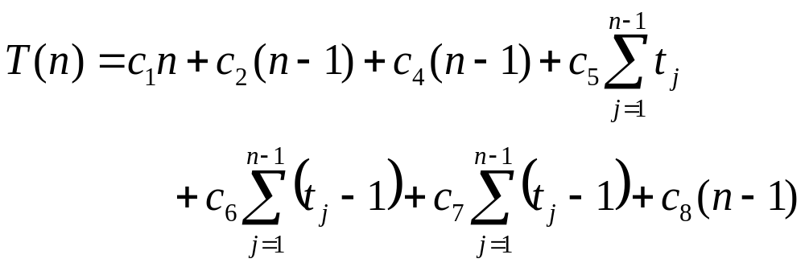
Analysis of Insertion Sort
Best Case – Sorted Array
  t_{j} = 1 for j=2, 3, ……, n

Slide 21
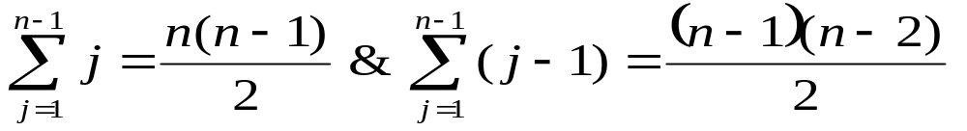
Analysis of Insertion Sort
Worst Case – Reverse Sorted Array
  t_{j} = j for j=2, 3, ……, n

Slide 22
Asymptotic Notation
Θ-Notation
  Asymptotically tight bound
  Θ(g(n)) = {f(n) : there exist positive constants c₁, c₂, and n₀ such that 0 ≤ c₁g(n) ≤ f(n) ≤ c₂g(n) for all n ≥ n₀}

Slide 23
Asymptotic Notation
O-Notation
  Asymptotic upper bound
  O(g(n)) = {f(n) : there exist positive constants c, and n₀ such that 0 ≤ f(n) ≤ cg(n) for all n ≥ n₀}
A General Guideline
  Ignore lower order terms
  Ignore leading constants

Slide 24
The O Notation - Examples
f(x) = 3x
g(x) = x
C = 3, N =0
f(x) ≤ 3*g(x)
f(x) = 4+7x
g(x) = x
C = 8, N =4
f(x) ≤ 8*g(x)
8*g(x)
f(x) = 4+7x
f(x) = 3x = 3g(x)
g(x) = x
g(x) = x
N
3x = O(x)
4+7x = O(x)

Slide 25
The O Notation - Exercises
f(x) = x+100x²
g(x) = x²
Show that
f(x) = O(g(x))
f(x) = 20+x+5x²+8x³
g(x) = x³
Show that
f(x) = O(g(x))

Slide 26
The θ Notation - Examples
f(x) = 3x
g(x) = x
C₁ = 1, N =0, C₂ = 3
Show
g(x) ≤ f(x) ≤ 3*g(x)
g(x) = x < f(x)
f(x) = 3x = 3g(x)
Therefore
f(x) = 3x = θ(x) = θ(g(x))
f(x) = 4+7x
g(x) = x
C₁ = 7, N =4, C₂ = 8
Show
7*g(x) ≤ f(x) ≤ 8*g(x)
7*g(x) = 7x < f(x)
f(x) = 7x+4 ≤ 8x (when x≥4)
Therefore
f(x) = 7x+4 = θ(x) = θ(g(x))

Slide 27
The θ Notation - Exercises
f(x) = x+100x²
g(x) = x²
Show that
f(x) = θ(g(x))
f(x) = 20+x+5x²+8x³
g(x) = x³
Show that
f(x) = θ(g(x))

Slide 28
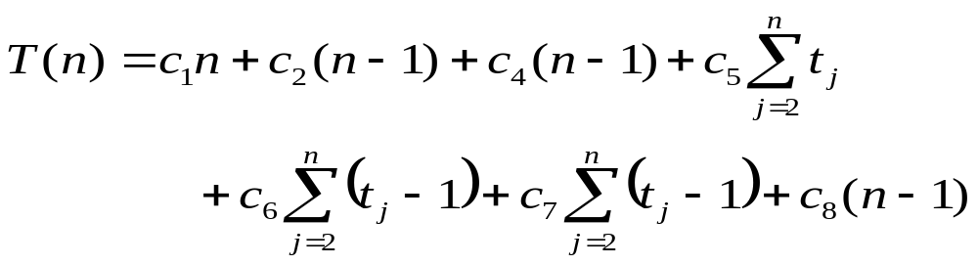
Asymptotic Notation
Example
Macro Substitution
  Convention: A set in a formula represents an anonymous function in the set
  f(n) = n³ + O(n²)
    f(n) = n³ + h(n) for some h(n) ∈ O(n²)

Slide 29
Asymptotic Notation
O-Notation
  May or may not be asymptotically tight
Other Notations (Self-Study)
  Ω-notation
    Asymptotic lower bound
    May or may not be asymptotically tight
  o-notation
    Asymptotic upper bound (Not asymptotically tight)
  ω-notation
    Asymptotic lower bound (Not asymptotically tight)

Slide 30
Analysis of Bubble Sort
Code | Cost | Times
BUBBLE-SORT(A)
do
2. swapped ← false
3. for i = 1 to A.length
4. if A[i-1] > A[i]
5. temp ← A[i]
6. A[i] ← A[i-1]
7. A[i-1] ← temp
8. swapped ← true
9. while swapped

Slide 31
Analysis of Selection Sort
Code | Cost | Times
SELECTION-SORT(A)
for i = 0 to A.length-1
2. //Select (i+1)th smallest element
3. int minJ = i;
4. for j = i+1 to A.length-1
5. //if this element is less, then it’s the new min
6. if (A[j] < A[minJ])
7. minJ = j

Slide 32
Analysis of Selection Sort
Code | Cost | Times
SELECTION-SORT(A)
8. //swap (i+1)th smallest element with element in index I
9. if(minJ != i)
10. int temp = A[minJ])
11. A[minJ] = A[i])
12. A[i] = temp

Slide 33
Homework
  Study the Ω, o and ω asymptotic notations
  What are the relationships between the Θ, O, Ω, o and ω notations?
Reading Assignment
  IA –Sections 3.1 (Asymptotic Notation)

Slide 34
References
[1] T.H. Cormen, C.E. Leiserson, R.L. Rivest and C. Stein, Introduction to Algorithms, 3rd Ed. Cambridge, MA, MIT Press, 2009.
[2] S. Baase and Allen Van Gelder, Computer Algorithms: Introduction to Design and Analysis, 3rd Ed. Delhi, India, Pearson Education, 2000.
[3] Lecture slides from Prof. Erik Demaine of MIT, available at http://dspace.mit.edu/bitstream/handle/1721.1/37150/6-046JFall-2004/NR/rdonlyres/Electrical-Engineering-and-Computer-Science/6-046JFall-2004/B3727FC3-625D-4FE3-A422-56F7F07E9787/0/lecture_01.pdf

