Slide 1
ET 2006 : Data Structures & Algorithms
Lecture 2: Algorithm Design Techniques – Recursion, Divide and Conquer Approaches
Malaka Walpola

Slide 2
Outline
Recursion
Divide & Conquer Approach
Solving Sample Problems

Slide 3
Learning Outcomes
After successfully studying contents covered in this lecture, students should be able to,
  explain and develop recursive algorithms
  explain the divide & conquer algorithm design technique
  solve simple computational problems using recursion and divide & conquer approaches

Slide 4
Recursion
Solving large/complex problems
  Important to think of the solutions at a higher level of abstraction
  Common solutions that we can re-apply to many related problems
    E.g., if we have a solution to sort a list of integers, we should be able to use a similar solution to sort a list of floating point numbers without having to “re-invent the wheel”An algorithm or function that calls itself directly or indirectly to solve a smaller version of its task is recursive

Slide 5
Recursion
An algorithm or function that calls itself directly or indirectly to solve a smaller version of its task is recursive
Recursion occurs until a final call which does not require further recursion
  Terminating condition(s)

Slide 6
Recursion – Sample Problems
Example Recursive Solutions
  Factorial
  Searching in a Linked List
  Creating a long string by duplicating a string several times
  Searching in an array
  Checking whether a given string is a palindrome

Slide 7
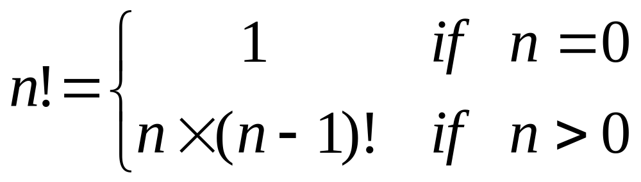
Recursion – Sample Problems
Factorial – n!
  n! = n X (n-1) X (n-2) X … X 3 X 2 X 1
  0! = 1 by definition
  Write the pseudocode of the program to calculate factorial using above definition
  Can write a recursive definition

Slide 8
Recursion – Sample Problems
Factorial using recursive definition
    int factorial (int n){
    if (n==0)
    return 1;
    else
    return n * factorial(n-1);
    }

Slide 9
Recursion Tree
A convenient way to visualize what happens during recursion
n!
n
*
(n-1)!
Build solution: bottom to top
n-1
*
(n-2)!
n-2
*
1
Terminating condition
*
0!

Slide 10
Recursion Tree
120
5!
24
5
*
4!
Build solution: bottom to top
6
4
*
3!
2
3
*
2!
1
2
*
1!
1
1
*
0!

Slide 11
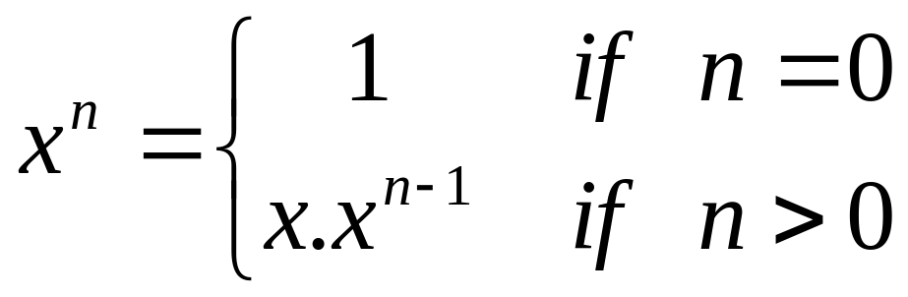
Recursion – Sample Problems
Compute the n^{th} power of a number (x) – x^{n}
  x^{n} = x.x.x.x.x……..x – n times
  Write a program to calculate x^{n}
  Recursive definition
    Write a recursive program
    How many recursive calls will be there?

Slide 12
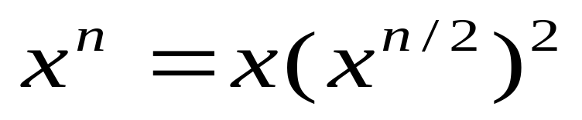
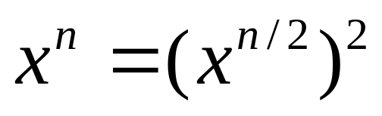
Recursion – Sample Problems
Compute the n^{th} power of a number (x) – x^{n}
  A better recursive definition
    When n is odd
    When n is even
    Write a recursive program
    How many recursive calls will be there?

Slide 13
Recursion – Sample Problems
  Searching in a linked list
  Write a recursive program to search for an item in a linked list
Creating a long string by duplicating a string several times
  public string duplicate (String s, int n)
    Returns a string consisting of ‘s’ repeated ‘n’ times
  e.g. duplicate(“abc”, 4) returns “abcabcabcabc”

Slide 14
Divide & Conquer Approach
Approach is Based on Recursion
Strategy
  Divide: Divide a given problem into smaller sub-problems that are similar to original problem
  Conquer: Solve a subset of sub-problem recursively
  Combine: Combine the solutions to sub-problems to get the solution to the original problem

Slide 15
Divide & Conquer Approach
Examples
  Binary search
  Depth-first tree traversals
  Merge sort
  Quick sort

Slide 16
Solving Problems
  Searching in an array
    Recursive approach
    Divide and conquer approach
Checking whether a given string is a palindrome
  Palindrome is a string that would read the same from left to write and write to left

Slide 17
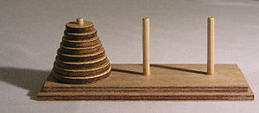
Solving Problems
  Towers of Hanoi
    Initial Setup:
      The game uses three rods
      A number of disks (n disks) is stacked in decreasing order from the bottom to the top of one rod
      The largest disk at the bottom and the smallest one on top
      The disks build a conical tower
    Objective:
      Move all the disks from one rod to another
    Rules:
      Only one disk may be moved at a time
      Only the uppermost disk from one of the rods can be moved in a move
      It can be put on another rod, if this rod is empty or if the uppermost disk of this rod is larger than the one which is moved

Slide 18
Solving Problems
  Erasing an object
    A black and white image is represented using a 2D-array
      1 for places where we have a black dot (pixel)
      0 for places where we have white dots
    An object in an image is the black dots that are connected to each other horizontally or vertically

Slide 19
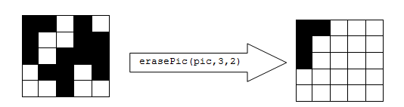
Solving Problems
  Erasing an object
    Write a function that would be able to erase all the dots that belong to one object

Slide 20
References
[1] T.H. Cormen, C.E. Leiserson, R.L. Rivest and C. Stein, Introduction to Algorithms, 3rd Ed. Cambridge, MA, MIT Press, 2009.
[2] S. Baase and Allen Van Gelder, Computer Algorithms: Introduction to Design and Analysis, 3rd Ed. Delhi, India, Pearson Education, 2000.
[3] Lecture slides from Prof. Erik Demaine of MIT, available at http://dspace.mit.edu/bitstream/handle/1721.1/37150/6-046JFall-2004/NR/rdonlyres/Electrical-Engineering-and-Computer-Science/6-046JFall-2004/B3727FC3-625D-4FE3-A422-56F7F07E9787/0/lecture_01.pdf

