Slide 1
Communications Engineering 1
Digital communication systems

Slide 2
Why Digital?
Noise and distortion immunity
More privacy and security due to encryption
Easier error detection techniques can be used, and correction as well.
Easy for processing and applying multiplexing techniques.
Lower cost.
Transmission rate can be changed easily.
Digital hardware implementation is flexible and permits the use of micrprocessors, digital switching elements and layer scale.

Slide 3
The Full Picture
Analog Signal
Sampling
Quantizing
Encoding
Transmitting
Modulating

Slide 4
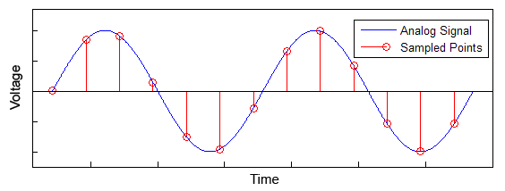
Sampling
The continuous time signal is converted to a discrete time signal.
Sampling frequency is selected according to the Nyquist’s sampling theorem.
Nyquist’s Sampling Theorem:
A signal whose spectrum is bandlimited to B Hz can be reconstructed without any error from its discrete time samples taken uniformly at a rate of R samples per second if R ≥ 2B.
If sampling is done below the Nyquist’s frequency, the signal will not be faithfully reconstructed at the receiver. This is called Aliasing.

Slide 5
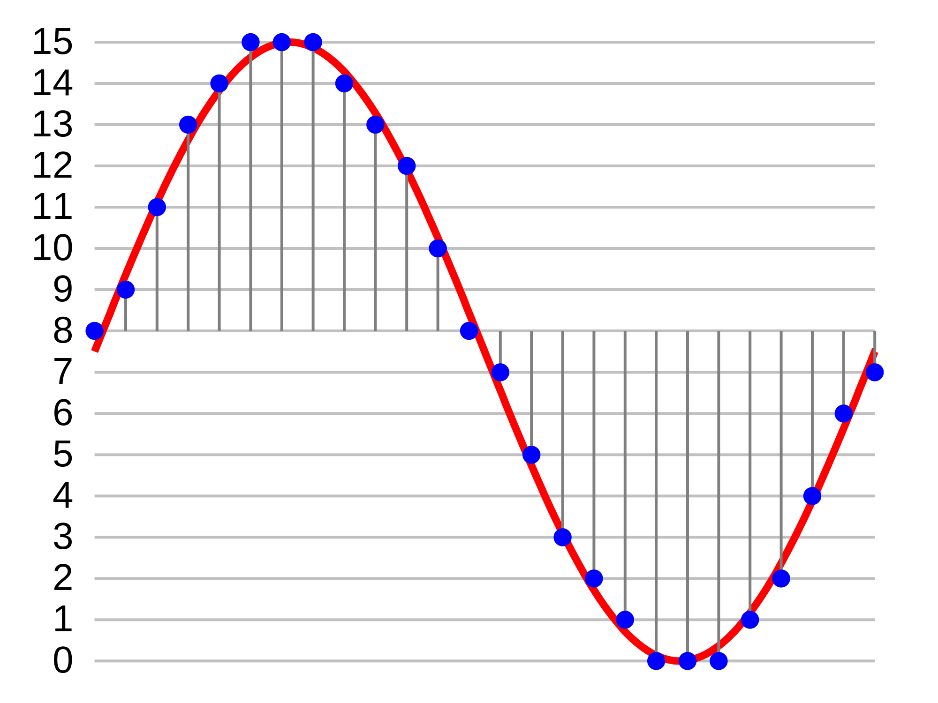
Quantizing
Each sample is approximated by one of several discrete levels.
This converts the signal to a digital signal.
Clearly the closer the spacing of the discrete amplitude levels, the better the approximation to the original signal
The difference between the original signal and the discretised signal is called quantisation noise

Slide 6
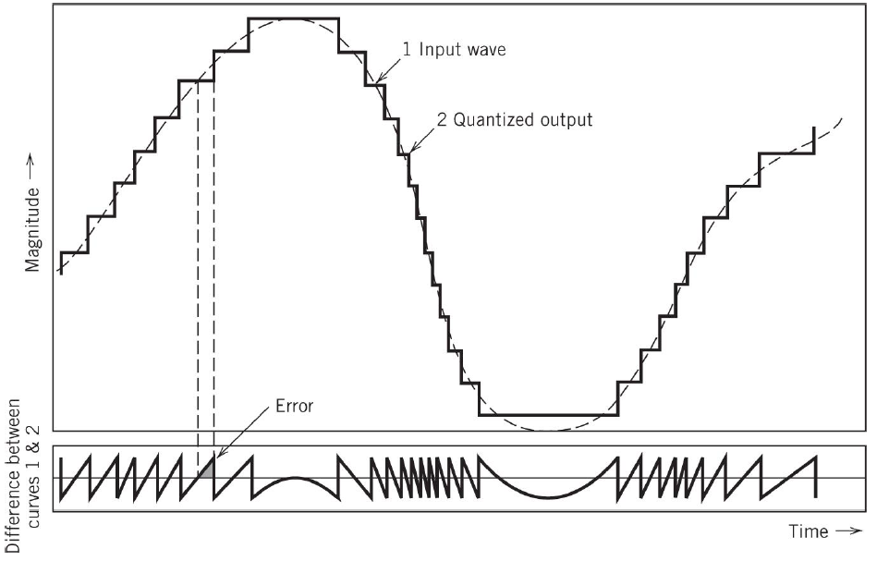
Quantization Noise

Slide 7
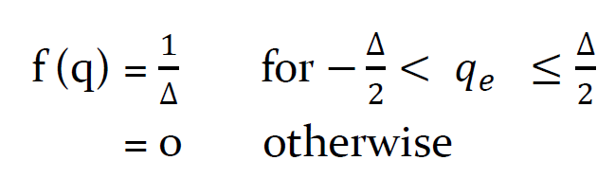
Quantization Noise
How do we calculate the magnitude of the noise introduced by quantisation?
Going to depend on the step-size Δ, of the quantiser which can be calculated as
Δ = 2m/L
where the input m is in the range (-m, m) and L is the number of representation levels of the quantiser.
If we assume the quantisation error is a uniformly distributed random variable, the probability density function of the quantisation error is given by

Slide 8
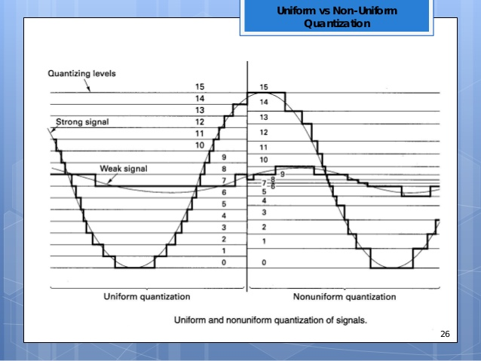
Non Uniform Quantization
The quantiser step size is smaller at low amplitudes and larger for high amplitudes.
This has the advantages of greater precision for low amplitude signals compared to a uniform quantiser with the same number of levels
  μ-law (Used in North America, Japan)
  A-law (Used in most other parts of the world)

Slide 9
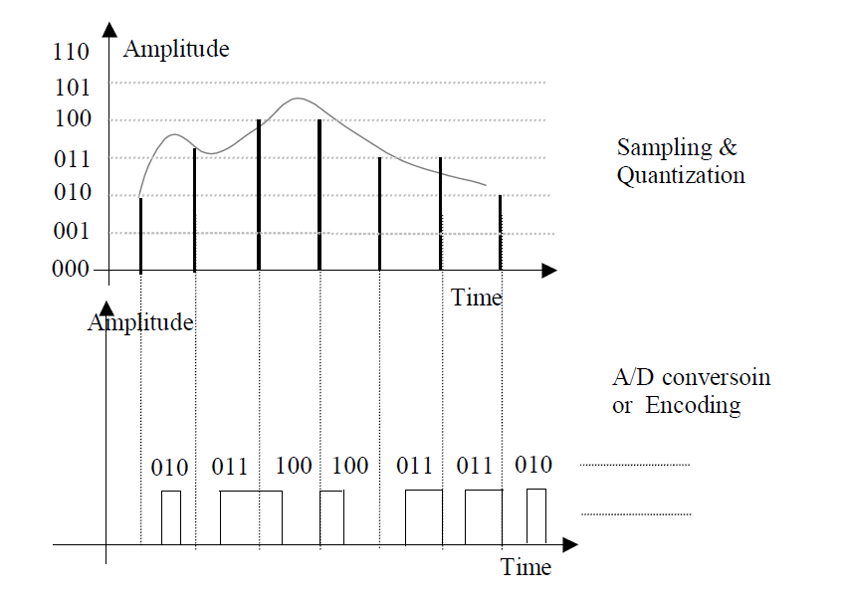
Encoding
Each quantized sample represented by a digital code.

Slide 10
Pulse Code Modulation (PCM)
A Widely used technique in telecommunications.
Converts a voice signal into a 64 kb/s data stream.
Essentially, a voice encoding technique.
PCM Standards
  Voice signal bandlimited to 4 kHz
  Sampling rate 8 ksamples/sec
  Encoding by 8 bits/sample
    256 quantization levels
  64 kb/s voice channel

Slide 11
PCM Codec

Slide 12
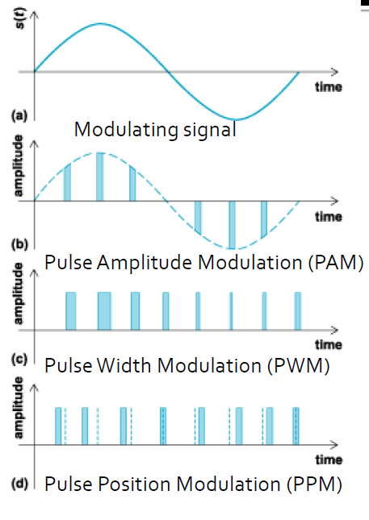
Pulse Modulation
▪The carrier is a pulse train
▪Analog modulating signal

Slide 13
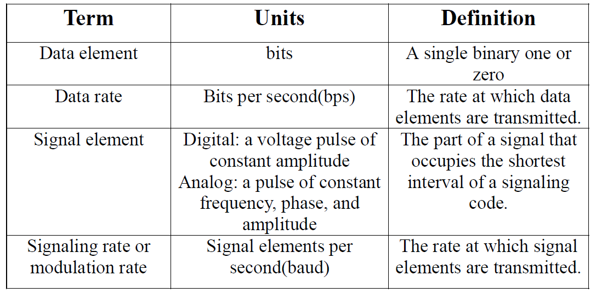
Line Coding
•A digital signal is a sequence of discrete, discontinuous voltage pulses.
•Each pulse is a signal element.
•Line coding Scheme maps the digital data stream into signal elements.
•Binary data is transmitted by encoding each data bit into these signal elements.

Slide 14
Properties of a good line code…
Signal spectrum: less bandwidth, no dc component, shape of spectrum (better to center in the middle of bandwidth)
Clocking: self-clocking capability is desired for synchronization
Error detection: better to have error-detection capability
Signal interference and noise immunity
Cost and complexity

Slide 15
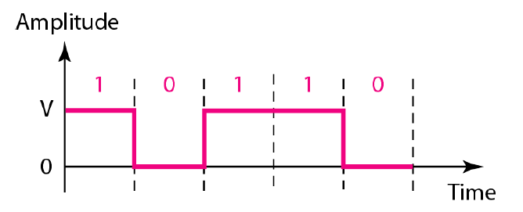
Unipolar
All signal levels are on one side of the time axis -either above or below
Non Return to Zero (NRZ)- The signal level does not return to zero during a symbol transmission.
Return to Zero (RZ)- The signal level does return to zero during every symbol transmission.
Scheme is prone to baseline wandering and DC components.
It has no synchronization or any error detection.
It is simple but costly in power consumption.

Slide 16
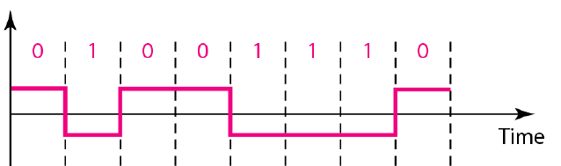
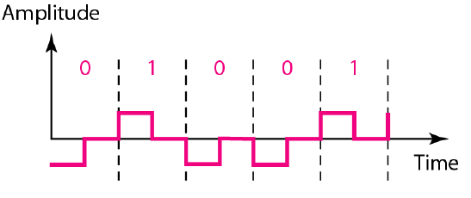
Bipolar
The voltages are on both sides of the time axis.
Can be implemented with two voltages. E.g. +V for 1 and -V for 0.
No DC component
RZ
NRZ

Slide 17
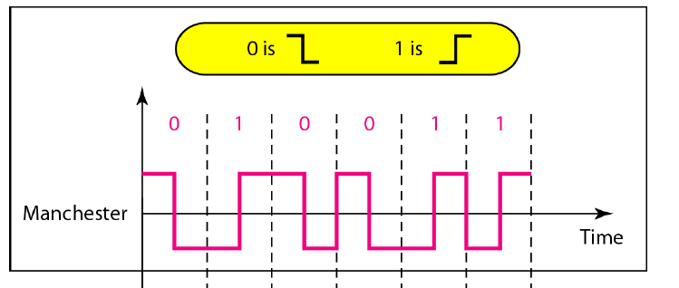
Manchester
Every symbol has a level transition in the middle: from high to low or low to high. Uses only two voltage levels.
Transition at the middle of the bit is used for synchronization.
No DC component.
No error detection.

Slide 18
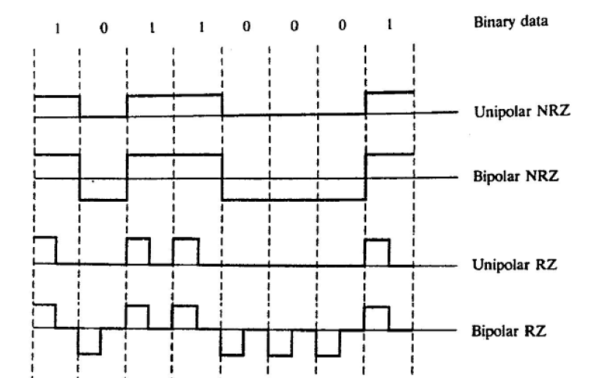
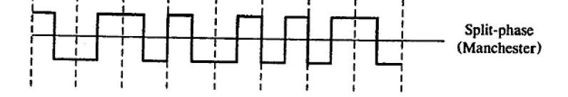

Slide 19
CW digital modulation schemes
Modulating signal is digital
Carrier is analog (CW)
•Amplitude Shift Keying (ASK)
•Frequency Shift Keying (FSK)
•Phase Shift Keying (PSK)
The varying parameter of the carrier switches between allowable values

Slide 20
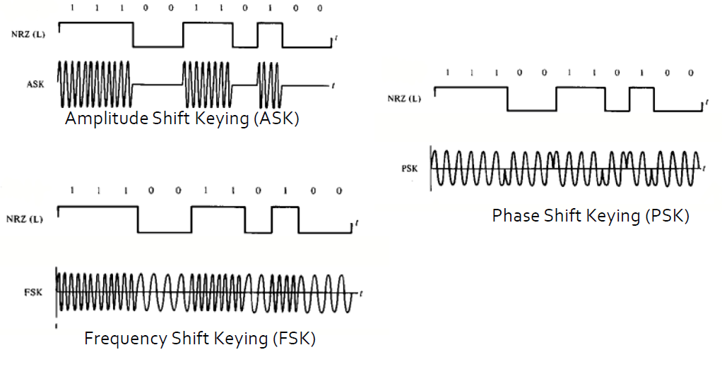
ASK / FSK / PSK

Slide 21
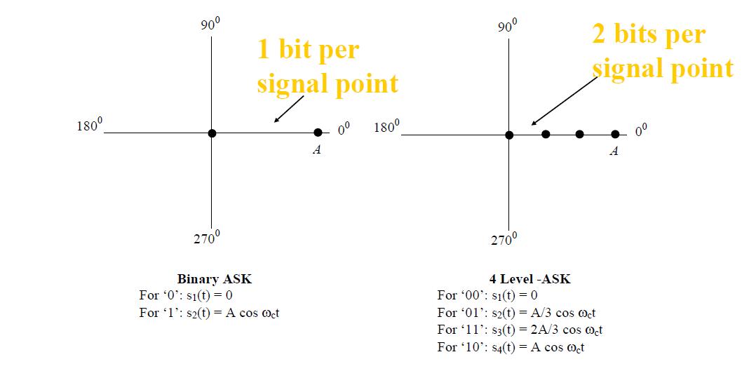
ASK: Signal Constellations

Slide 22
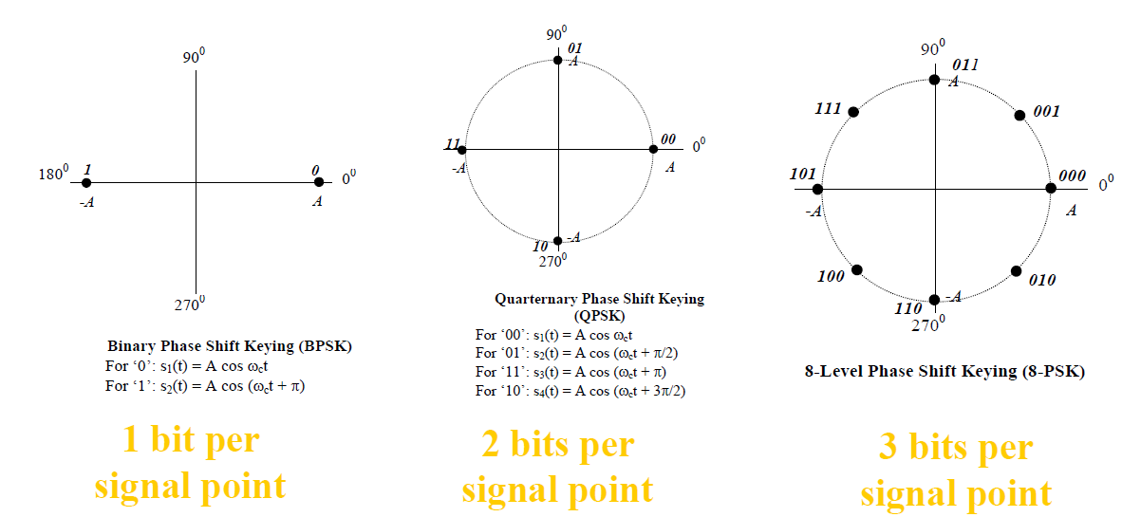
PSK: Signal Constellations

Slide 23

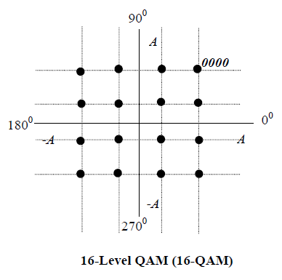
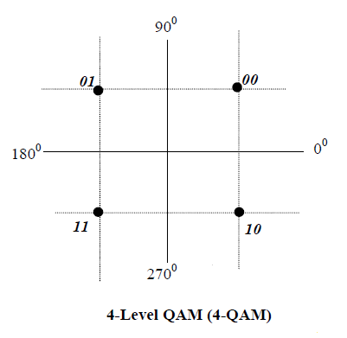
Quadrature Amplitude Modulation (QAM)
• Combination of ASK and PSK
• signal points

Slide 24
END

