Slide 1
Field-Effect Transistors
Electronic Devices and Circuit Theory
Boylestad
Chapter 6

Slide 2
Ch.6 Summary
FETs vs. BJTs
  Similarities:
    Amplifiers
    Switching devices
    Impedance matching circuits
  Differences:
    FETs are voltage controlled devices. BJTs are current controlled devices.
    FETs have higher input impedance. BJTs have higher gain.
FETs are less sensitive to temperature variations and are better suited for integrated circuits
FETs are generally more static sensitive than BJTs.

Slide 3
Ch.6 Summary
FET Types
JFET: Junction FET
MOSFET: Metal–Oxide–Semiconductor FET
  D-MOSFET: Depletion MOSFET
  E-MOSFET: Enhancement MOSFET

Slide 4
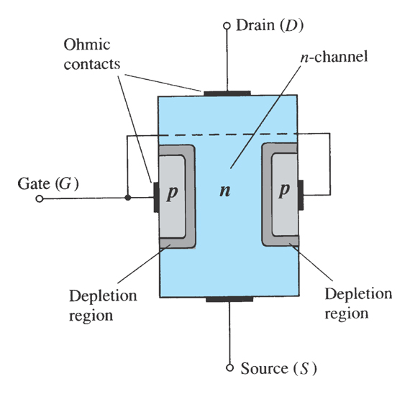
Ch.6 Summary
JFET Construction
There are two types of JFETs:
  n-channel
  p-channel
The n-channel is the more widely used of the two.
JFETs have three terminals:
  The Drain (D) and Source (S) are connected to the n-channel
  The Gate (G) is connected to the p-type material

Slide 5
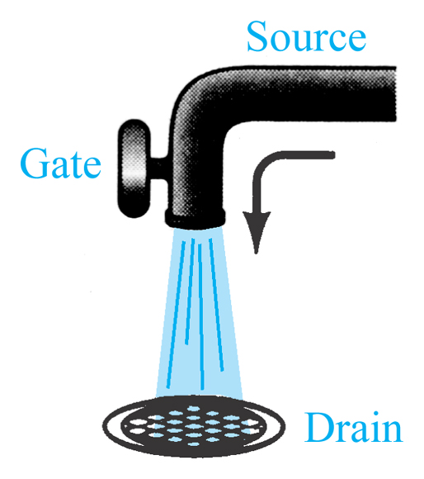
Ch.6 Summary
JFET Operation: The Basic Idea
JFET operation can be compared to that of a water spigot.
The source is the accumulation of electrons at the negative pole of the drain-source voltage.
The drain is the electron deficiency (or holes) at the positive pole of the applied voltage.
The gate controls the width of the n-channel and, therefore, the flow of charges from source to drain.

Slide 6
Ch.6 Summary
JFET Operating Characteristics
There are three basic operating conditions for a JFET:
V_{GS} = 0 V, V_{DS} increasing to some positive value
  V_{GS} < 0 V, V_{DS} at some positive value
  Voltage-controlled resistor

Slide 7
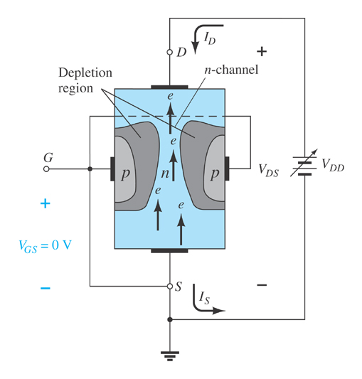
Ch.6 Summary
JFET Characteristics: V_{GS}=0V
Three things happen when V_{GS} = 0 V and V_{DS} increases from 0 V to a more positive voltage:
  The size of the depletion region between p- type gate and n-channel increases.
  Increasing the size of the depletion region decreases the width of the n-channel, which increases its resistance.
  Even though the n-channel resistance is increasing, the current from source to drain (I_{D}) through the n-channel is increasing because V_{DS} is increasing.

Slide 8
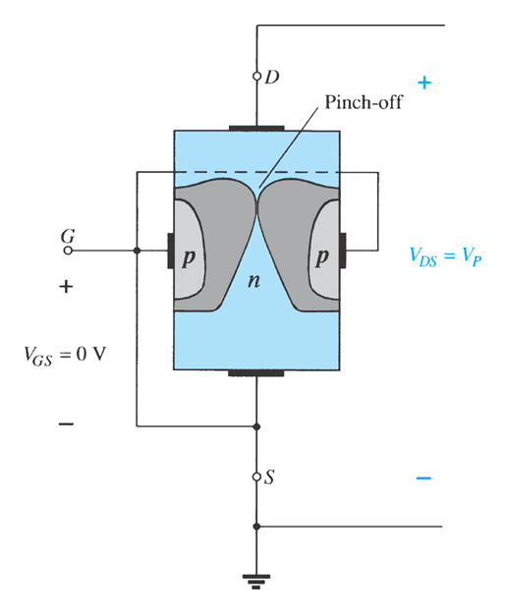
Ch.6 Summary
JFET Characteristics: Pinch Off
If V_{GS} = 0 V and V_{DS} continually increases to a more positive voltage, a point is reached where the depletion region gets so large that it pinches off the channel.
This suggests that the current in channel (I_{D}) drops to 0 A, but it does not: As V_{DS} increases, so does I_{D}. However, once pinch off occurs, further increases in V_{DS} do not cause I_{D} to increase.

Slide 9
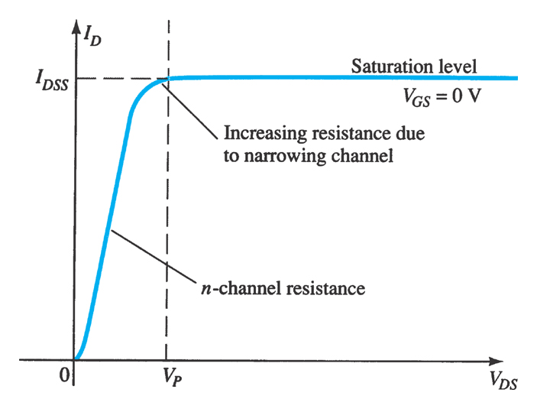
Ch.6 Summary
JFET Characteristics: Saturation
At the pinch-off point:
Any further increase in V_{DS} does not produce any increase in I_{D}. V_{DS} at pinch-off is denoted as V_{p}
I_{D} is at saturation or maximum, and is referred to as I_{DSS.}

Slide 10
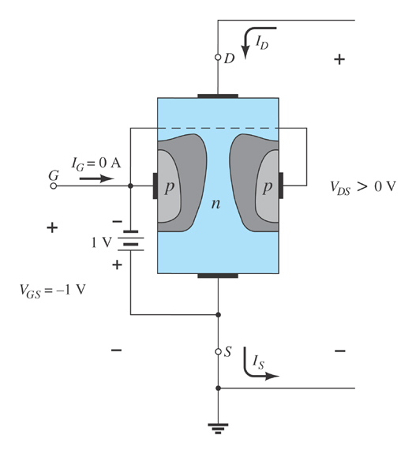
Ch.6 Summary
JFET Operating Characteristics
As V_{GS} becomes more negative, the depletion region increases.

Slide 11
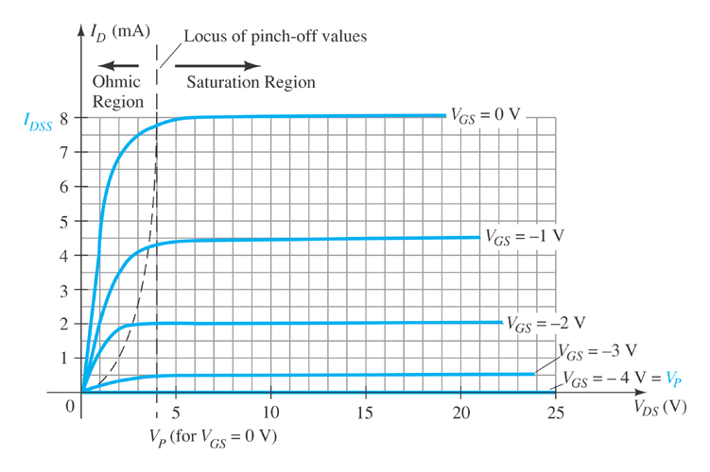
Ch.6 Summary
JFET Operating Characteristics
As V_{GS} becomes more negative:
The JFET experiences pinch-off at a lower voltage (V_{P}).
I_{D} decreases (I_{D} < I_{DSS}) even when V_{DS} increases
I_{D} eventually drops to 0 A. The value of V_{GS} that causes this to occur is designated V_{GS(off)}.
Note that at high levels of V_{DS} the JFET reaches a breakdown situation. I_{D} increases uncontrollably if V_{DS} > V_{DSmax}, and the JFET is likely destroyed.

Slide 12
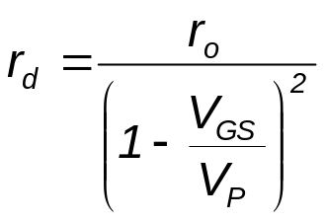
Ch.6 Summary
Voltage-Controlled Resistor
The region to the left of the pinch-off point is called the ohmic region.
The JFET can be used as a variable resistor, where V_{GS} controls the drain-source resistance (r_{d}).
As V_{GS} becomes more negative, the resistance (r_{d}) increases.

Slide 13
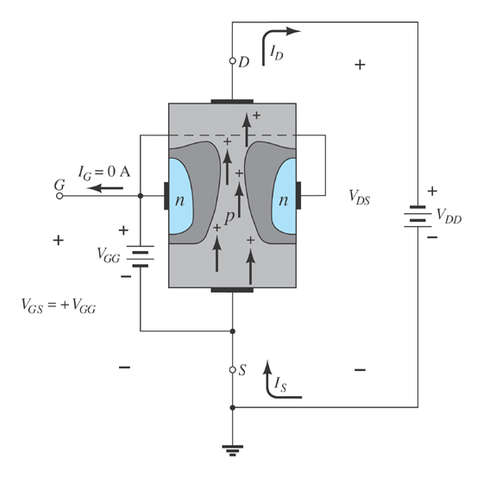
Ch.6 Summary
P-Channel JFETs
The p-channel JFET behaves the same as the n-channel JFET. The only differences are that the voltage polarities and current directions are reversed.

Slide 14
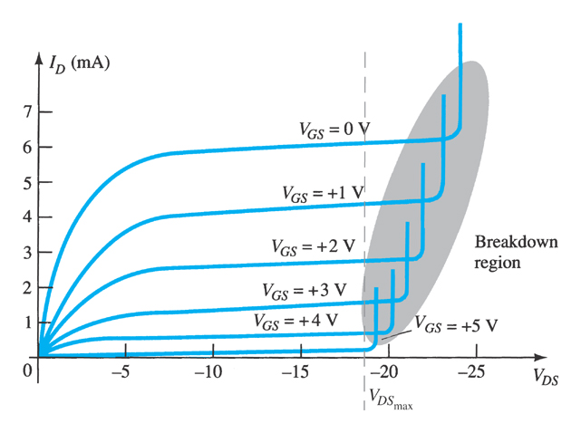
Ch.6 Summary
P-Channel JFET Characteristics
As V_{GS} becomes more positive:
The JFET experiences pinch-off at a lower voltage (V_{P}).
  The depletion region increases, and I_{D} decreases (I_{D} < I_{DSS})
I_{D} eventually drops to 0 A (when V_{GS} = V_{GSoff})
Also note that at high levels of V_{DS} the JFET reaches a breakdown situation: I_{D} increases uncontrollably if V_{DS} > V_{DSmax}.

Slide 15
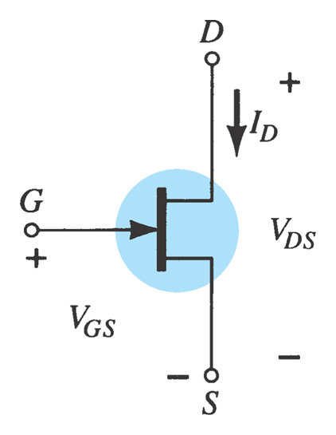
Ch.6 Summary
N-Channel JFET Symbol

Slide 16
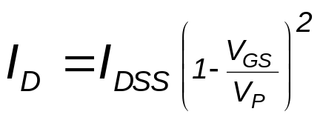
Ch.6 Summary
JFET Transfer Characteristics
JFET input-to-output transfer characteristics are not as straightforward as they are for a BJT.
BJT: β indicates the relationship between I_{B} (input) and I_{C} (output).
JFET: The relationship of V_{GS} (input) and I_{D} (output) is a little more complicated:

Slide 17
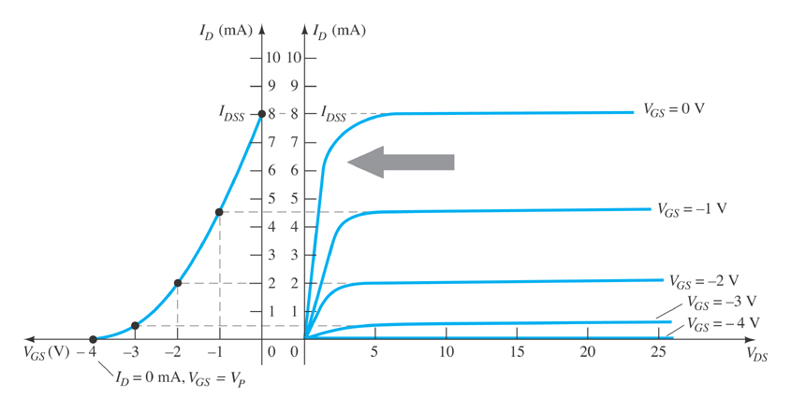
Ch.6 Summary
JFET Transfer Curve
This graph shows the value of I_{D} for a given value of V_{GS}.

Slide 18
Ch.6 Summary
Plotting the JFET Transfer Curve
Using I_{DSS} and V_{p} (V_{GS(off)}) values found in a specification sheet, the transfer curve can be plotted according to these three steps:
1. Solving for V_{GS} = 0 V: I_{D} = I_{DSS}
2. Solving for V_{GS} = V_{GS(off)}: I_{D} = 0 A
3. Solving for V_{GS} = 0 V to V_{GS(off)}: 0 A < I_{D} < I_{DSS}

Slide 19
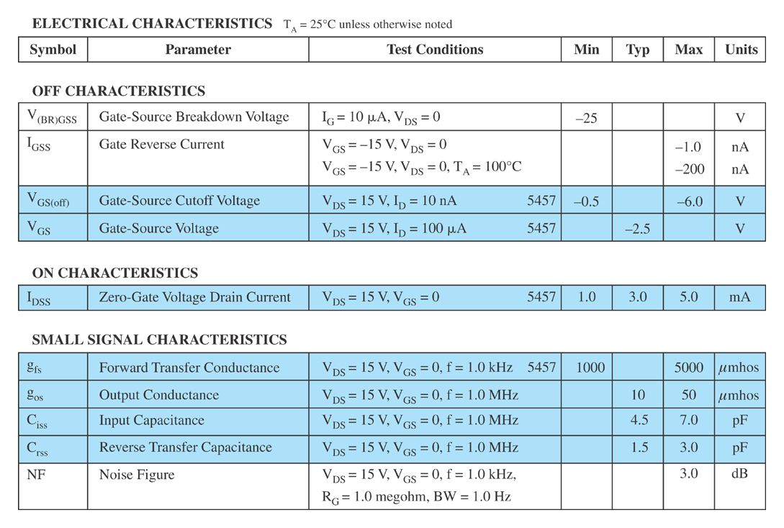
Ch.6 Summary
JFET Specification Sheet
Electrical Characteristics

Slide 20
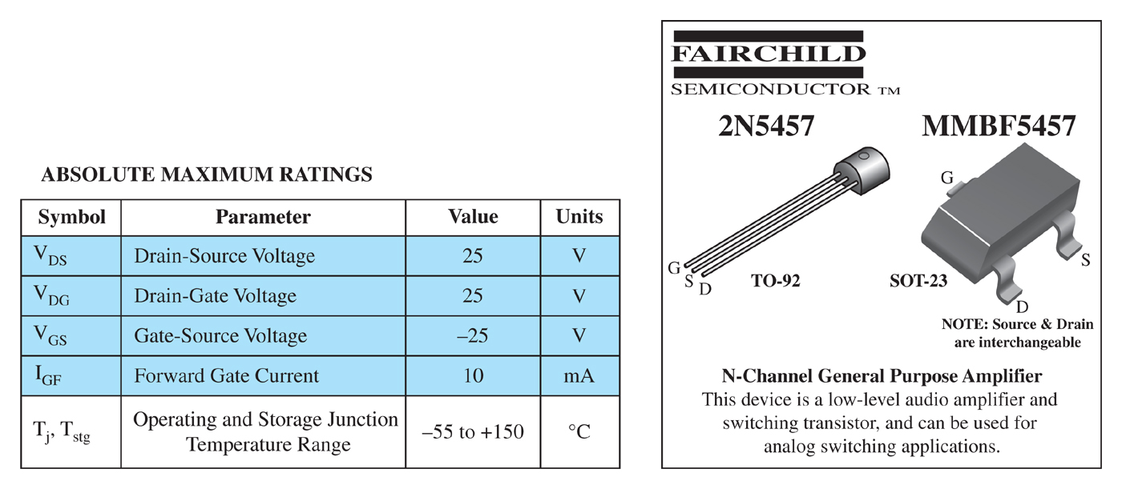
Ch.6 Summary
JFET Specification Sheet
Maximum Ratings

Slide 21
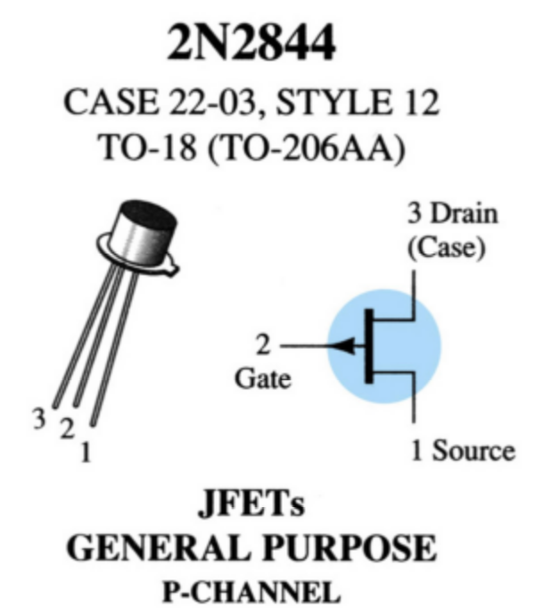
Ch.6 Summary
Case and Terminal Identification

Slide 22
Ch.6 Summary
Testing JFETs
Curve Tracer
    A curve tracer displays the I_{D} versus V_{DS} graph for various levels of V_{GS}.
Specialized FET Testers
    These testers show I_{DSS} for the JFET under test.

Slide 23
Ch.6 Summary
MOSFETs
MOSFETs have characteristics similar to those of JFETs and additional characteristics that make then very useful.
There are two types of MOSFETs:
  Depletion-Type
  Enhancement-Type

Slide 24
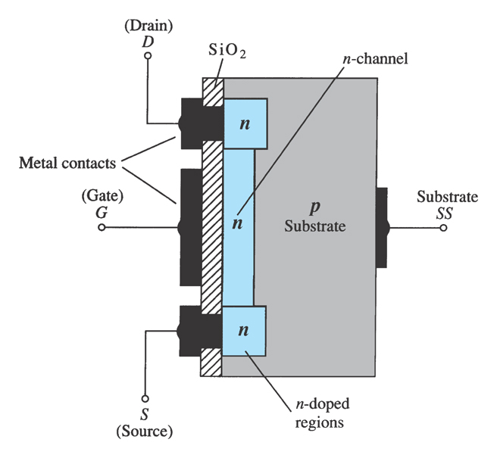
Ch.6 Summary
Depletion-Type MOSFET Construction
The Drain (D) and Source (S) connect to the to n-type regions. These n-typed regions are connected via an n-channel. This n-channel is connected to the Gate (G) via a thin insulating layer of silicon dioxide (SiO₂).
The n-type material lies on a p-type substrate that may have an additional terminal connection called the Substrate (SS).

Slide 25
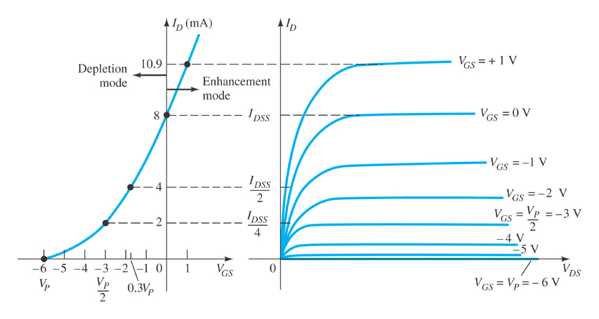
Ch.6 Summary
Basic MOSFET Operation
A depletion-type MOSFET can operate in two modes:
  Depletion mode
  Enhancement mode

Slide 26
Ch.6 Summary
Depletion Mode Operation (D-MOSFET)
The characteristics are similar to a JFET.
  When V_{GS} = 0 V, I_{D} = I_{DSS}
  When V_{GS} < 0 V, I_{D} < I_{DSS}
  The formula used to plot the transfer curve for a JFET applies to a D-MOSFET as well:

Slide 27
Ch.6 Summary
Enhancement Mode Operation
(D-MOSFET)
V_{GS} > 0 V, I_{D} increases above I_{DSS} (I_{D} > I_{DSS})
The formula used to plot the transfer curve still applies:
Note that V_{GS} is now positive

Slide 28
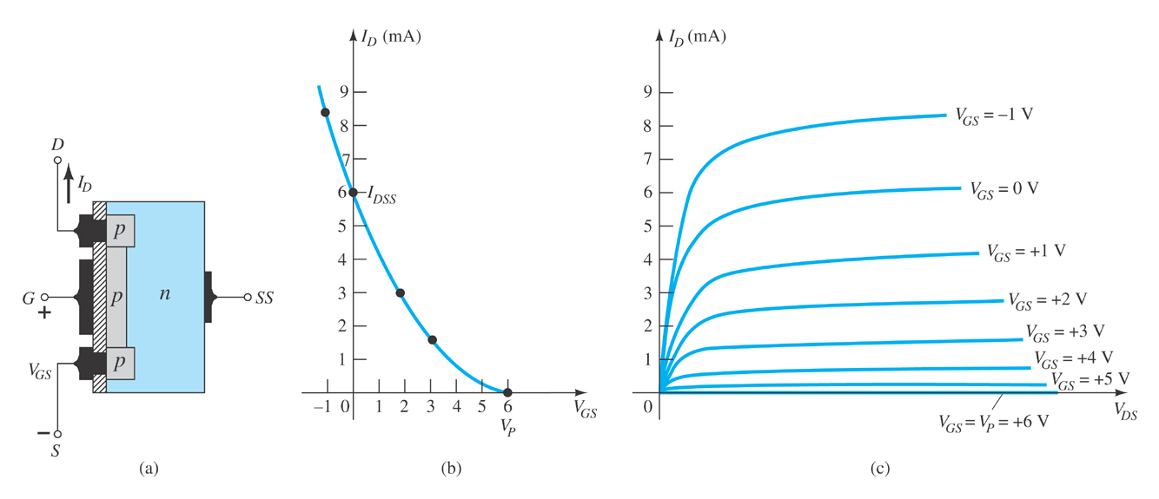
Ch.6 Summary
p-Channel D-Type MOSFET

Slide 29
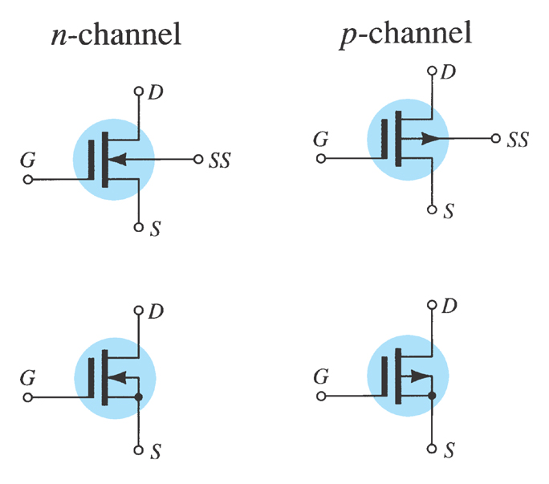
Ch.6 Summary
D-Type MOSFET Symbols

Slide 30
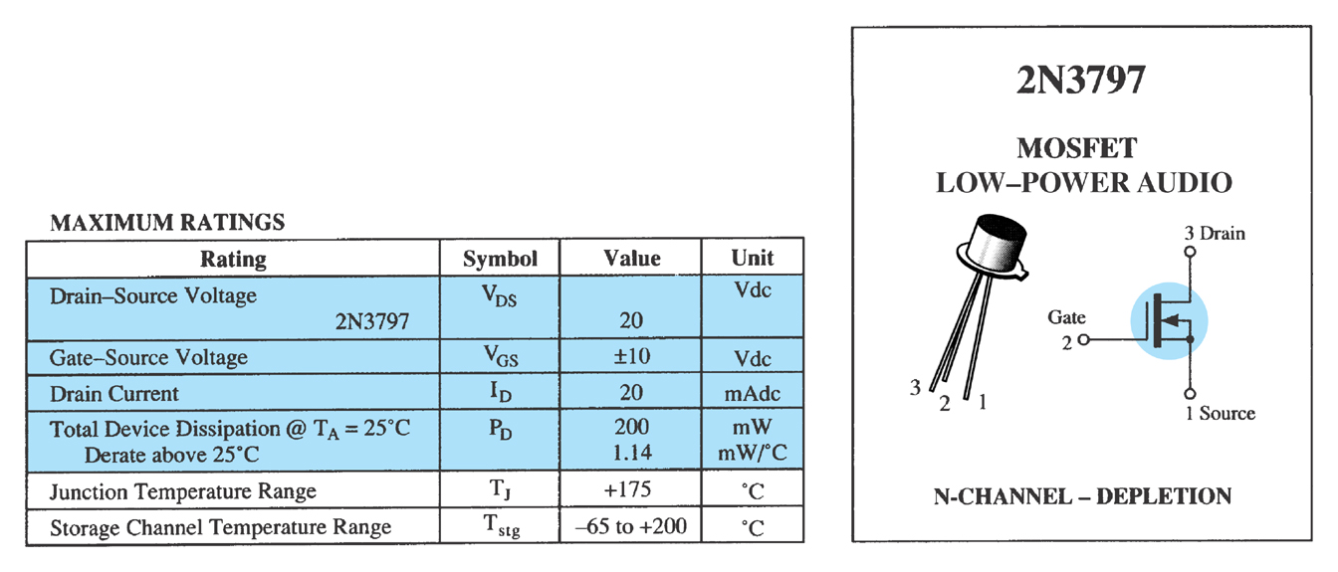
Ch.6 Summary
Specification Sheet
Maximum Ratings

Slide 31
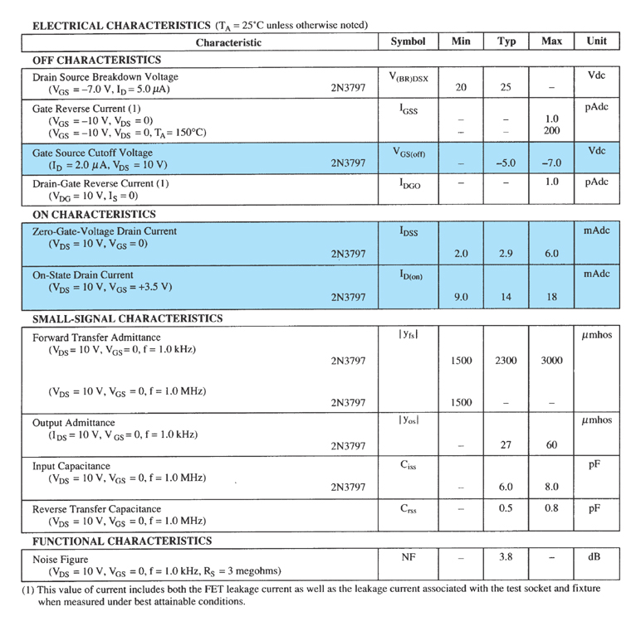
Ch.6 Summary
Specification Sheet
Electrical
Characteristics

Slide 32
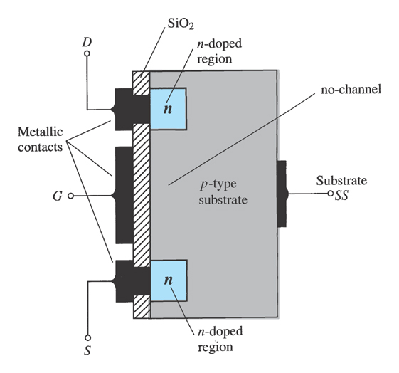
Ch.6 Summary
E-Type MOSFET Construction
The Drain (D) and Source (S) connect to the to n-type regions. These n-type regions are connected via an n-channel
The Gate (G) connects to the p-type substrate via a thin insulating layer of silicon dioxide (SiO₂)
There is no channel
The n-type material lies on a p-type substrate that may have an additional terminal connection called the Substrate (SS)

Slide 33
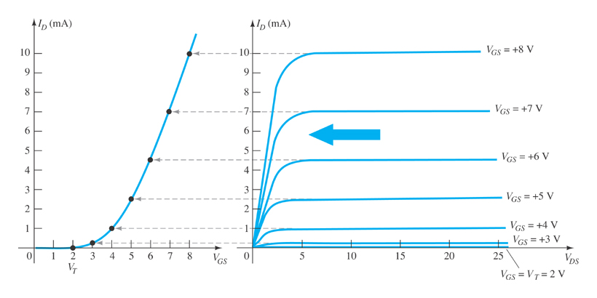
Ch.6 Summary
E-Type MOSFET Operation
The enhancement-type MOSFET (E-MOSFET) operates only in the enhancement mode.
V_{GS} is always positive
As V_{GS} increases, I_{D} increases
As V_{GS} is kept constant and V_{DS} is increased, then I_{D} saturates (I_{DSS}) and the saturation level (V_{DSsat}) is reached

Slide 34

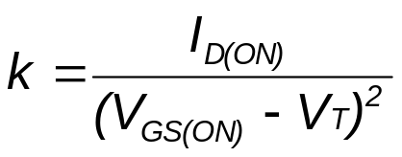

Ch.6 Summary
E-Type MOSFET Transfer Curve
To determine I_{D} given V_{GS}:
where:
  V_{T} = the E-MOSFET
  threshold voltage
k, a constant, can be determined by using values at a specific point and the formula:
V_{DSsat} can be calculated using:

Slide 35
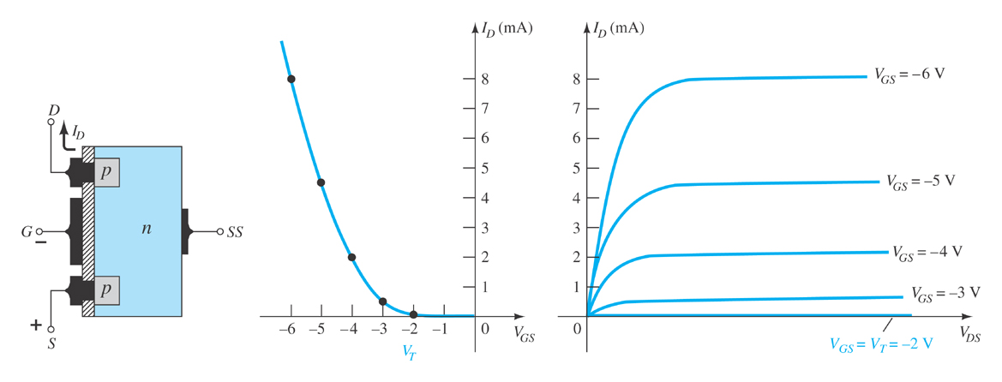
Ch.6 Summary
p-Channel E-Type MOSFETs
The p-channel enhancement-type MOSFET is similar to its n-channel counterpart, except that the voltage polarities and current directions are reversed.

Slide 36
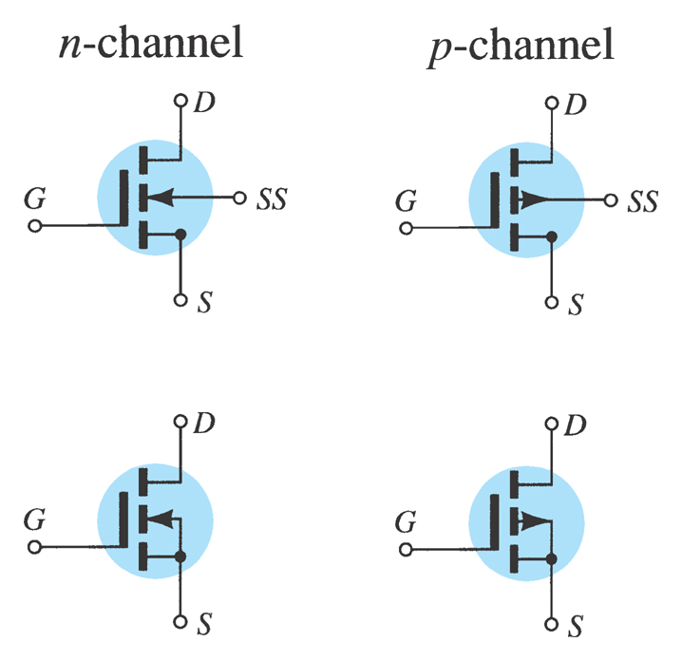
Ch.6 Summary
MOSFET Symbols

Slide 37
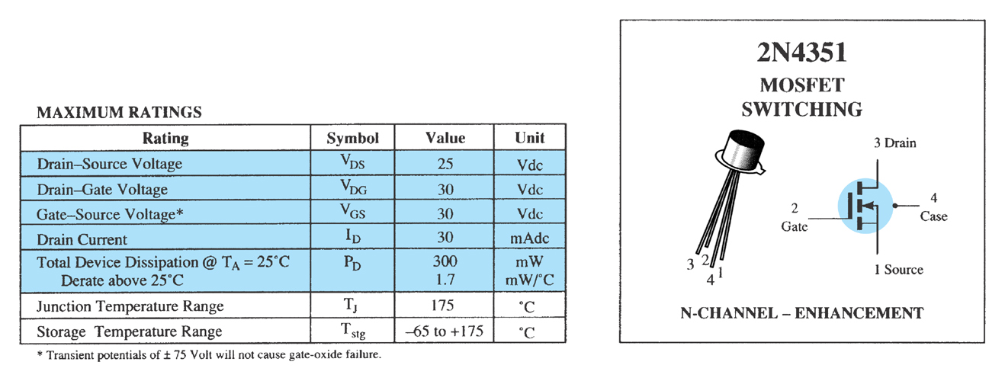
Ch.6 Summary
Specification Sheet
Maximum Ratings
more…

Slide 38
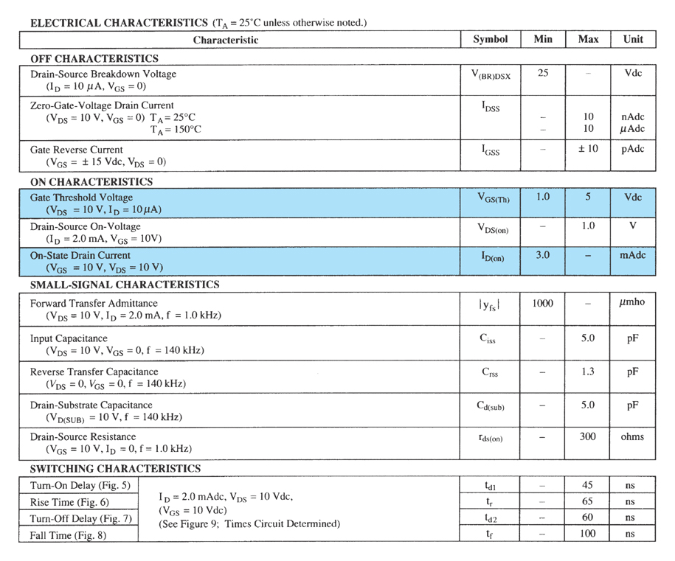
Ch.6 Summary
Specification Sheet
Electrical Characteristics

Slide 39
Ch.6 Summary
Handling MOSFETs
MOSFETs are very sensitive to static electricity.
Because of the very thin SiO₂ layer between the external terminals and the layers of the device, any small electrical discharge can create an unwanted conduction.
Protection
  Always transport in a static sensitive bag
  Always wear a static strap when handling MOSFETS
  Apply voltage limiting devices between the gate and source,
  such as back-to-back Zeners to limit any transient voltage.

Slide 40
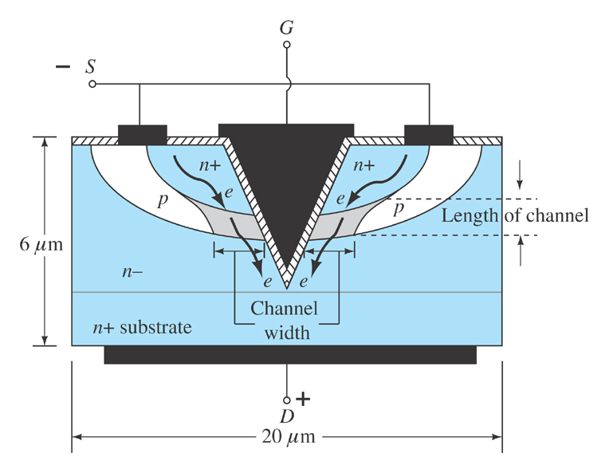
Ch.6 Summary
VMOS Devices
VMOS (vertical MOSFET) is a component structure that provides greater
surface area.
Advantages
VMOS devices handle higher currents by providing more surface area to dissipate the heat.
VMOS devices also have faster switching times.

Slide 41
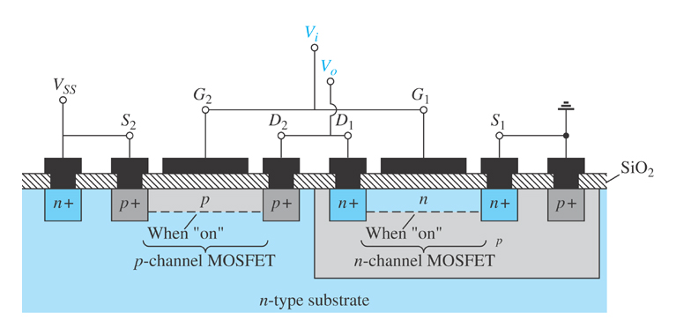
Ch.6 Summary
CMOS Devices
CMOS (complementary MOSFET) uses a p-channel and n-channel MOSFET; often on the same substrate as shown here.
Advantages
Useful in logic circuit designs
Higher input impedance
Faster switching speeds
Lower operating power levels

Slide 42
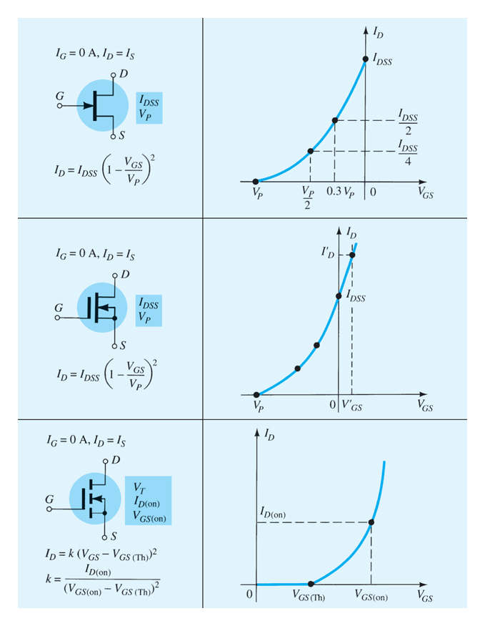
Ch.6 Summary
Summary Table

