Slide 1
Communications Engineering 1
Analog communication systems

Slide 2
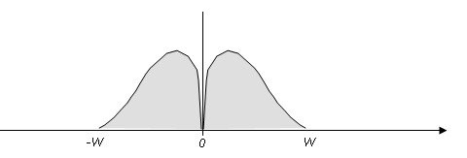
A Baseband Signal
A baseband signal is a signal that occupies the frequency range from 0Hz up to a certain cutoff.
It is called the baseband because it occupies the base, or the lowest range of the spectrum.

Slide 3
What is modulation?
  Translation of a signal from its baseband to a higher frequency band
  Different signals can be moved to different frequency bands
Information
-
bearing signal
Channel
Demodulator
Recovered signal
Modulator
Modulating signal
Modulated signal
Carrier

Slide 4
What is modulation?
Signal 1
Frequency
Signal 2
Frequency
Signal 3
Frequency

Slide 5
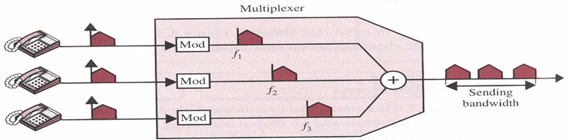
Why Modulate?
  Carry multiple signals over a channel
  Move signals to a frequency band where antennas for transmission are of a practical size- The antenna length is proportional to the wavelength of the signal.
  Noise and Distortion Removal

Slide 6
The carrier signal
Varies some property of the carrier in proportion to the modulating signal
  Amplitude – Amplitude Mudulation (AM)
  Frequency- Frequency Modulation (FM)
  Phase- Phase Modulation (PM)
  Called continuous wave modulation techniques.
Amplitude
Frequency
Phase

Slide 7
Amplitude Modulation Techniques
Dual sideband suppressed carrier (DSB-SC)
Conventional amplitude modulation (AM)
Single sideband amplitude modulation (SSB)
Vestigial sideband amplitude modulation (VSB)

Slide 8
Dual sideband suppressed carrier
(DSB-SC)
Modulation and Demodulation
Done in class

Slide 9
AM
Modulation
Done in class

Slide 10
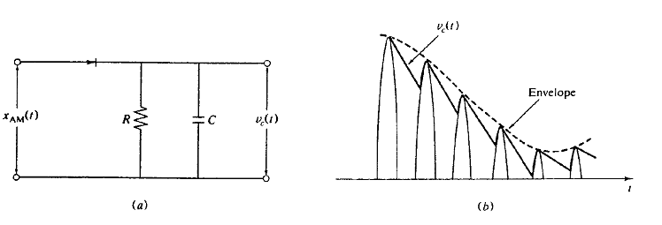
Envelope Detector
Envelope detector consisting of a diode and a resistor- capacitor combination.

Slide 11
Envelope Detector
During the positive half-cycle of the input signal, the diode is forward-biased and the capacitor C charges up rapidly to the peak value of the input signal.
As the input signal falls below its maximum, the diode turns off.
This is followed by a slow discharge of the capacitor through resistor R until the next positive half-cycle.
When the input signal becomes greater than the capacitor voltage and the diode turns on again.
The capacitor charges to the new peak value, and the process is repeated.

Slide 12
DSB-SC Vs AM
DSB-SC has a higher power efficiency compared to, but the demodulation is complex compared to AM :
The basic difficulty associated with the DSB modulation is that for demodulation, the receiver must generate a local carrier that is in phase and frequency synchronism with the incoming carrier.
AM has a lower power efficiency, but a remarkably simple demodulator.
Both techniques utilize twice the bandwidth of the modulating signal.

Slide 13
SSB and VSB- Bandwidth Efficient Modulation
Will be explained graphically in class

Slide 14
Frequency Modulation (FM)
Modulation
Done in class

Slide 15
END

